Slide 1
Quantifying Enzyme Loading in Bacterial Microcompartments Using a Tetracysteine–FlAsH Tagging Strategy
Cassidy Verburg
Department of Biochemistry: Hegg Lab

Slide 2
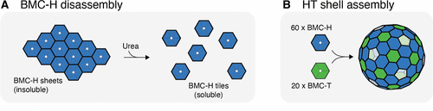
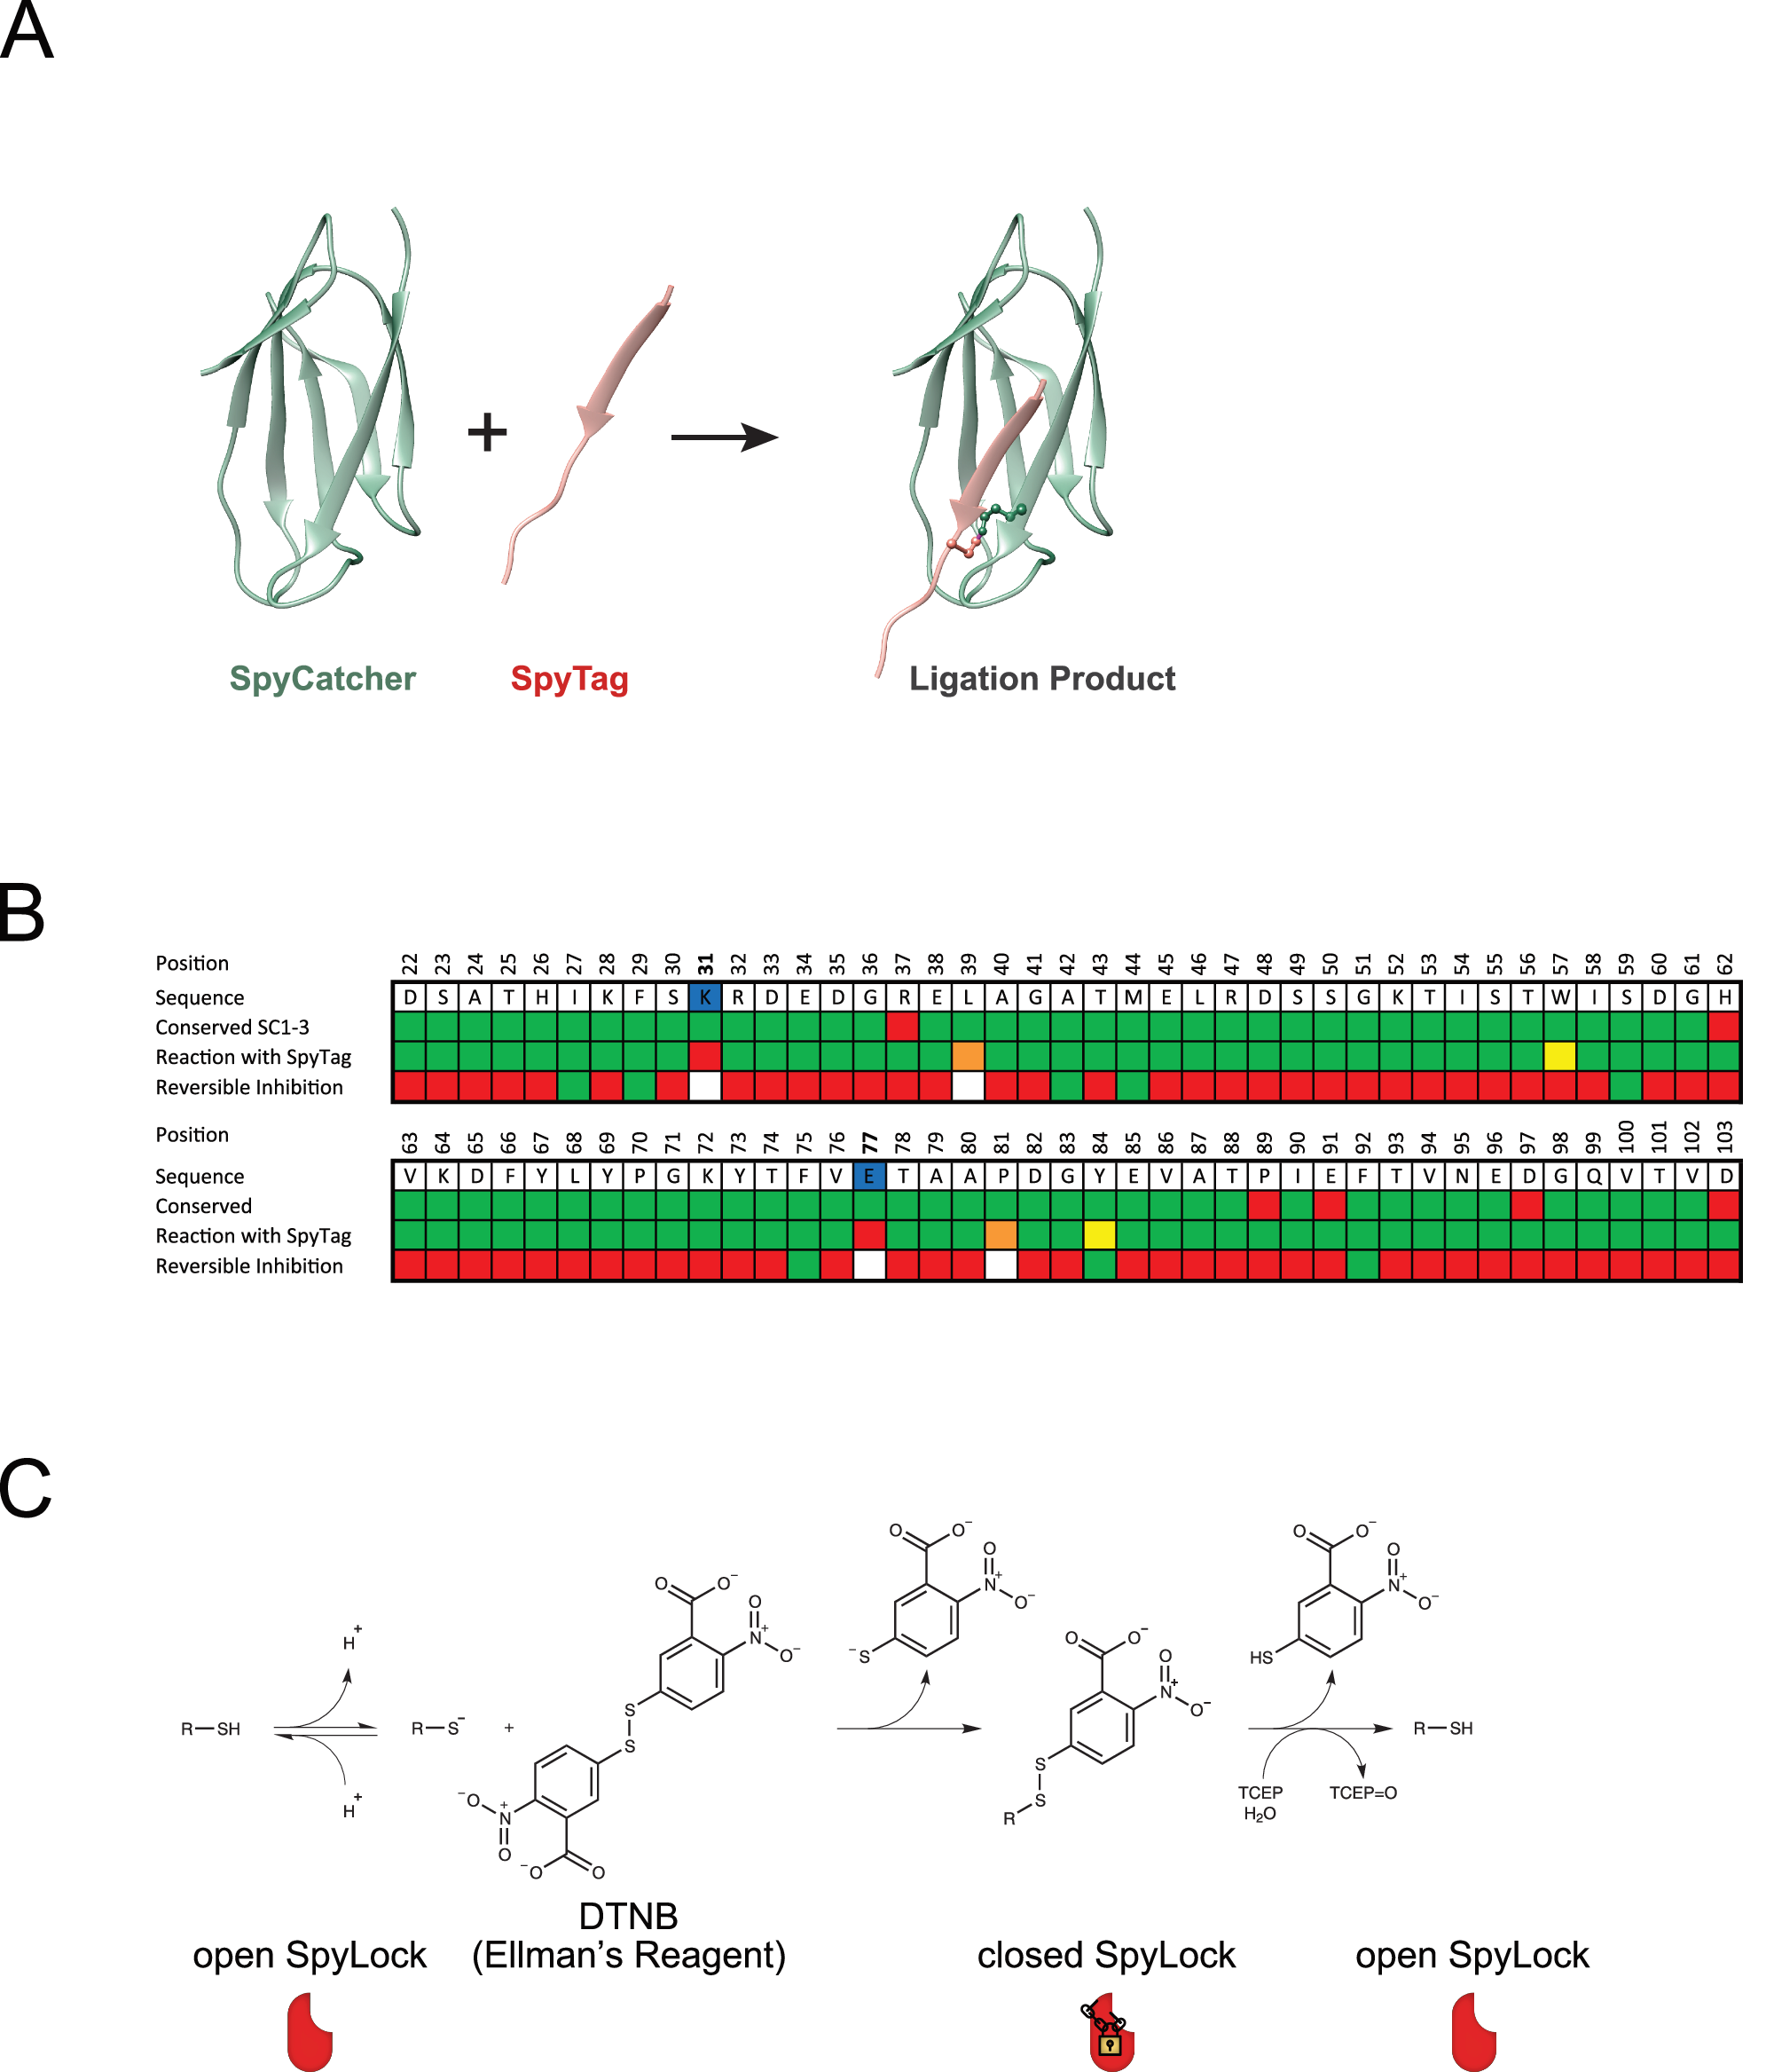

Introduction: BMC and Enzyme Encapsulation
Bacterial microcompartments (BMCs) are proteinaceous organelles that spatially organize metabolic reactions and represent attractive scaffolds for pathway engineering.
In the absence of pentamers, BMC-H and BMC-T1 assemble into a wiffle ball–like structure with open vertices.
Enzyme encapsulation in BMCs enhances metabolic efficiency by co-localizing enzymes, retaining intermediates, and creating a controlled microenvironment that improves reaction specificity.

Slide 3
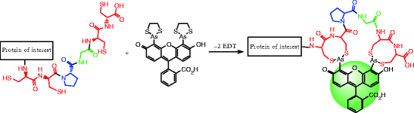
Introduction: Quantification – TC tag
There is no current accurate methodology of quantifying the amount of enzyme encapsulated withing the BMC.
To address the limitation of quantification, a Tetracysteine (TC) motif (CCPGCC) was added to the protein. This binds to the biarsenical fluorescein dye FlAsH (Fluorescein Arsenical Hairpin Binder), without interfering with the protein structure or BMC.
Once the tag binds to the dye, the dye fluoresces, this fluorescents can be measured to determine the amount of encapsulated protein.

Slide 4
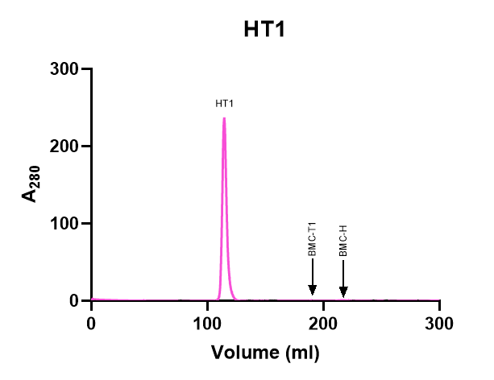
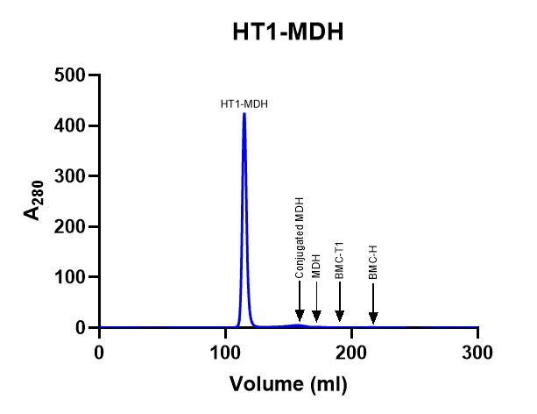
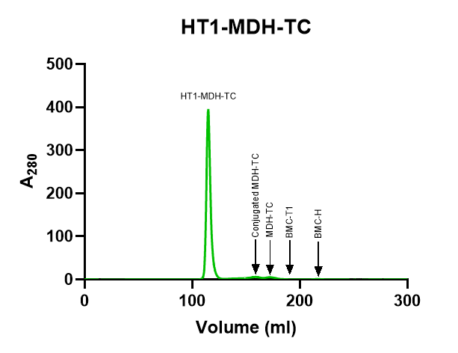
Shell Assembly
Once the protein and the hexamers and trimers are purified; they are mixed in 1:3 ratio of trimers to hexamers to form the BMC
The absence of other peaks on the SEC chromatogram indicates successful encapsulation

Slide 5
Standardization and Quantification
 | nM | MW | Volume | nmoles | ng | Rest (ng) | nmoles of WB | Monomers per shell
HT1-MDH-TC | 166.00 | 50.62 | 150 | 0.0249 | 1260.44 | 3739.56 | 0.000714 | 34.85
 | nM | MW | Volume | nmoles | ng | Rest (ng) | nmoles of WB | Monomers per shell
HT1-MDH-TC | 155.00 | 50.62 | 150 | 0.02325 | 1176.92 | 3823.09 | 0.00073 | 31.83

Slide 6
Further Optimization/ Importance
Ultimately, the goal is to make this quantification as accurate as possible this entails attempting to reduce the non-specific hydrophobic binding as much as possible
Currently performing other assays to with other reagents to see how those reduce the background. For example, have performed assays using EDT (ethanedithiol)
Once a methodology has been produced to obtain accurate quantification this can be applicable to any enzyme and make studying the encapsulated enzymes more applicable.

