Slide 1
Hemiacetal and Acetal Formation

Slide 2
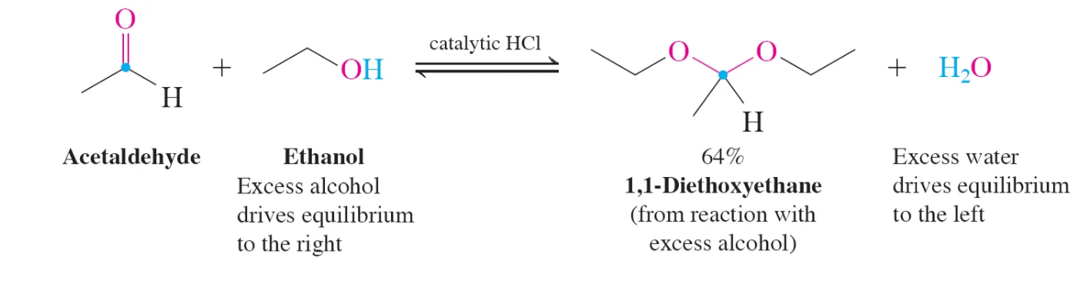

Slide 4
Video of Hemiacetal and Acetal Assembly Mechanism
Video Link

Slide 5
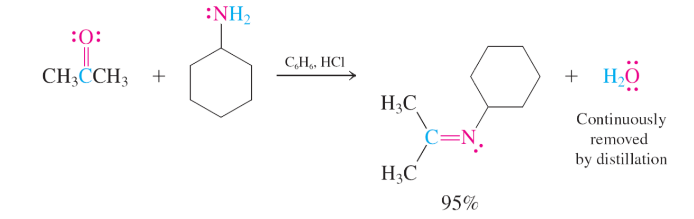
Imines: from Carbonyls and Amines

Slide 6
Imines: from Carbonyls and Amines

Slide 7
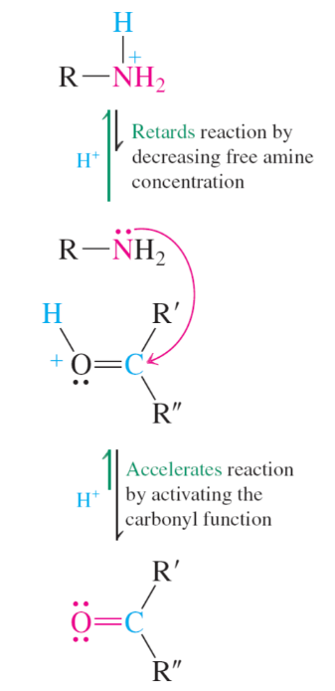
pH 4 to 5 is needed so neutral amine Nuc is present

Slide 8
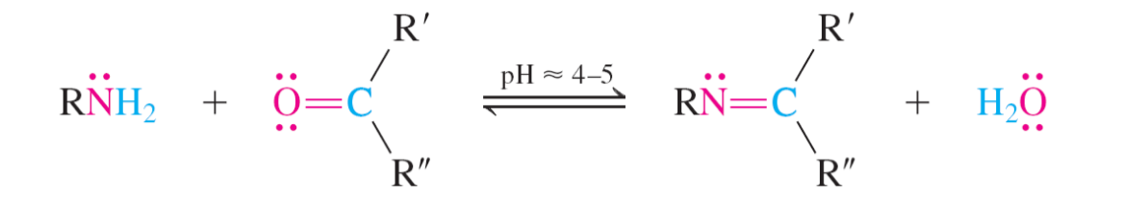

Slide 9
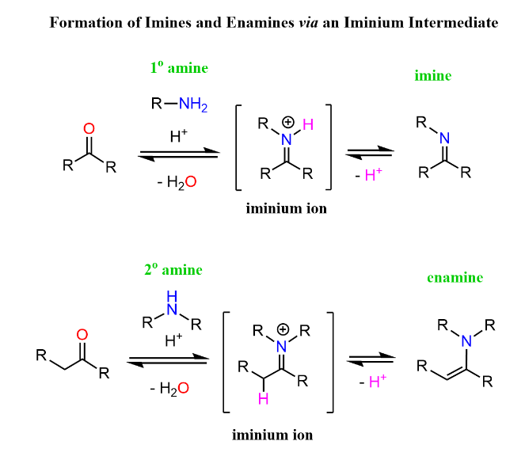
1° Amine form imine to make NEUTRAL cpd

Slide 10
2° Amine form Enamine to supply NEUTRAL cpd

