Slide 1
Prevalence of Carbohydrates

Slide 2
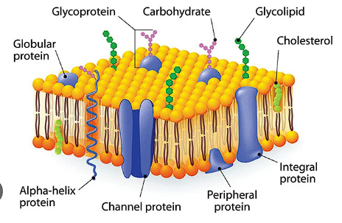
Membrane Carbohydrates:
Function in Adhesion and Cell Recognition
A Glycolipid

Slide 3
Membrane Carbohydrates:
Function in Adhesion and Cell Recognition
An antimicrobial glycopeptide made by Bacillus subtilis that inhibits the phosphoenolpyruvate:sugar phosphotransferase (PTS) -- mediates carbohydrate uptake in other bacteria

Slide 4
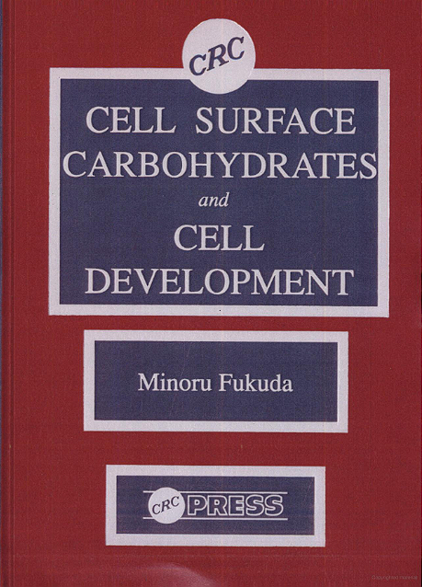
Carbohydrate Analysis in the Literature

