Slide 1
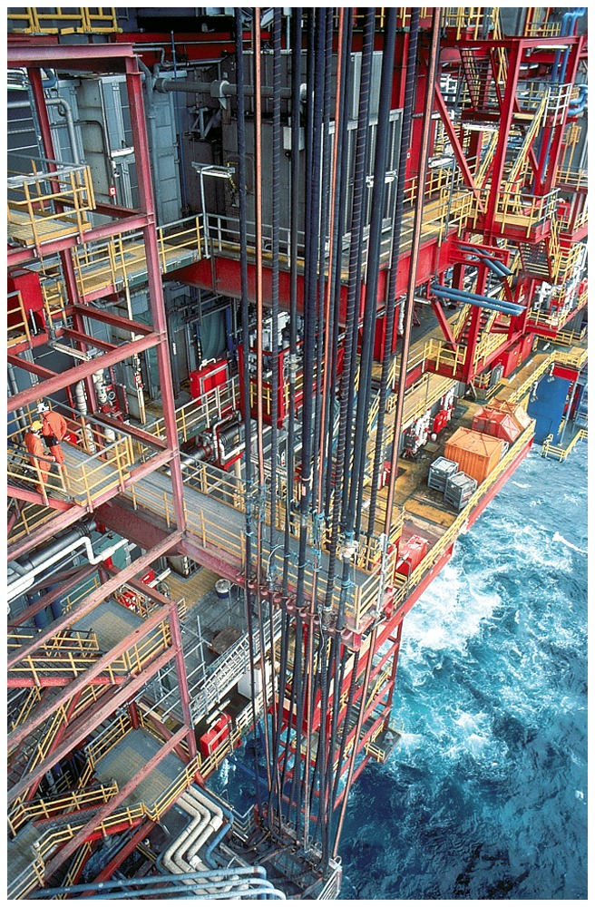
Petroleum!!
Chapter 2: Alkanes, Thermodynamics, And Kinetics
Combustion
How warm,
how fast?

Slide 2
All Reactions Are Equilibria
“Barrier” kcal/mol
Exothermicity
~20
CH₃Cl + Na⁺ ⁻OH
CH₃OH + Na⁺ Cl⁻
or
-23.4 kcal mol⁻¹
high
CH₄ + O₂
CO₂ + 2H₂O
-213 kcal mol⁻¹
Equilibrium lies very much to the right.
What governs these equilibria?

Slide 3
Chemical Thermodynamics And Kinetics
Chemical Thermodynamics:
Energy changes during reaction, extent of “completion of equilibration,” “to the left/right,” “driving force.”
2. Chemical Kinetics:
How fast is equilibrium established; rates of disappearance of starting materials or appearance of products
The two principles may or may not go in tandem

Slide 4
Equilibria
Two typical cases
K
[B] [products]
1.
A
B
K =
=
[A] [reactants]
K = equilibrium constant
[ ] = concentration in mol L⁻¹
K
[C][D]
2.
A + B
C + D
K =
[A][B]
If K large: reaction “complete,” “to the right,” “downhill.” How do we quantify? Gibbs free energy, ∆G°

Slide 5
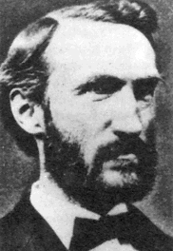
Gibbs Free Energy ∆G°
The “° ” refers to molecules in their standard states, 1 atm, 25 °C (298 kelvin), 1 M (concentration).
∆G° = -RT lnK = -2.3RT logK
T in kelvin (0 kelvin = -273 °C)
Josiah Willard Gibbs
(1839–1903)
R = gas constant ~ 2cal deg⁻¹ mol⁻¹
Large K : Large negative ∆G° : downhill

Slide 6
Equilibria And Free Energy
At 25ºC (298 kelvin): ΔGº = -1.36 logK
K
Therefore, for
A
B
When K = 1 (A/B = 50/50), then ΔGº = 0 kcal mol⁻¹
K = 10, then ΔGº = -1.36 kcal mol⁻¹
K = 100, then ΔGº = -2.72 kcal mol⁻¹
K = 0.1, then ΔGº = +1.36 kcal mol⁻¹
CH₃Cl + Na⁺ ⁻OH
CH₃OH + Na⁺ Cl⁻
ΔGº = -23.4 kcal mol⁻¹
What is order of magnitude of K roughly?
23.4/1.36 ~ 17, i.e. ~10¹⁷ huge!

Slide 7
Enthalpy ∆H° And Entropy ∆S°
∆G° = ∆H° - T ∆S°
cal kelvin⁻¹ mol⁻¹ or entropy units (e.u.)
kcal mol⁻¹
temperature in kelvin
Enthalpy ∆H° = heat of the reaction, arising mainly from changes in combined bond strengths:
∆H° = (sum of strength of bonds broken) – (sum of strengths of bonds made)

Slide 8
Example:
CH₃CH₂―H
+
Cl―Cl
CH₃CH₂―Cl + H―Cl
101
58
84
103
∆H° = 159 – 187 = -28 kcal mol⁻¹
∆H° negative: called “exothermic”
positive: called “endothermic”
∆S° = change in the “order” or “freedom” or “dispersal of energy” in the system. Nature strives for disorder. More disorder = positive ∆S ° (makes a negative contribution to ∆G° ). More order = negative ∆S ° (makes a positive contribution to ∆G° ).

Slide 9
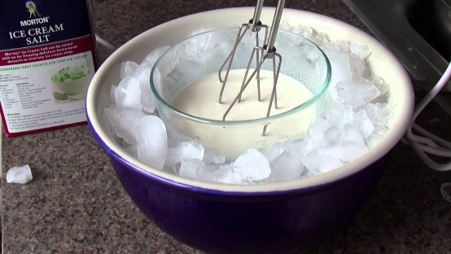

Chemical example:
CH₂ CH₂ + HCl
CH₃CH₂Cl
2 molecules
1 molecule
Ice cream makers:
cool with ice/NaCl;
Dissolution of salt is endothermic (i.e. ∆H° is positive), and the process is driven by entropy.
∆H° = -15.5 kcal mol⁻¹
∆S° = -31.3 e.u.
Negative = makes a positive contribution to ∆G°
If # of molecules unchanged, ∆S° small, ∆H° controls ( we can estimate value from bond strength tables)

Slide 10
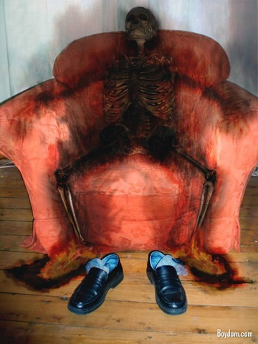
Rates
All processes have “activation barriers” (E_{a}), otherwise we and our surroundings would spontaneously combust.
Rate of reaction is controlled by: 1. Barrier height (energy of transition state); bonds have to be loosened

Slide 11
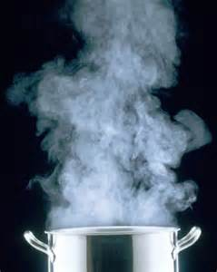
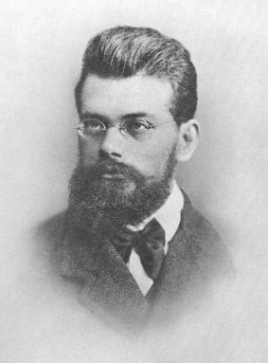
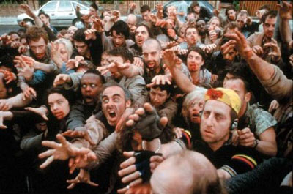
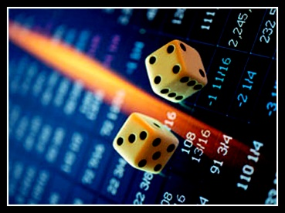
2. T (increased T means faster moving molecules; number of collisions increases; faster reaction)
Boltzmann Distribution
Ludwig Eduard Boltzmann
(1844 –1906)
The average kinetic energy of molecules at room temperature is ~ 0.6 kcal mol⁻¹, enough to overcome E_{a} ~ 20 kcal mol⁻¹.
3. Concentration (the number of collisions increases with concentration)
4. “Probability” factor (how likely is a collision to lead to reaction; depends on sterics, electronics)
Notes:
Air: a single molecule undergoes 10 to the 10 collisions/sec. Cf. breathing 60 times/min; in 80 years: 2.5 billion 2.5x10tothe9

Slide 12
Reaction Rate
Rate measurements lead to Rate Laws, which tell us something about nature of the transition state. Very common:
1.
A
B
1st order rate law
If rate = k [A]
Unimolecular reaction (TS involves only A)

Slide 13
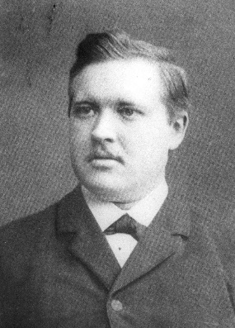
2. A + B C
2nd order rate law
If rate = k [A][B]
Bimolecular reaction (TS involves both A and B).
How do we measure barriers ?
Energy of activation from Arrhenius equation:
-E_{a}
RT
at high T, k = A, “maximum rate”
k =
Ae
Svante Arrhenius (1859–1927)
If E_{a} large → reaction slow
Increasing temperature → reaction speeds up
Notes:
Le Chatelier Summary
Increasing the temperature of a system in dynamic equilibrium favours the endothermic reaction. The system counteracts the change you have made by absorbing the extra heat.
Decreasing the temperature of a system in dynamic equilibrium favours the exothermic reaction. The system counteracts the change you have made by producing more heat.
ImportantAgain, this isn't in any way an explanation of why the position of equilibrium moves in the ways described. It is only a way of helping you to work out what happens.Note: I am not going to attempt an explanation of this anywhere on the site. To do it properly is far too difficult for this level. It is possible to come up with an explanation of sorts by looking at how the rate constants for the forward and back reactions change relative to each other by using the Arrhenius equation, but this isn't a standard way of doing it, and is liable to confuse those of you going on to do a Chemistry degree. If you aren't going to do a Chemistry degree, you won't need to know about this anyway!

Slide 14
Potential Energy Diagrams
Transition state
[TS]
‡
k_{f}
E_{a}
k_{r}
E
Reactant
[A]
∆G °
= ∆H ° (when ∆S ° small)
Product
[B]
Reaction coordinate (progress of reaction)
[B]
k _{forward}
K =
=
[A]
k _{reverse}

Slide 15
Rate Determining Transition State
Many reactions have many steps, but there is always a rate determining TS (bottleneck).
TS

Slide 16
Problem:
Which is right: On heating,
Compound A converts to C directly.
It goes first to B and then to C.
It stays where it is.
B
A
C

Slide 17
Acid-Base Equilibria
HA + H₂O
+
-
H₃O + A
Conjugate Acid
Conjugate Base
Acid
Base
Brønsted and Lowry:
Acid = proton donor Base = proton acceptor

Slide 18
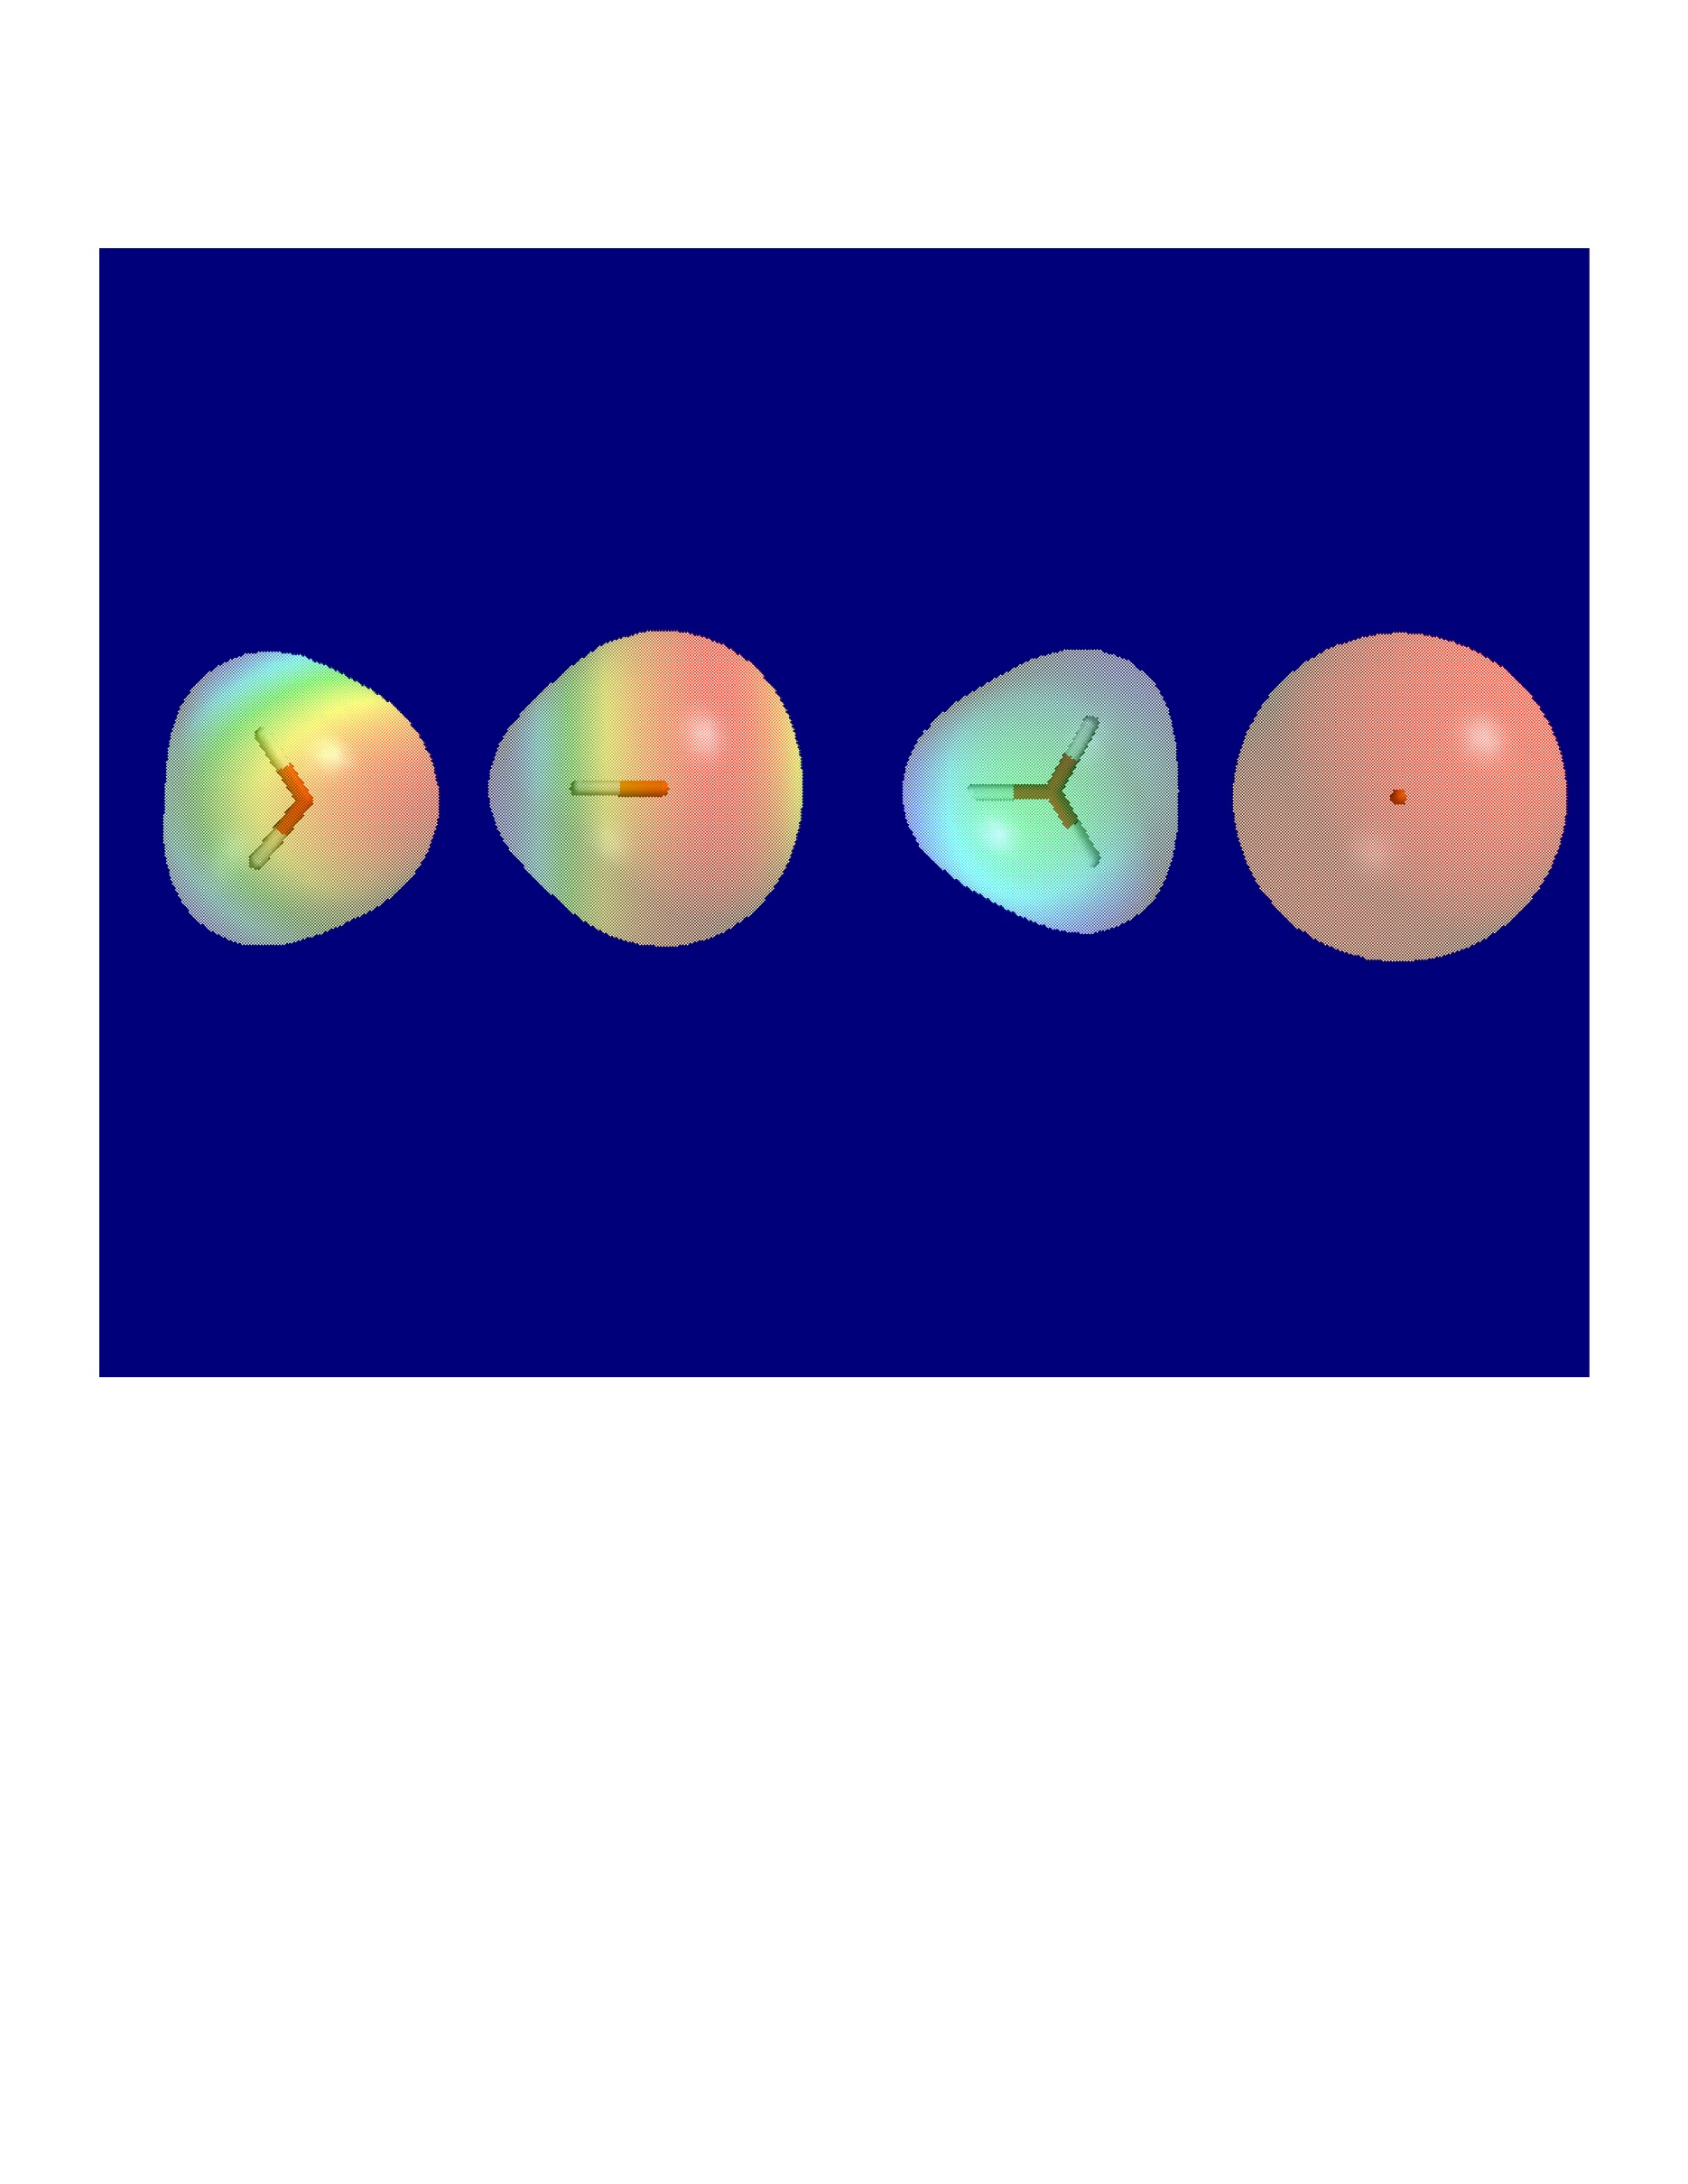
Acid-Base: Electron “Pushing” And Electrostatics
Electron-pushing arrows
H
H
+
-
+
H
Cl
H
O
+
Cl
O
H
H
Electron pair moves
+
+

Slide 19
+
-
HA + H₂O
H₃O + A
+
-
[H₃O] [A]
K =
mol/L
[HA] [H₂O]
Solvent 55
+
-
[H₃O][A]
K_{a} =
K x 55 =
[HA]
Acidity
constant
pK_{a} = -log K_{a}

Slide 20
Acidity
Acidity increases with:
1. Electronegativity (moving to the right in PT)
2. Increasing size of A (H A gets weaker; Coulombic effect of respective mutual nuclear-electron attraction and bond polarization is diminished; down the PT)
3. Resonance, e.g.,
pK_{a}
:
-
CH₃OH 15.5
:
:
CH₃O
:
:
:
:
O
H₂SO₄
-
:
:
:
:
:
:
O
O
:
S
OH
O
-
:
:
:
:
:
CH₃COH
4.3
CH₃
C
O
-5.0
:
:
O
:
:

Slide 21
Relative Acid Strengths
Strong
Weak
Very
weak

Slide 22
Lewis Acids And Bases
F
F
Lewis acids: e-deficient
B
6e
F
Lewis bases:
Lone e-pairs
-
R
R
R―O
R―S
N
R
R
R
R
F
F
+
-
O
B
O
BF₃
e-pushing arrows
R
F
R
Turns +
Turns -

Slide 23
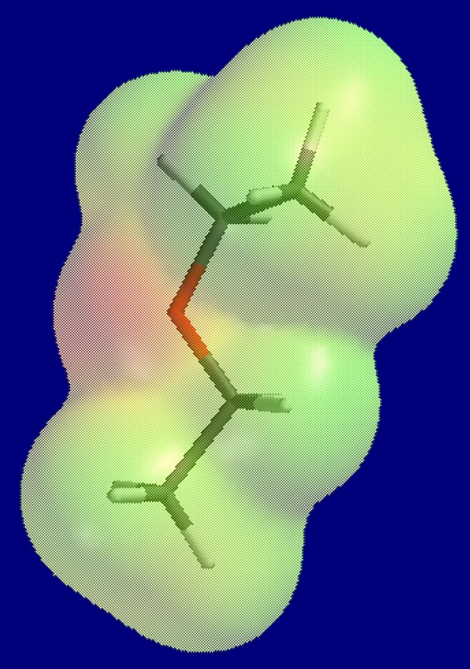
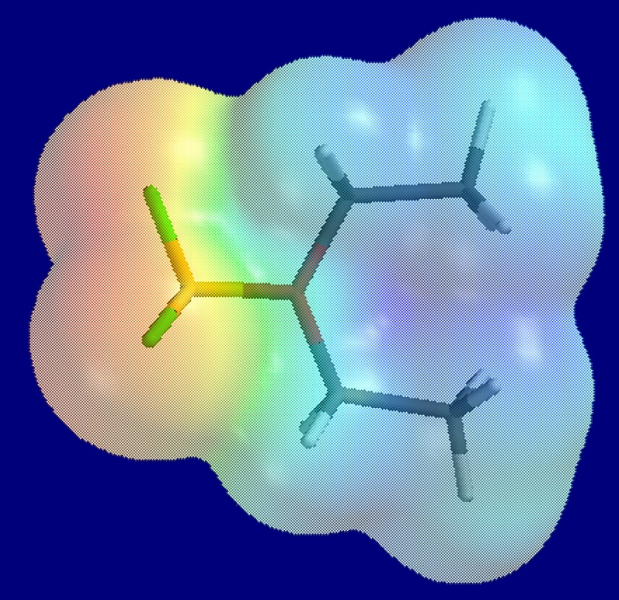
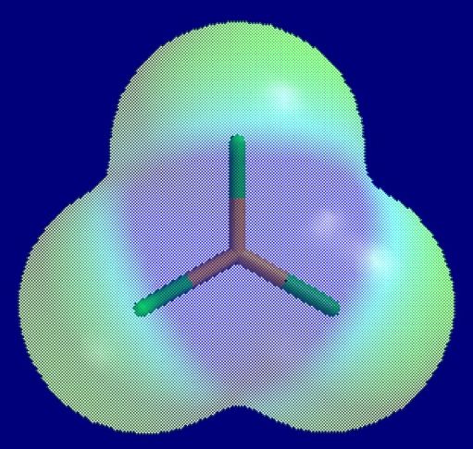
Lewis Acid-Base Electrostatics
F
F
CH₂CH₃
CH₂CH₃
-
+
O
F
B
O
B
+
F
F
CH₂CH₃
CH₂CH₃
F
+

Slide 24
Alkanes
1 Å = 10⁻⁸ cm
Hydrocarbons without
functional groups
Straight chain: CH₃CH₂CH₂CH₃
Line notation:
C₄H₁₀
Butane
H
CH₃
CH₃
Branched:
CH₃
CH₃
C
CH₃
C₄H₁₀
2-Methylpropane

Slide 25
and
are constitutional isomers.
Same molecular formula, different connectivity
Cyclic:
Cyclohexane C₆H₁₂
Bicyclic:
Bicyclo[2.2.2]octane C₈H₁₄
Polycyclic . . . . . .

Slide 26
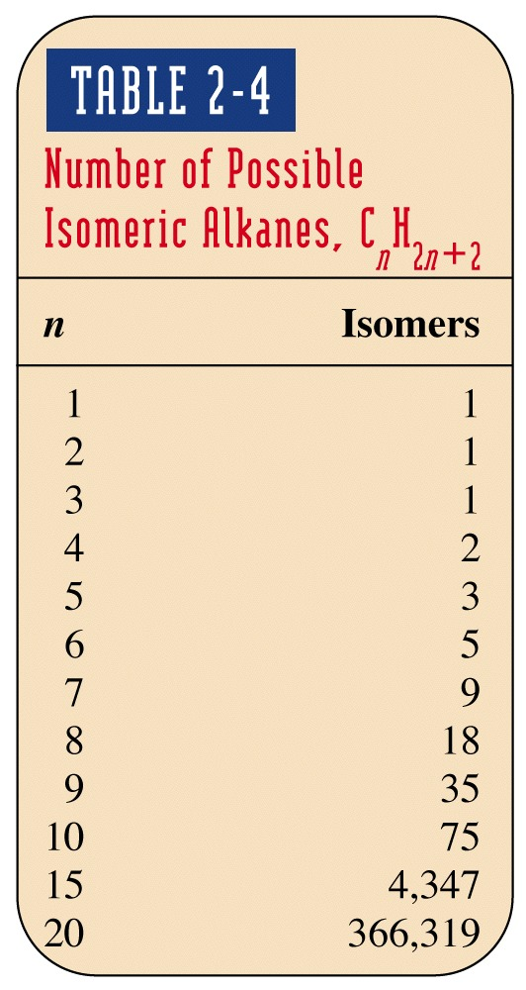
Homologous Series
Insert-CH₂- groups into C-C bonds.
Straight chain CH₃(CH₂)_{x}CH₃
General molecular formula
for acyclic systems.
Cyclic alkanes: C_{n}H_{2n}

Slide 27
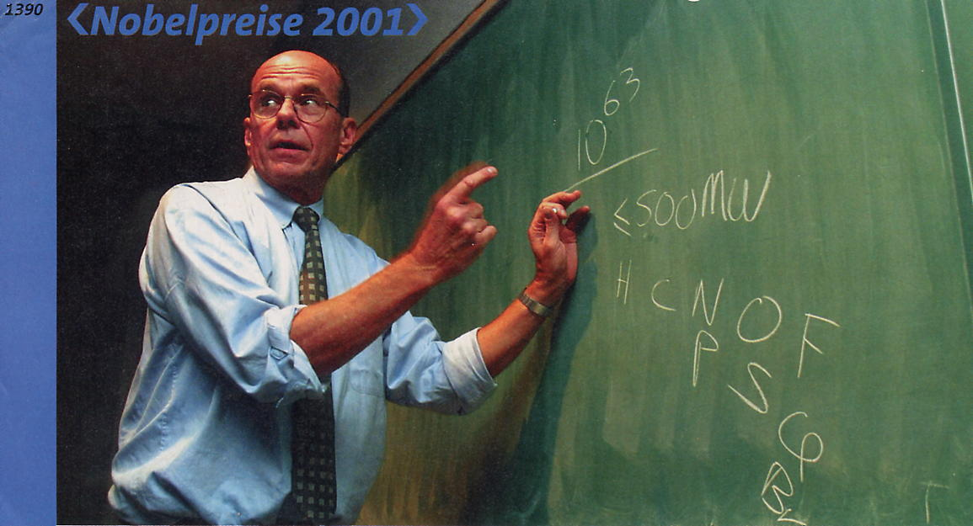
2015 Chemical Abstracts listings cross the 100 million mark (10⁸) for chemical substances
Barry Sharpless (Scripps) NP 2001: chemical “space”

Slide 28
The Names Of Alkanes Are Based On The IUPAC Rules

Slide 29
Naming Alkyl Substituents
Change ending –ane to –yl, as in
methane / methyl, hexane / hexyl
Short notation: Alkane R-H / alkyl R-
“Lingo”: RCH₂ “primary”
R
R
R
C
“secondary”
R
C
H
“tertiary”
H
R

Slide 30
IUPAC Rules
1. Find the longest chain and name it (Table 2-5)
CH₃CHCH₂CH₃
CH₃
A (methyl substituted) butane
An octane (substituted by ethyl, two methyls)
When there are two equal longest chains, choose the one with more substituents
4 substituents
3 substituents

Slide 31
2. Name substituents (as alkyl or halo)
Halo: bromo, fluoro, chloro, iodo
a. For straight chain R: methyl, ethyl, propyl, etc.
b. For branched chain R:
α. Find longest chain (starting from point of attachment)
β. Name substituents
Example:
(Methylpropyl)

Slide 32
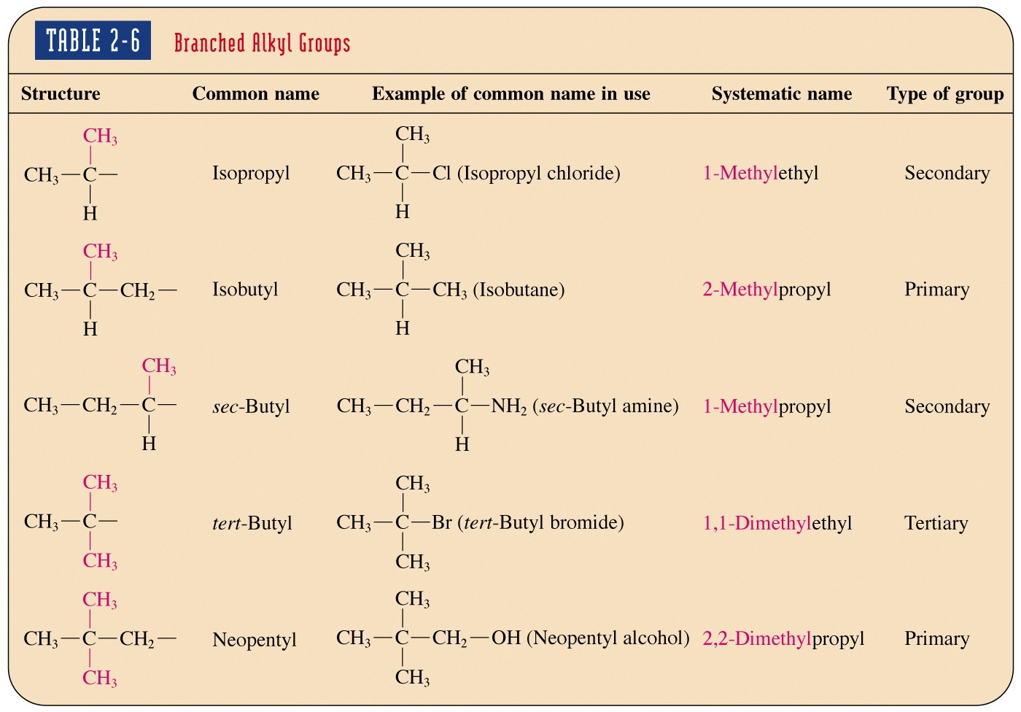
Branched Alkyl Groups
Exams

Slide 33
c. Multiple same substituents:
For R = straight, use prefix di-, tri-, tetra-, penta-, etc.:
Dimethylhexane
For R = branched, use: bis-, tris-, tetrakis-, etc., and alkyl name in parentheses:
Bis(methylpropyl)

Slide 34
d. Common names: we will use colloquially isopropyl, tert-butyl, neopentyl
Notes:
What should I do about a title
Are the numbers okay?

Slide 35
3. Number stem, starting from the end closest to a substituent:
2
5
7
2
4
1
3
4
6
8
9
1
3
If both ends equidistant to the first substituent, proceed until the first point of difference:
5
7
1
2
3
4
6
8
9
Branched substituents: Number from carbon of attachment (C1)
Defined as 1
1
2
3

Slide 36
4. Name the alkane in alphabetical (not numerical) order of substituents, location given by number prefix.
7
3
2
6
4
1
8
5
5-Ethyl-2-methyl-octane
2-Methylbutane
Alphabet: Di-, tri-, etc. not counted for main stem R.
But: Counted when in branched R
7
3
2
6
4
1
8
5
7
6
4
2
1
8
5
3
Not counted
{
5-Ethyl-2,2-di-methyloctane
5-(1,1-Dimethylethyl)-3-ethyloctane
Counted

Slide 37
Problem:
I
Cl
Br
Longest chain?

Slide 38
8
7
I
6
5
4
Cl
3
2
1
Br
Substituents?

Slide 39
Iodo
8
7
I
6
1-Chloroethyl
5
4
Cl
3
Dimethyl
2
1
Br
Bromo
Final name?

Slide 40
Iodo
8
7
I
6
1-Chloroethyl
5
4
Cl
3
Dimethyl
2
1
Br
Bromo
1-Bromo-5-(1-chloroethyl)-7-iodo-2,2-dimethyloctane

Slide 41
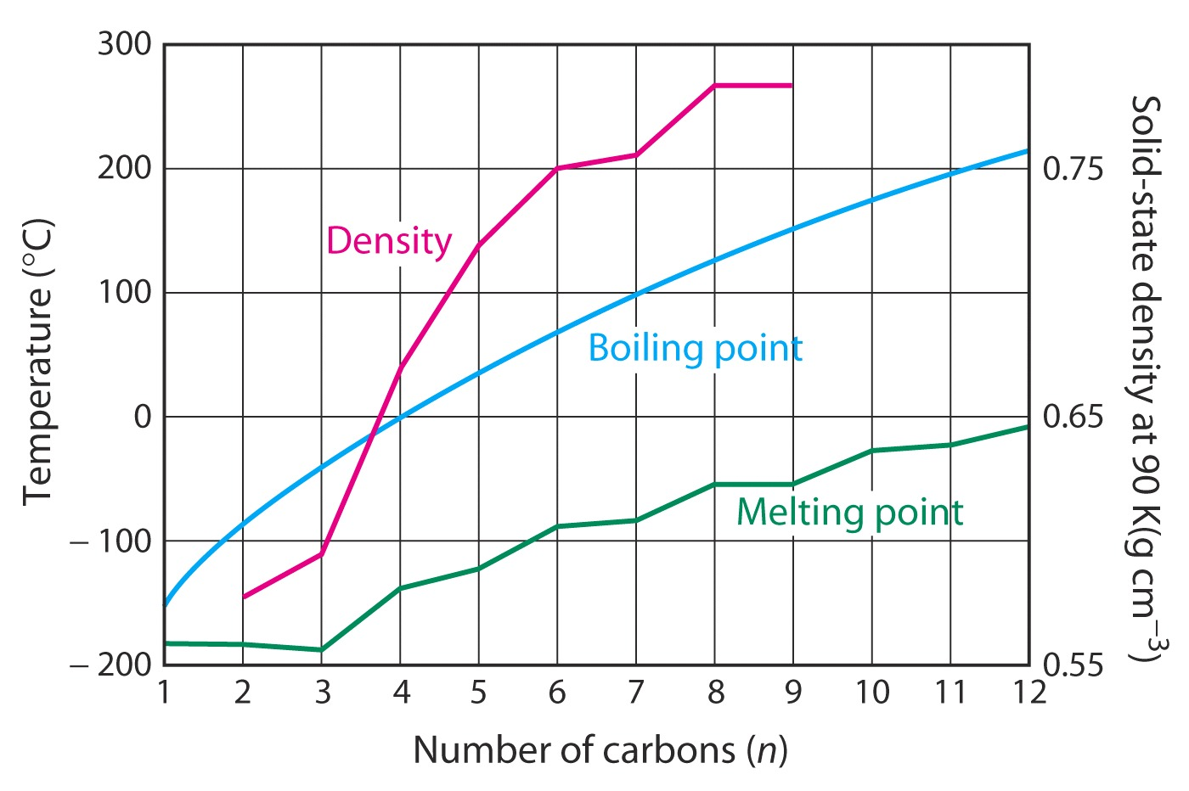
Physical Properties Of Alkanes
Intermolecular Forces Increase With Size

Slide 42
Intermolecular Forces
Salts
Polar molecules
Alkanes (alkyls)

Slide 43
Dynamics: The Rotamers Of Ethane
Staggered
Eclipsed
Staggered

Slide 44

Newman Projections
Note: Any one Newman projection occurs along only one bond. Everything else is a substituent.
Notes:
The symbol is a combination of the semaphore signals for the letters "N" and "D," standing for "nuclear disarmament".[50] In semaphore the letter "N" is formed by a person holding two flags in an inverted "V," and the letter "D" is formed by holding one flag pointed straight up and the other pointed straight down. Superimposing these two signs forms the shape of the centre of the peace symbol

Slide 45
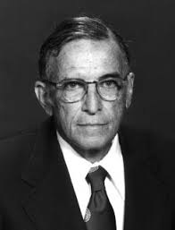
Rotation With Newman Projections
Melvin S. Newman (1908–1993)

Slide 46

Rotation Around Bonds Is Not “Free”: Barriers To Rotation
Ethane has barrier to rotation of ~3 kcal mol⁻¹. Barrier due to steric and electronic effects.
e-Repulsion
Most stable
rotamer is
staggered
Least stable rotamer is the transition state of rotation and eclipsed

Slide 47
Potential Energy Diagrams

Slide 48
Propane: Methyl Increases Barrier

Slide 49
Butane: Staggered And Eclipsed Isomeric Rotamers

Slide 50
Doors
Walba

