Slide 1
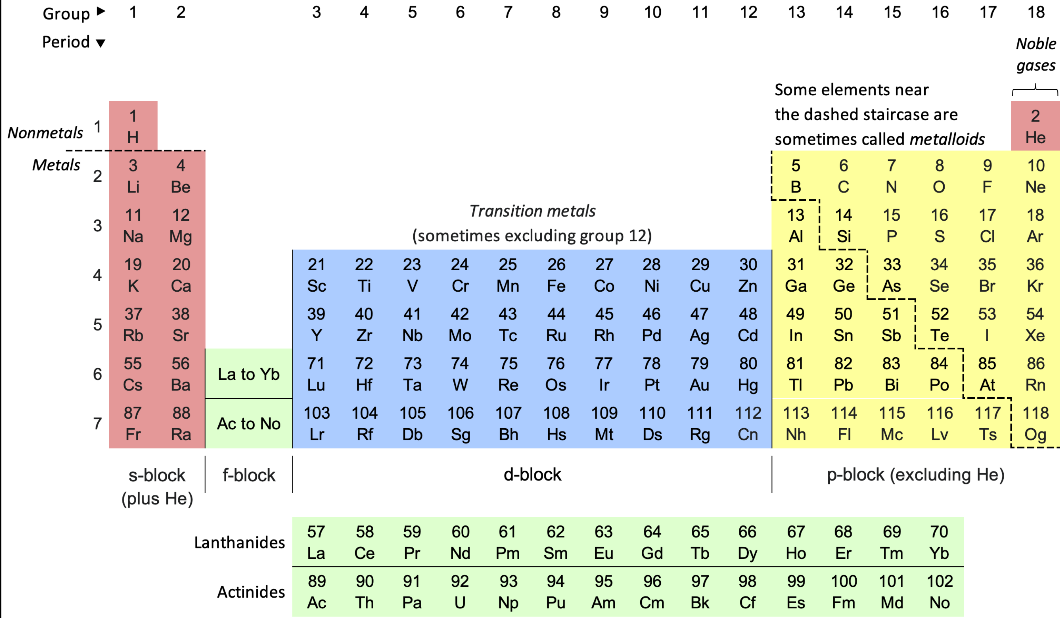
Why “Know” the Periodic Table?

Slide 2
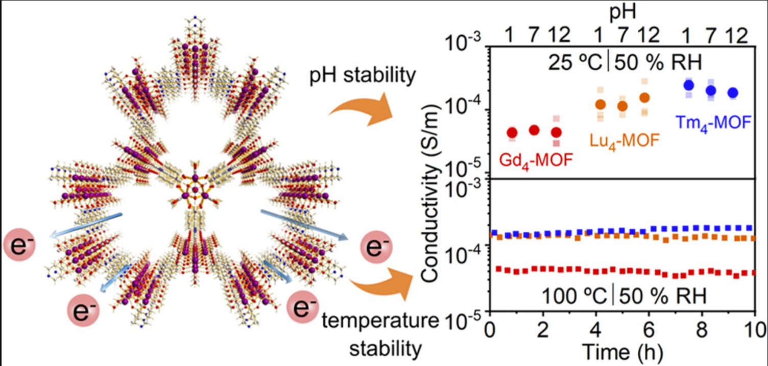
Why “Know” the Periodic Table? Gadolinium (Gd)

Slide 3
Why “Know” the Periodic Table? Thulium (Tm)

Slide 4
Why “Know” the Periodic Table? Lutetium (Lu)

Slide 5
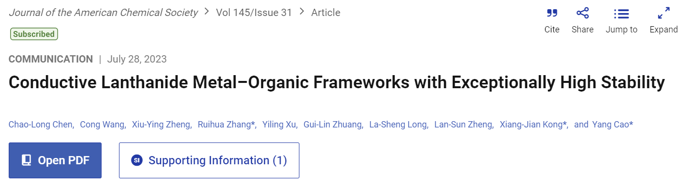
Why “Know” the Periodic Table?
The Ln₄-MOFs show remarkable structural stability
Stable conductivity pH (1–12)
Temperature stability (373 K ~90 °C)
Electric field as high as 800 000 V/m.
Strong coordination bonds between high-valent Ln(III) ions and rigid carboxylic linkers and hydrogen bonds that enhance electron transport

Slide 6

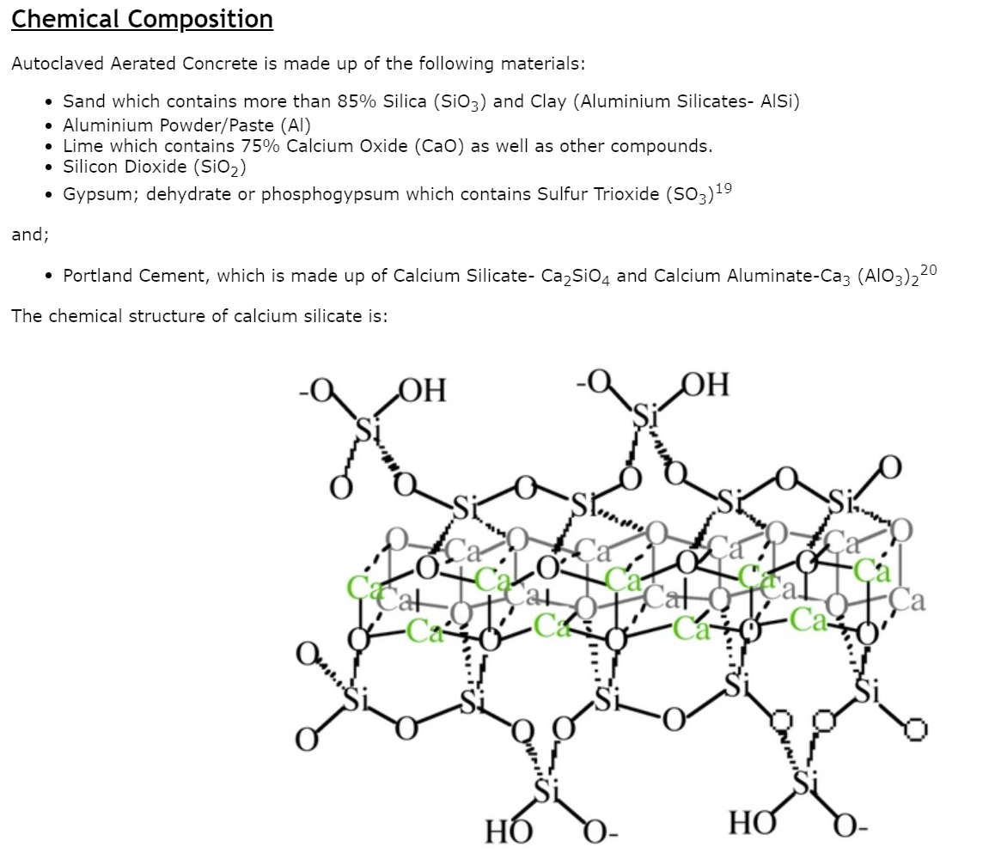
Why “Know” the Periodic Table?

