Slide 1
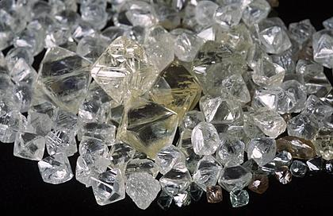
Organic Chemistry:
The Chemistry Of Carbon
Rachmaninov

Slide 2
CEM 351

Slide 3
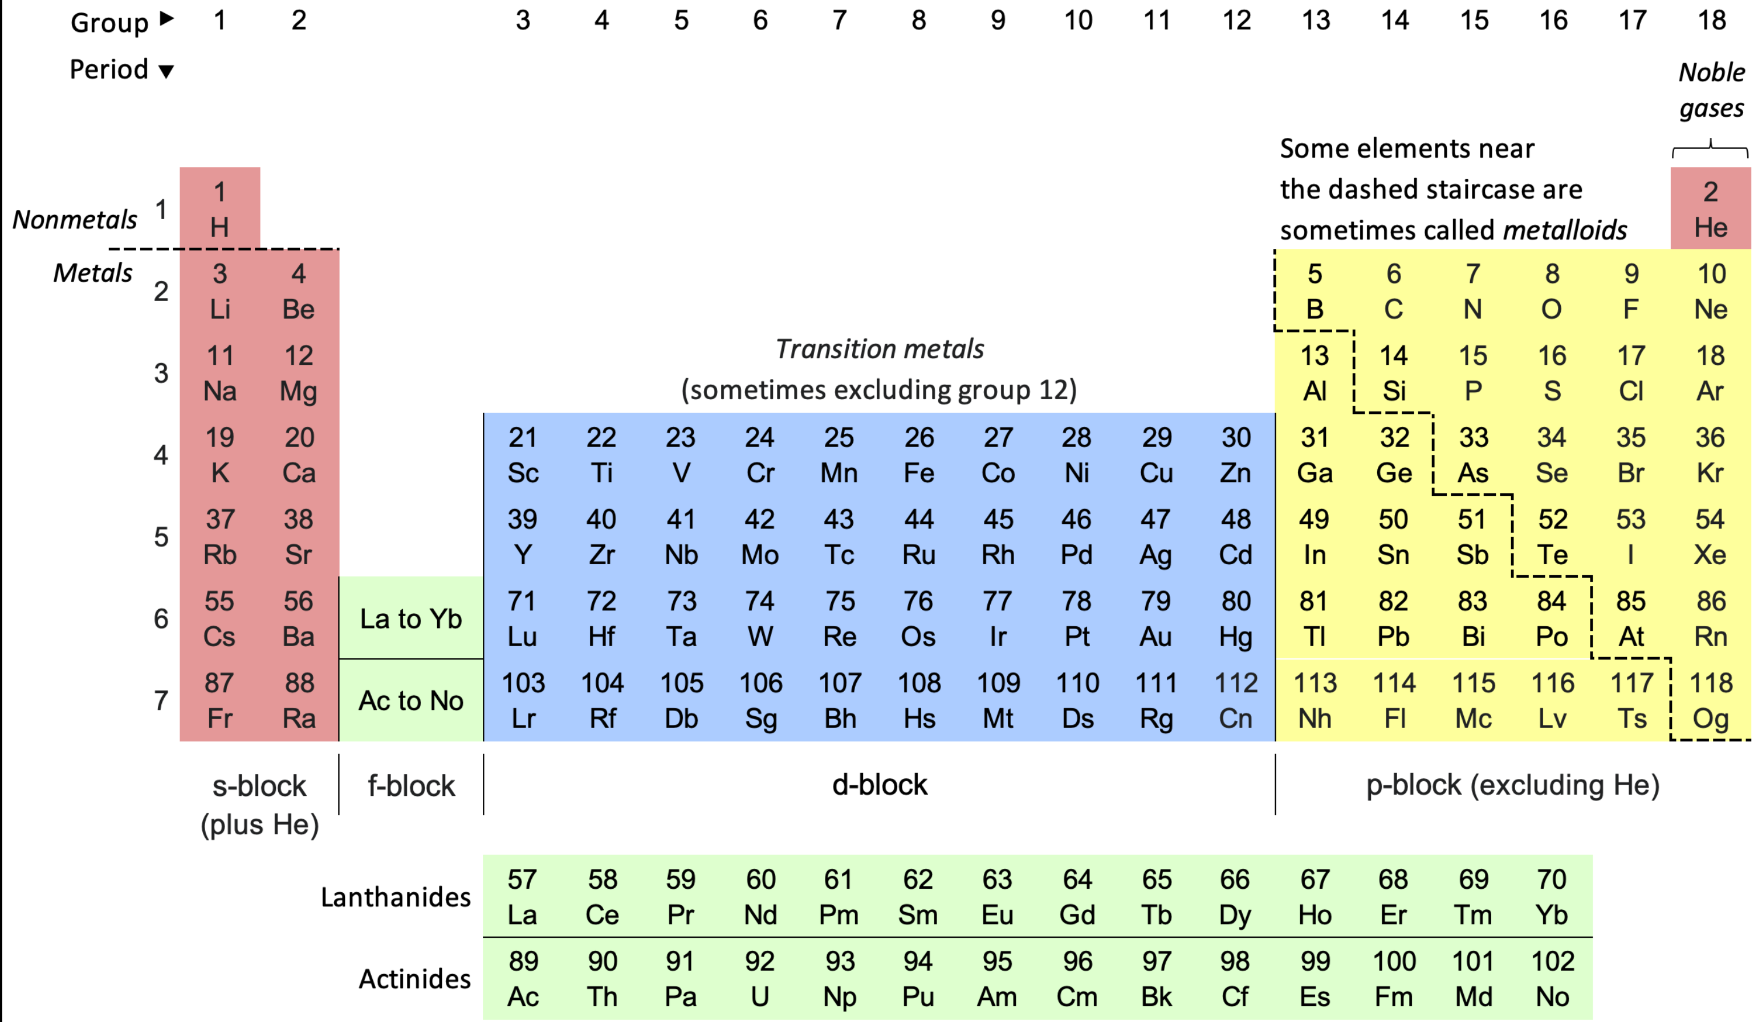
Why “Know” the Periodic Table?

Slide 4
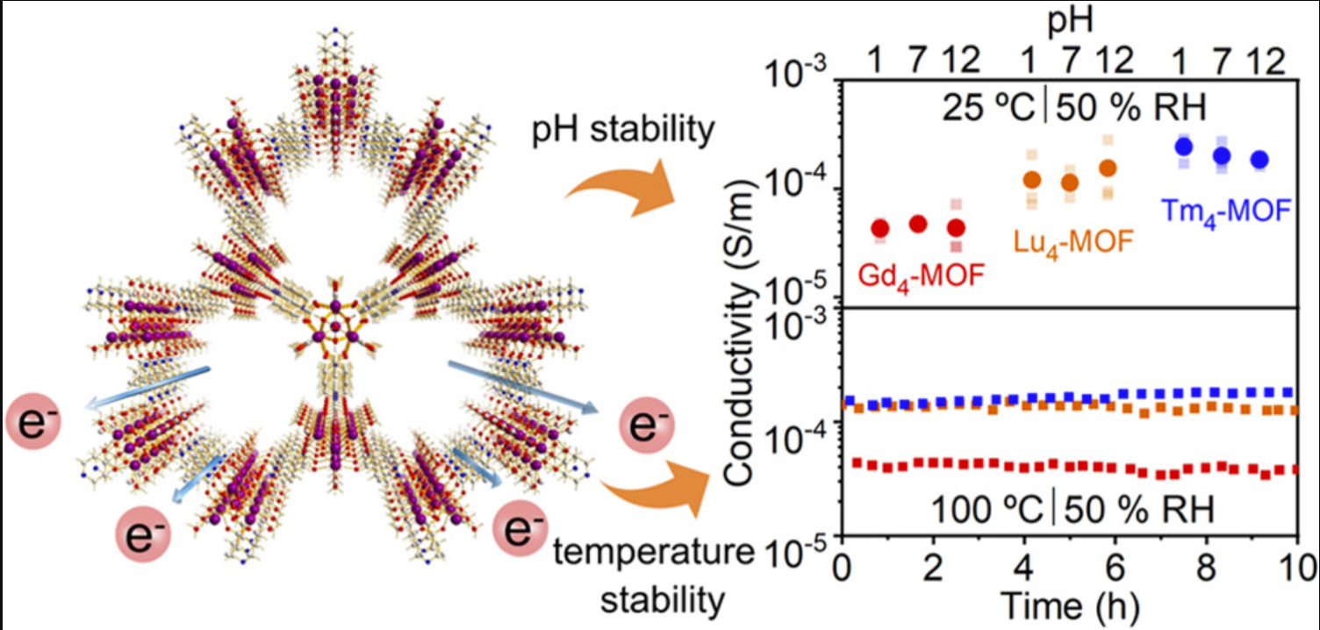
Why “Know” the Periodic Table? Gadolinium (Gd)

Slide 5
Why “Know” the Periodic Table? Thulium (Tm)

Slide 6
Why “Know” the Periodic Table? Lutetium (Lu)

Slide 7

Why “Know” the Periodic Table?
The Ln₄-MOFs show remarkable structural stability
Stable conductivity pH (1–12)
Temperature stability (373 K ~90 °C)
Electric field as high as 800 000 V/m.
Strong coordination bonds between high-valent Ln(III) ions and rigid carboxylic linkers and hydrogen bonds that enhance electron transport

Slide 8

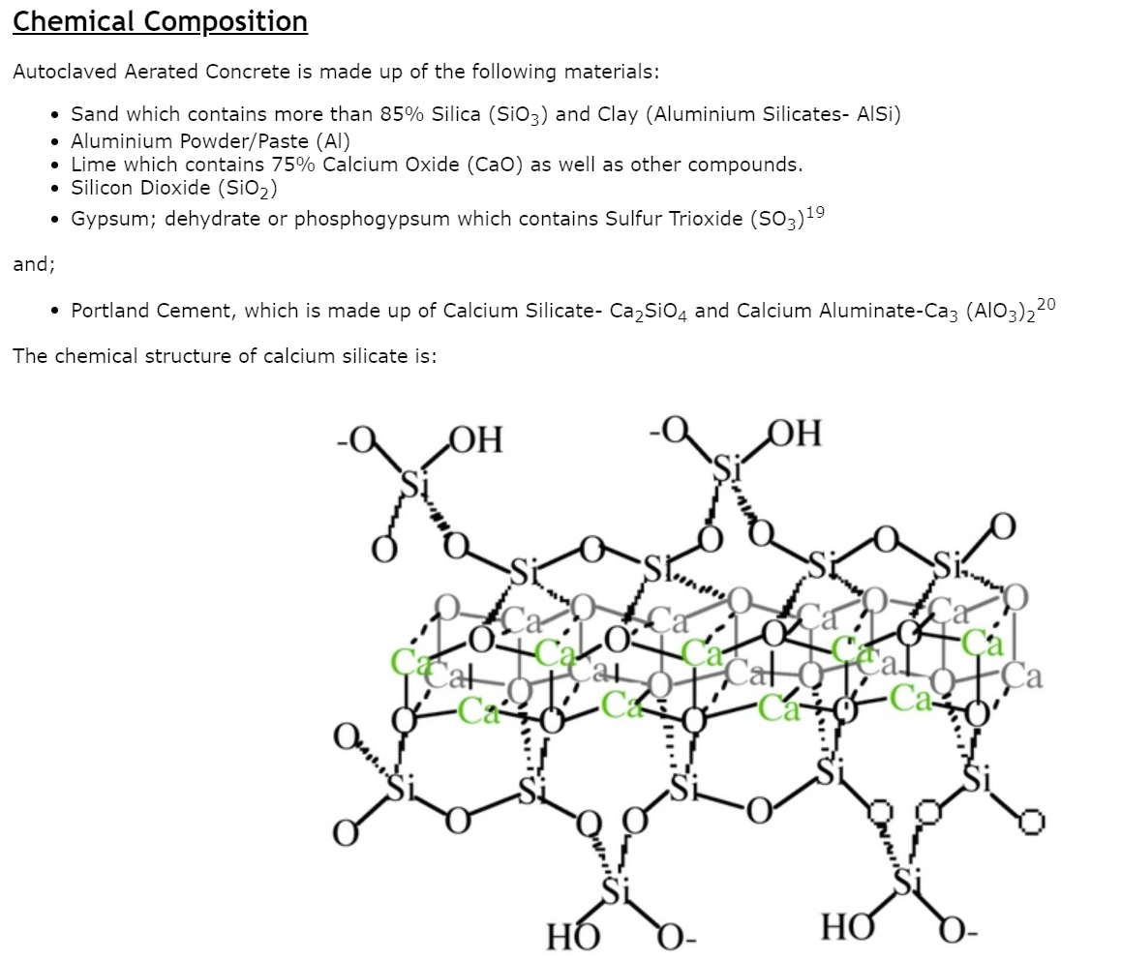
Why “Know” the Periodic Table?

Slide 9
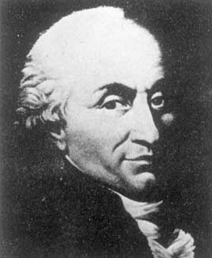
Chapter 1:Bonding
A Review Of CEM141
Classical view of atom (Bohr)
Charles Augustin de Coulomb
1736-1806
Atom 1 + Atom 2 A:A (A A) or A⁺A⁻
“favorable”
“Rules”:
1. Opposite charges attract each other (Coulomb)
2. Electrons spread out in space (delocalization)
Notes:
French Revolution (1789–1799)
Charles Augustin de Coulomb

Slide 10
Bond Strength And Length
Bond strength

Slide 11
Covalent Bonding: Sharing Electrons
Dimensions:
five orders of magnitude
Nuclear diameter ~ 10⁻¹⁵ m
Electronic orbit ~ 10⁻¹⁰ m
Mass ratio proton : electron = ~ 1800
11

Slide 12
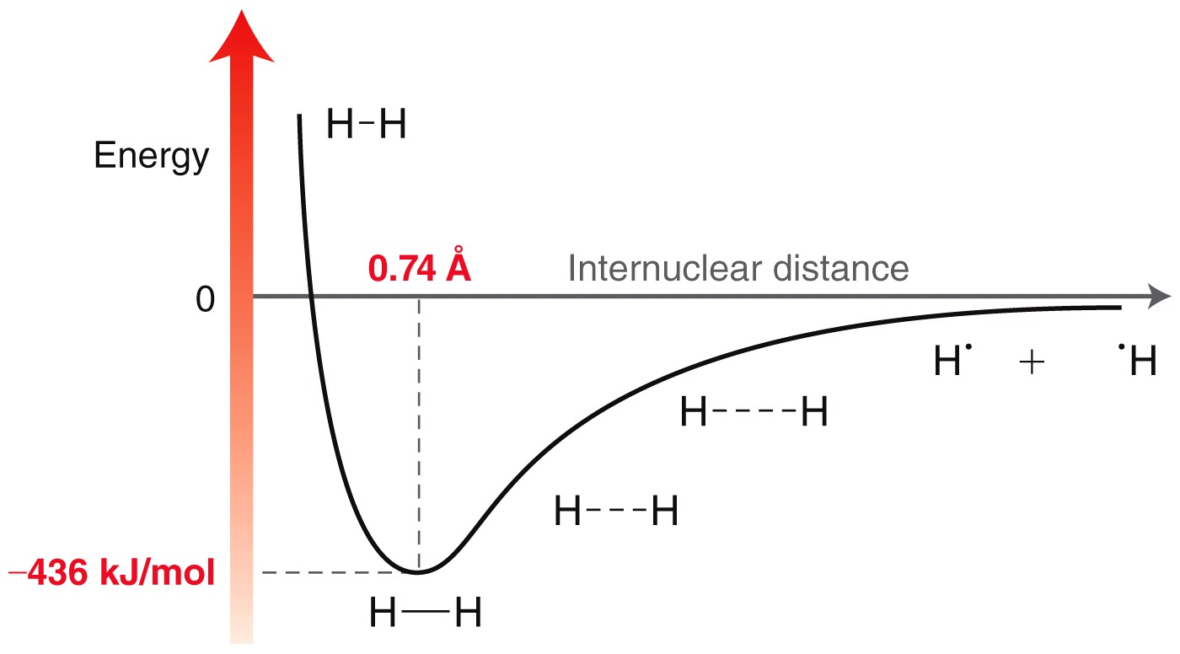

Covalent Bonding
How do potential energy and stability relate?
What forces keep the bond at the optimal length?

Slide 13

Ionic Bonding:
“No” Sharing of Electrons
Who donates and who accepts?
13

Slide 14
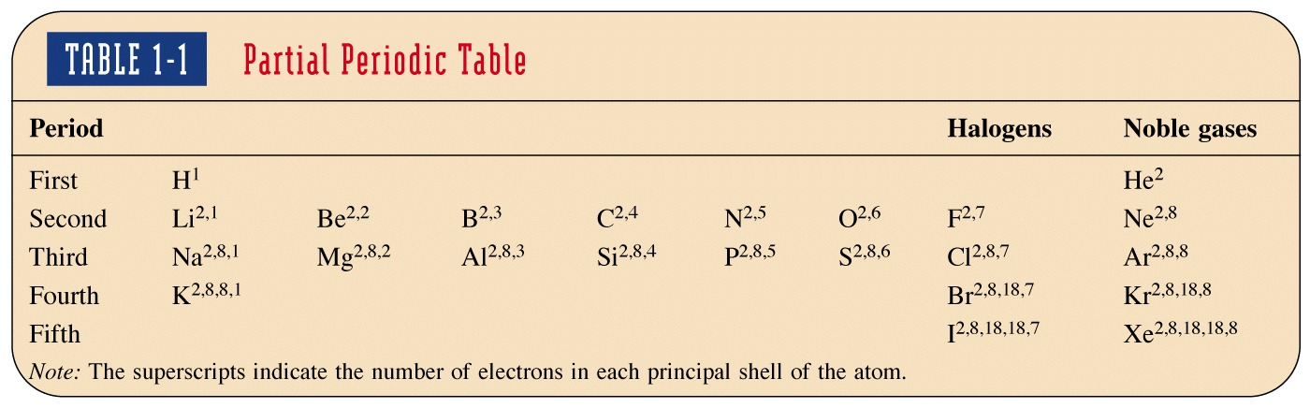
Partial Periodic Table
Duet
Octets
Valence electrons

Slide 15
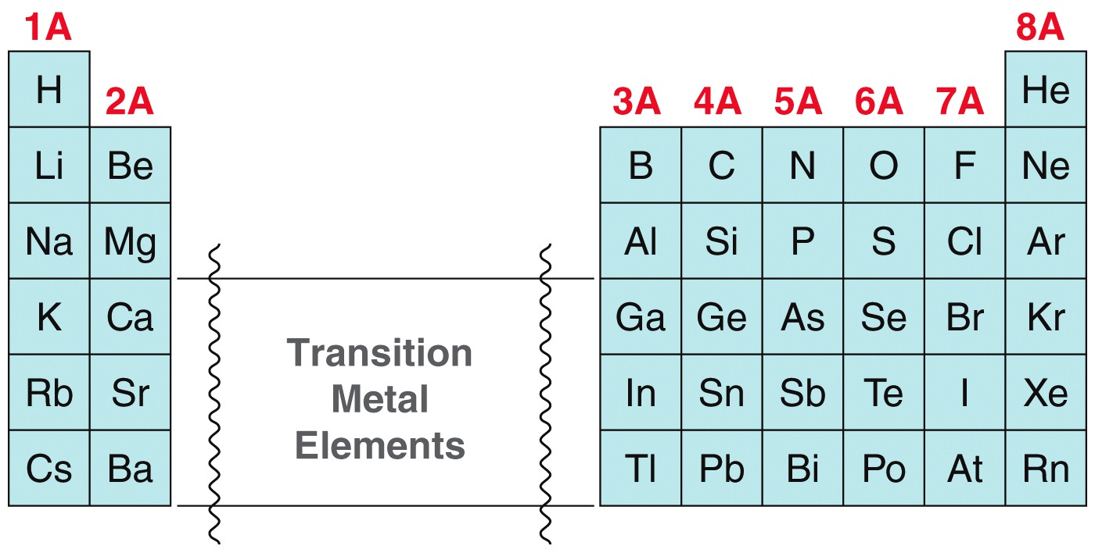
Counting Valence Electrons
You can always calculate the number of valence electron by analyzing the e- configuration.

Slide 16
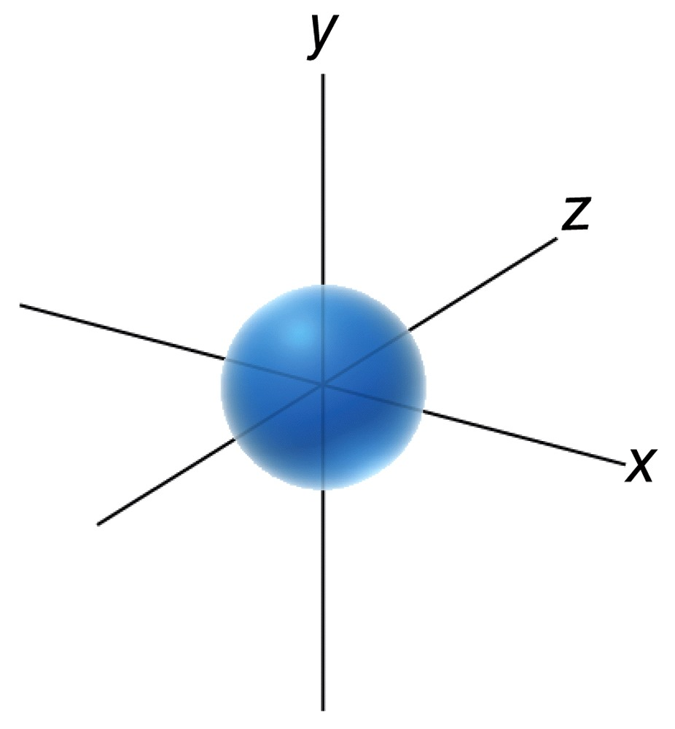
Atomic Orbitals
General Chemistry review
In the 1920s, Quantum Mechanics was established as a theory to explain the wave properties of electrons
The solution to wave equations for electrons provides us with visual pictures called orbitals
16

Slide 17
Atomic Orbitals
General Chemistry review
  The type or orbital be identified by its shape
  Orbital: Region where 90% probability of finding electron Remaining 10% tapers off moving away from the nucleus
17

Slide 18
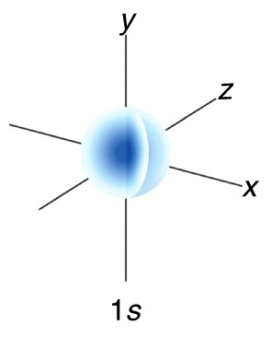
Atomic Orbitals
Electrons are most stable (lowest in energy) if they are in the 1s orbital. (1 is principal quantum number, or shell)
The 1s orbital is full once there are two electrons in it.
The 1s orbital has no nodes; thus, no points where the probability of finding the electron is 0.
Nodes = n – 1 (n = principal quantum number)
18

Slide 19
Pauli Exclusion Principle
Or: Max e⁻ in an orbital
Energy diagram depicting solutions as energy “levels”:
p_{x}
p_{y}
p_{z}
There are rules for “filling up” levels with e
2s
electrons (He)
1s
Pauli Exclusion Principle: 2e max in each level/orbital

Slide 20
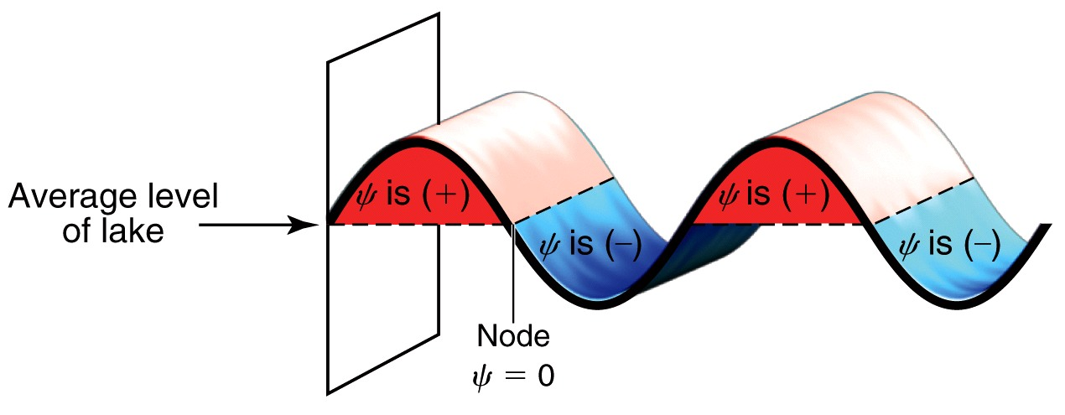
Atomic Orbitals
In Theory, electrons behave as both particles and waves. The theory does match experimental data, and it has predictive capability.
  Like a wave on a lake, an electron’s wavefunction can be (+), (–), or ZERO.
20

Slide 21
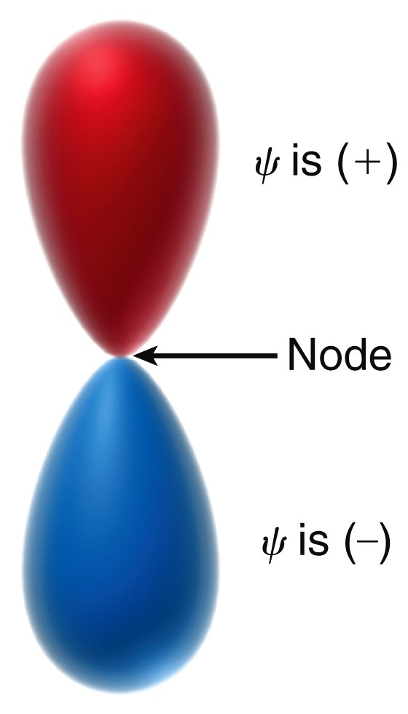
Atomic Orbitals
Orbitals generated mathematically from wavefunctions, regions can be (–), (+), or ZERO
  The sign of the wave function has nothing to do with electrical charge.
The sign is important for orbital overlapping in bonds.
The 2p orbital has 1 nodal plane; thus, a point where the probability of finding the electron is 0.
Nodes = n – 1 (n = principal quantum number; 2 – 1 = 1 node)
21

Slide 22
Atomic Orbitals
Orbitals generated mathematically from wavefunctions, regions can be (–), (+), or ZERO
  The sign of the wave function has nothing to do with electrical charge.
The sign is important for orbital overlapping in bonds.
The 2p orbital has 1 nodal plane; thus, a point where the probability of finding the electron is 0.
Nodes = n – 1 (n = principal quantum number; 2 – 1 = 1 node)
22

Slide 23
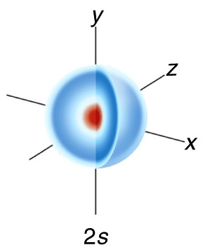
Atomic Orbitals
The 2s orbital is filled next. The 2s orbital has a node.
ns orbital (nodes = n – 1; 2 – 1 = 1 node)
Locate the node in the picture.
23

Slide 24
The S Orbitals
1s
2s
1s

Slide 25
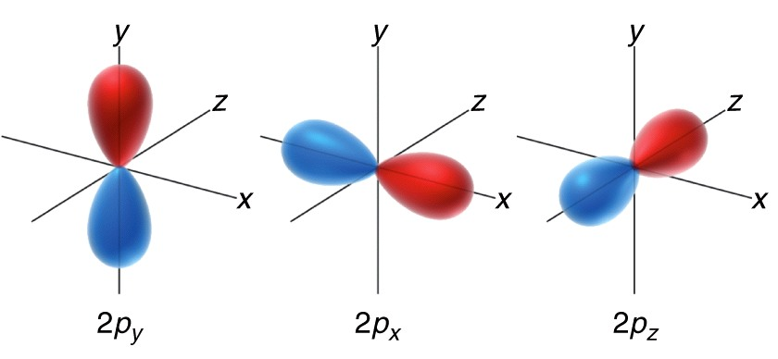
Atomic Orbitals
Once the 2s is full, electrons fill into the three degenerate (same energy) 2p orbitals
Where are the nodes in each of the 2p orbitals?
25

Slide 26
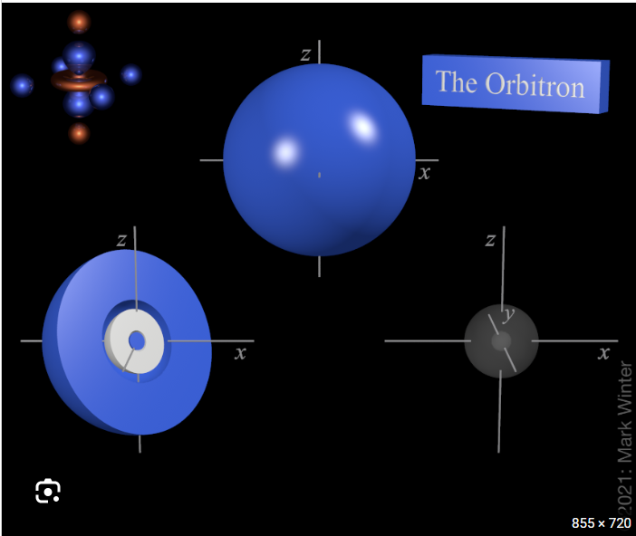
Atomic Orbitals
Once the 3s is full, electrons fill the three degenerate (same energy) 3p orbitals
Where are the nodes in each of the 3p orbitals? n – 1 = ?
26

Slide 27
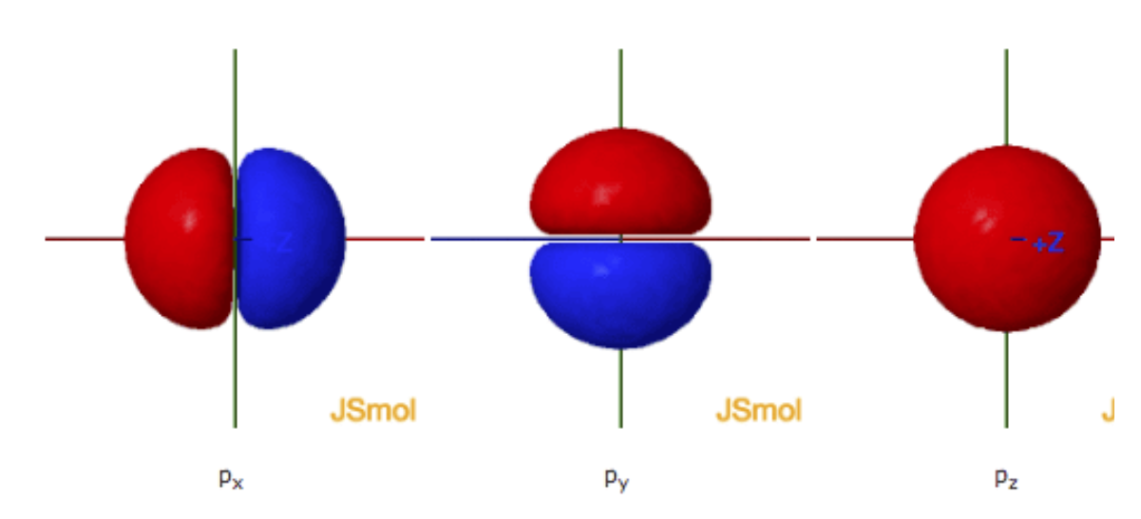
Atomic Orbitals
Once the 3s is full, electrons fill the three degenerate (same energy) 3p orbitals
Where are the nodes in each of the 3p orbitals? n – 1 = ?
27

Slide 28
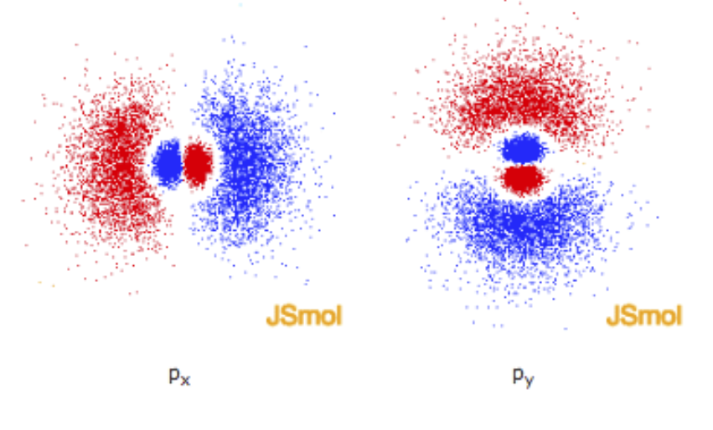
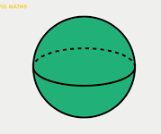
Atomic Orbitals
Once the 3s is full, electrons fill the three degenerate (same energy) 3p orbitals
Where are the nodes in each of the 3p orbitals?
Line = planar node that passes through the nucleus
Sphere = spherical node around the nucleus
28

Slide 29
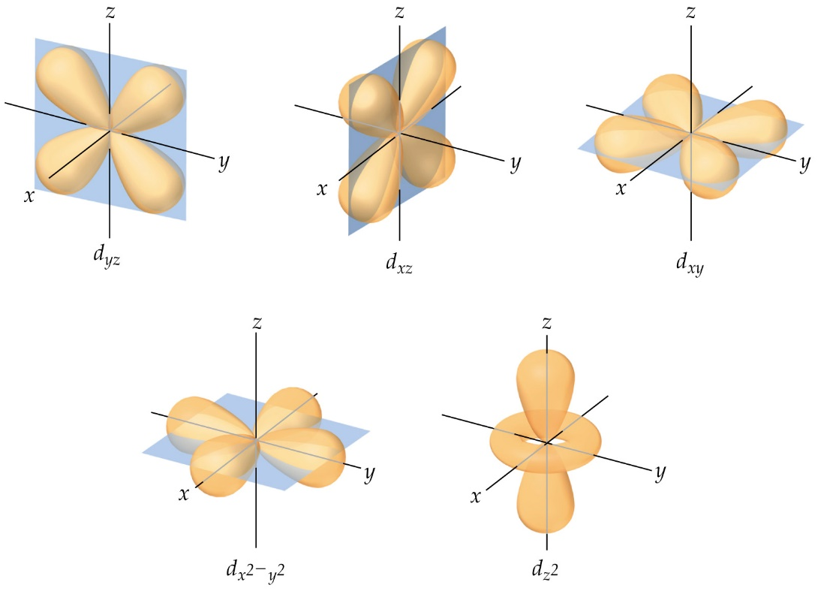
The Five d Orbitals
The wavefunctions: five d orbitals
3d orbitals have how many nodes? Could you identify them if told there are no spherical nodes?

Slide 30
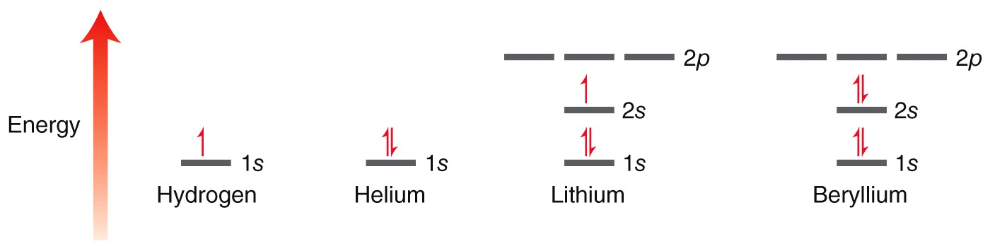
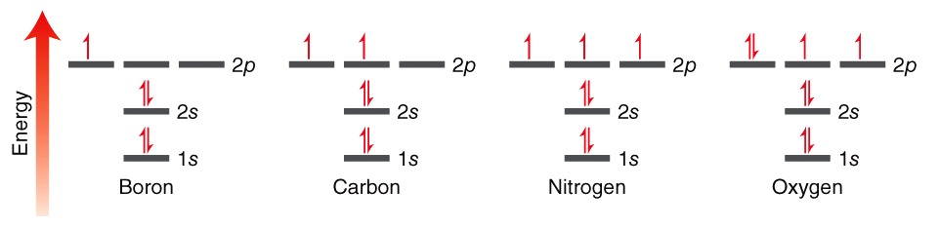
Atomic Orbitals
Common elements and their electron configurations
Practice with SkillBuilder 1.6
30

Slide 31
Atomic Orbitals
What are the rules that govern our placement of electrons ?
31

Slide 32
Aufbau (AufBau) Principle
Or: Where The Electrons Go
Energy diagram depicting solutions as energy “levels”:
There are rules for “filling up” levels with e
Lower energy orbitals filled first (closed shell)
Pauli: Exclusion principle: 2e max in each level
32

Slide 33


Hund’s Rule
Or: Where The Electrons Go
When filling a subshell with multiple orbitals of equal energy, electrons will singly occupy each orbital before doubling up in any one orbital, and these singly occupied electrons will all have the same spin
33

Slide 34
Hund’s Rule
Or: Where The Electrons Go
When filling a subshell with multiple orbitals of equal energy, electrons will singly occupy each orbital before doubling up in any one orbital, and these singly occupied electrons will all have the same spin
34

Slide 35
Hund’s Rule
Or: Where The Electrons Go
When filling a subshell with multiple orbitals of equal energy, electrons will singly occupy each orbital before doubling up in any one orbital, and these singly occupied electrons will all have the same spin
35

Slide 36
Pauli Exclusion Principle
Or: Where The Electrons Go
When filling a subshell with multiple orbitals of equal energy, electrons will singly occupy each orbital before doubling up in any one orbital, and these singly occupied electrons will all have the same spin
36

Slide 37
Why Do Elements React?
Aim
Noble Gas Configuration
“Ionic” Bonds
-1e
Li^{2,1}
[Li²]⁺
Transfer of Valence Electrons
-1e
Na^{2,8,1}
[Na^{2,8}]⁺
F^{2,7}
+1e
[F^{2,8}]⁻
Therefore:
+
-
Booom
2 Na
+
F₂
2 Na F

Slide 38
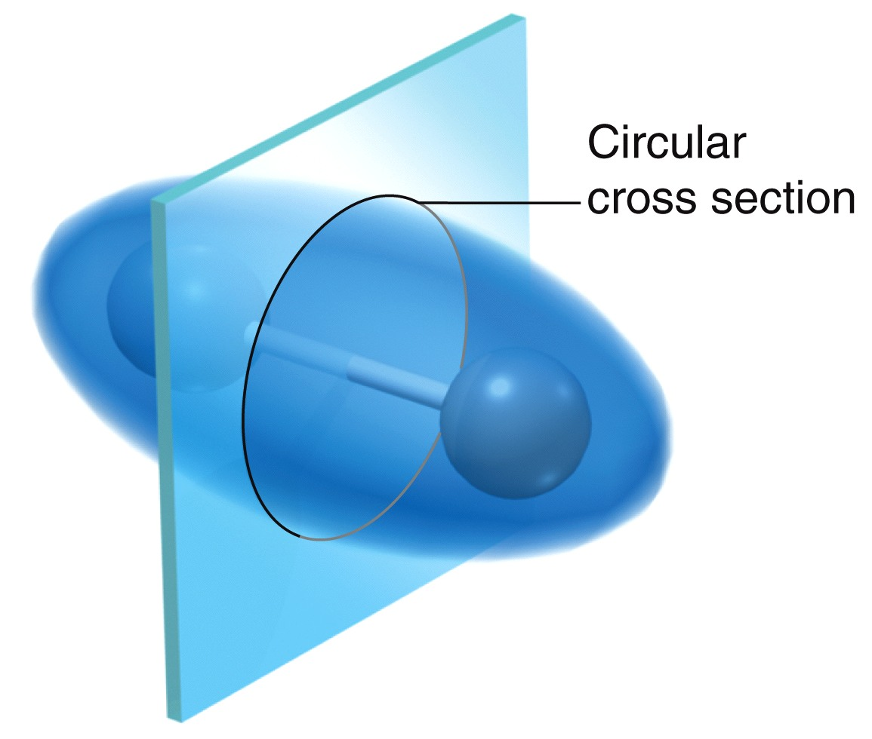
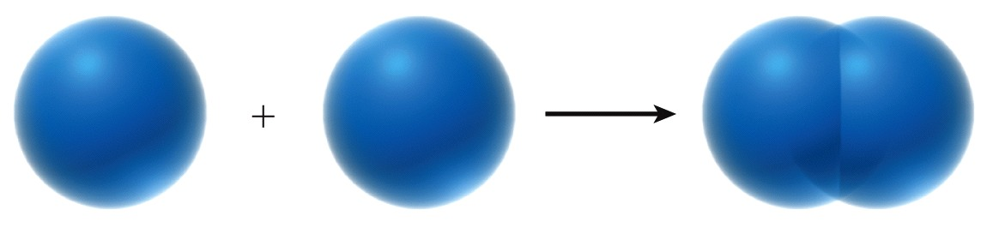

Valence Bond Theory
The bond for a H₂ molecule results from constructive interference

Slide 39
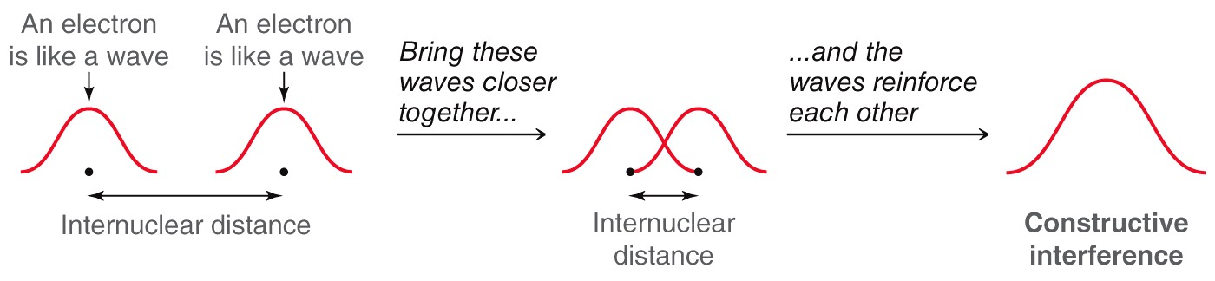
Valence Bond Theory
A bond occurs when atomic orbitals overlap. Overlapping orbitals is like overlapping waves
Only constructive interference results in a bond
39

Slide 40
Valence Bond Theory
A bond occurs when atomic orbitals overlap. Overlapping orbitals is like overlapping waves
Only constructive interference results in a bond
40

Slide 41
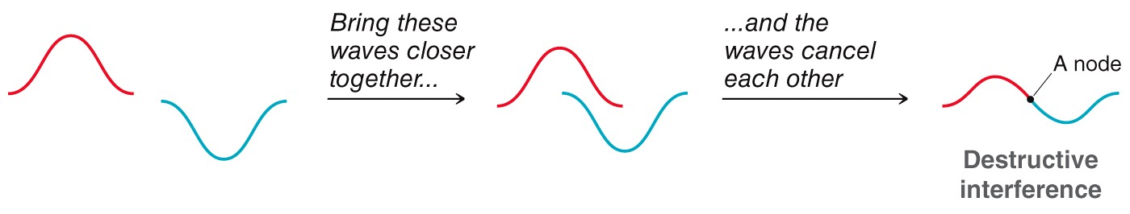
Valence Bond Theory
A bond occurs when atomic orbitals overlap. Overlapping orbitals is like overlapping waves
Only constructive interference results in a bond
41

Slide 42
Valence Bond Theory
A bond occurs when atomic orbitals overlap. Overlapping orbitals is like overlapping waves
Only constructive interference results in a bond
42

Slide 43

2. “Covalent” Bonds
Elements in the “middle” of the periodic table have a problem with electron affinity (EA) and ionization potential (IP):
Shows only
valence e
C⁴⁺
-4e
C
+4e
C⁴⁻
(He)
(Ne)
Compromise: electron-sharing
H
.
.
The Hindenburg, 1937
C
+
4 H
.
.
H
C
H
.
.
.
.
H
.
.
2 H₂
+
O₂
H O H
.
.
.
.
.
.

Slide 44
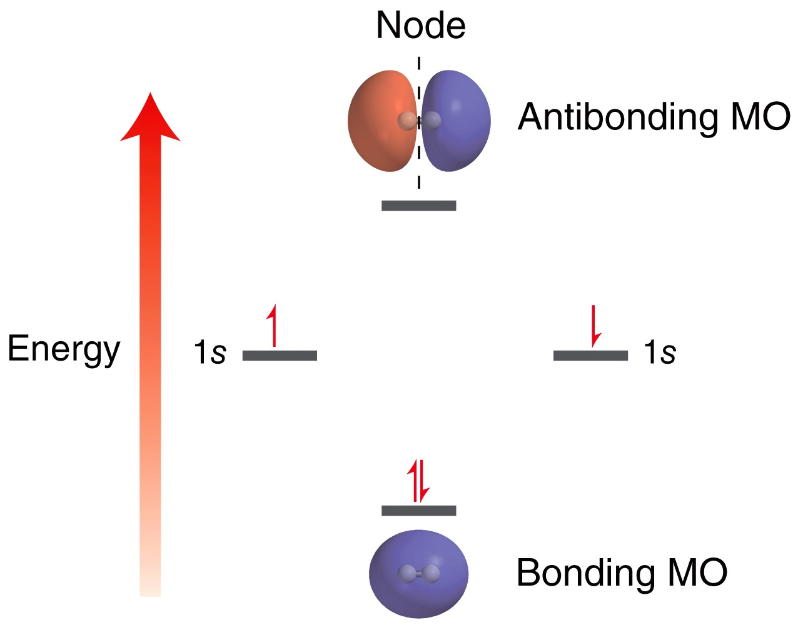
Molecular Orbital (MO) Theory
Atomic orbital wavefunctions overlap to form MOs that extend over the entire molecule.
MOs include both constructive and destructive interference.
The number of MOs created = the number of AOs used.
H₂ MOs
44

Slide 45
Molecular Orbital Theory
Why is the antibonding orbital higher in energy?
When the AOs overlap, why do the electrons go into the bonding MO rather than the antibonding MO?

Slide 46
Molecular Orbital Theory
Imagine a He₂ molecule. How would its MOs compare to those for H₂?
In general, if a molecule has all of its bonding and antibonding MOs occupied, will it be stable or unstable?
Why does Helium exist in its atomic form rather than in molecular form?

