Slide 1
Chapter 7: Unimolecular Substitution And Elimination
S_{N}2, S_{N}1
E1, E2
Relative “rates” of the four arrows differ and depend on substrate, reagent, and conditions
-
E1, E2
-
B
H
:
Nu
:
C
C
L
S_{N}2, S_{N}1, E1, E2

Slide 2
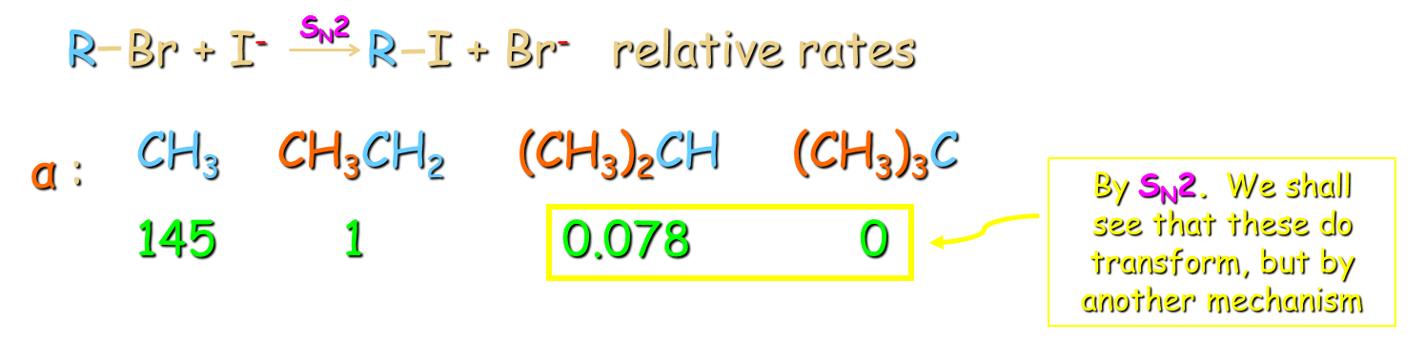
Some Observations
Recall from Chapter 6:
Indeed:
+
Moderate rate
+
(CH₃)₂CH Br
H OH
(CH₃)₂CH OH
H Br
Hydrolysis
Secondary
Lousy Nu
+
Fast!
+
(CH₃)₃C Br
H OCH₃
(CH₃)₃C OCH₃
H Br
Methanolysis
Tertiary!
Lousy Nu
Generally: “Solvolysis”

Slide 3
A New Mechanism
1. Rate = k [R-L], 1st order unimolecular, only R-L in rate-determining TS: “bottleneck”.
2. Stereochemistry: not stereospecific, i.e. enantiomerically pure starting material leads to (extensively) racemic products; pure cis (or trans) gives cis/trans mixtures, etc..
Both observations inconsistent with S_{N}2 mechanism

Slide 4
3. Accelerates with polar (best with protic, in contrast to S_{N}2) solvents:
O
Hexane < CHCl₃ < CH₃CCH₃ < CH₃OH
4. Accelerates with better L
L: Cl < Br < I < OSO₂R
5. Product determining steps occur after “bottleneck”: competition between Nu’s.
+
-
k₁
(CH₃)₃CCl
+
CH₃OH
+
Na N₃
Intermediate
..
-
:
+
:
-
CH₃OH
:
:
.
.
N
N
N
k₂
k₃
.
.
(CH₃)₃OCH₃
(CH₃)₃CN₃ wins
.
.
k₃
>
k₂
>
k₁

Slide 5
What Is The Intermediate? Mechanism
1.
Electron deficient!

Slide 6
2.

Slide 7
3.

Slide 8
The Mechanism Explains The Data
1st Order rate law
Racemization
Acceleration in polar solvents
Acceleration with better L
Product determining step occurs after rate determining step
Unimolecular nucleophilic substitution:
S_{N}1
SN1

Slide 9
S_{N}2 Versus S_{N}1
“Bottleneck”
Bottleneck:
SN1PotE

Slide 10
Racemization
In practice: Often, slight inversion is observed, due to “ion pairing”, R⁺····Br⁻.
SN1Racem

Slide 11
The Strong Effect Of Polar Solvents On The S_{N}1 Reaction
Increasing solvent polarity speeds reaction
Increasing solvent polarity retards reaction

Slide 12
As Expected: Good Leaving Groups Accelerate The S_{N}1 Reaction

Slide 13
The Nucleophile Has No Effect On The Rate Of The S_{N}1 Reaction
All reactions take place at the same rate k₁.
But in competition, the better Nu wins.

Slide 14
What Makes S_{N}1 Possible?
1. α-Branching slows competing S_{N}2.
2. α-Branched carbocations are stabilized by hyperconjugation.
H
+
<
+
+
+
+
CH₃
CH₃CH₂
(CH₃)₂CH
(CH₃)₃C
C
C
Energetically inaccessible in solution
The only cations feasible in solution

Slide 15
Hyperconjugation
Django
Lip

Slide 16
Reactivity Of R-X In Substitutions
R_{prim}-L : no S_{N}1, only S_{N}2
R_{tert}-L : only S_{N}1, no S_{N}2 R_{sec}-L : both
S_{N}2/S_{N}1 ratios difficult to predict, except in “stacked" cases, such as:
-
DMF
-
(CH₃)₂CH Cl
+
CH₃S
(CH₃)₂CHSCH₃
+
Cl
S_{N}2
(CH₃)₂CH OSO₂CF₃
+
H₂O
(CH₃)₂CHOH
+
S_{N}1
Solvent
CF₃SO₃H

Slide 17
Substitutions Of R-X Overview

Slide 18
Problem:
-(CH₃)₂S
S_{N}2 or S_{N}1 ?

Slide 19
Elimination: E1
(-)
(-)
When Nu acts as B the intermediate cations of the S_{N}1 reaction are deprotonated: Elimination E1 to alkenes, a competing reaction:
:
:
L
+
-
B
C
C
:
C
C
-
C
C
–BH
–L
H
H
E1, proton loss to base (solvent in solvolysis)
S_{N}2, B:⁻ acts as Nu:⁻
Nu
C
C
H

Slide 20
Methanolysis Of 2-Bromo-2-Methylpropane

Slide 21
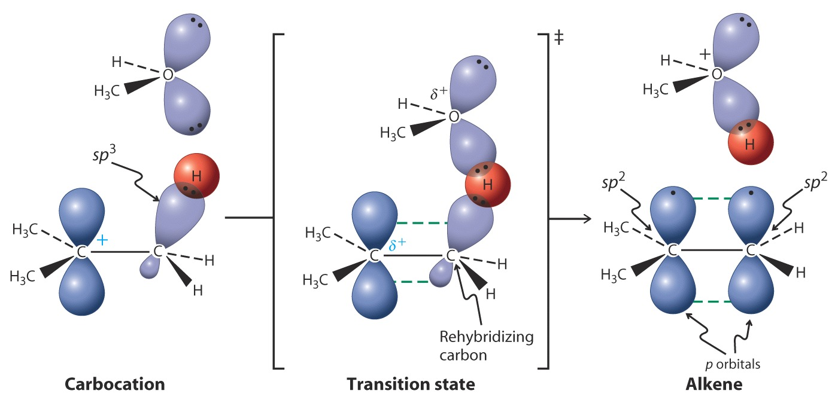
The Deprotonation Step
Hyperconjugation
We usually omit the base in deprotonations and
simply write “-H⁺ ”.
Orb
Lip
Notes:
2:26 Caruso Tosca E lucevan le stelle

Slide 22
Mechanism Of E1
Consistent with this picture, the ratios of S_{N}1 to E1 products are independent of L

Slide 23
E1 Gives Mixtures Of Alkenes
All neighboring C H in cation are acidic:
:
:
.
CH₃OH
CH₃OH
:
+
:
Mixture
-
Cl
+
H
Cl
CH₃
CH₃O
:
H
+
+
+
“Regio-” (constitutional) and stereoisomers (cis/trans)
+

Slide 24
E1/S_{N}1 Ratios Are Difficult To Predict
Generally: Increasing amounts of E₁ products are formed with:
1. Higher T, because entropy of elimination is positive: (RX is converted to alkene plus HX).
Recall: ∆G° = ∆H º–T∆Sº, hence positive ∆Sº makes ∆G° more negative.
2. Very poorly nucleophilic medium (slows S_{N}1), e.g: nonhydroxylic solvent, poor nucleophiles (e.g., SO₄²⁻, CO₃²⁻).
Why not strong base? Yes, but changes the mechanism once again.

Slide 25
Bimolecular Elimination E2
Strong base attacks R-L directly at β-H: E2 (faster than S_{N}1/E1 — and S_{N}2 if sterically hindered)
Mechanism:
-
1. Rate = k[R-L][ B]
2nd order bimolecular TS
:
2. L leaves in TS: RCl RBr RI
+
3. H removed in TS: deuterium isotope
effect k_{H}/k_{D}~ 7
L
*
*
4. Stereochemistry:
Anti-TS
C
C
-
B
H
:

Slide 26
The E2 Reaction is Stereospecific
One diastereomer of RX gives only one stereoisomer of alkene product:
R,R/S,S gives only E

Slide 27
S,R/R,S gives only Z

Slide 28
The Transition State of the E2 Reaction
TS: staggered, best overlap, least e-repulsion
Cream
E2
Walba

Slide 29
Anti Versus Syn E2

Slide 30
Hindered Bases Ensure E2
Steric hindrance slows or shuts down competing S_{N}2

Slide 31
Mechanisms By Which Haloalkanes React With Nucleophiles (Bases)

Slide 32
Factors That Affect The Competition Between S_{N} And E
Factor 1: Base strength of the nucleophile
Weak Bases
Substitution more likely
-
-
-
-
H₂O
H₂O
ROH
ROH
PR₃
halides
RS
,
,
,
,
N₃
NC
RCOO
,
,
,
,
,
Strong Bases
Likelihood of elimination increased
-
-
-
-
HO
RO
H₂N
R₂N
,
,
,
Factor 2: Steric hindrance around the reacting carbon
Sterically unhindered
Sterically hindered
Primary haloalkanes
Branched prim, or sec and tert haloalkanes
Substitution more likely
Likelihood of elimination increased

Slide 33
Factor 3: Steric hindrance in nucleophile (strong base)
Sterically unhindered
Sterically hindered
-
-
-
-
-
-
HO
,
CH₃O
,
CH₃CH₂O
,
H₂N
(CH₃)₃CO
,
[(CH₃)₃CH]₂N
Substitution may occur
Elimination strongly favored

Slide 34
Problem:
An alkene
1. Mechanism: S_{N}2 S_{N}1 E2 E1?
2. At lower temperatures one of the following ratios will increase:
S_{N}2 / S_{N}1 S_{N}1 / E1 E2 / E1 S_{N}2 / E2

Slide 35
Reactivity Of Primary Haloalkanes
R-X With Nucleophiles (Bases)
For unhindered primary R X :
S_{N}2 with good nucleophiles that are not strongly basic
-
Acetone
-
CH₃CH₂CH₂Br
+
CN
CH₃CH₂CH₂CN
+
Br
S_{N}2 with good nucleophiles that are also strong bases
-
CH₃OH
-
CH₃CH₂CH₂Br
+
CH₃O
CH₃CH₂CH₂OCH₃
+
Br
But E2 with strong, hindered bases
CH₃
-
(CH₃)₃COH
CH₃CH₂CH₂Br
+
CH₃CO
CH₃CH
CH₂
HBr
CH₃
No (or exceedingly slow) reaction with poor nucleophiles
(CH₃OH)

Slide 36
For branched primary R X :
S_{N}2 with good nucleophiles (although slow compared with unhindered RX)
CH₃
CH₃
Acetone
-
-
CH₃CCH₂Br
+
I
CH₃CCH₂I
+
Br
H
H
E2 with strong base (not necessarily hindered)
CH₃
CH₃
-
CH₃CH₂OH
CH₃CCH₂Br
+
CH₃CH₂O
CH₃C
CH₂
HBr
H
No (or exceedingly slow) reaction with poor nucleophiles or neopentyl systems (in which E is not possible)

Slide 37
Reactivity Of Secondary Haloalkanes R-X With Nucleophiles (Bases)
S_{N}1 and E1 when X is a good leaving group in a highly polar medium with weak nucleophiles
CH₃
CH₃
CH₃CH₂OH
CH₃CBr
CH₃COCH₂CH₃
+
CH₃CH
CH₂
HBr
H
H
Major
Minor (more on increasing T)

Slide 38
S_{N}2 with high concentrations of good, weakly basic nucleophiles
CH₃
CH₃
-
CH₃CH₂OH
-
CH₃CBr
+
CH₃S
CH₃CSCH₃
+
Br
H
H
E₂ with high concentrations of strong base (for example, HO or RO in alcohol solvent)
-
-
CH₃
-
CH₃CH₂OH
CH₃CBr
+
CH₃CH₂O
CH₃CH
CH₂
HBr
H

Slide 39
Reactivity Of Tertiary Haloalkanes R-X With Nucleophiles (Bases)
S_{N}1 and E₁ in polar solvents when X is a good leaving group and only dilute or no base is present
CH₃
CH₃
HOH, acetone
alkenes
CH₃CH₂CBr
CH₃CH₂COH
+
HBr
CH₃
CH₃
E₂ with high concentrations of strong base
H₃C
CH₂
-
H₃C
CH₂
CH₃O, CH₃OH
CH₃CH₂CCl
CH₃CH₂C
HCl
CHCH₃
H₃C
CH₂

