Slide 1
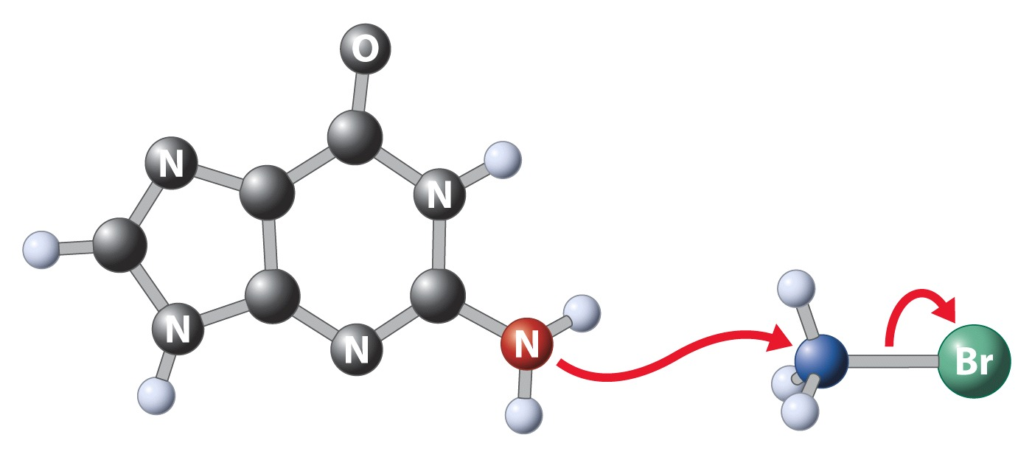
Chapter 6: Nucleophilic Substitution of Haloalkanes
Guanine base of DNA
Leaving group
Nucleophile
Nucleus
Toxic

Slide 2
Haloalkanes
+
-
C
X
Names: Halo- is a substituent to alkane stem
3
1
F
I
CH₃
4
2
Cl
Br
R
S
1-Chlorobutane
2-Iodo-2-methylpentane
(1S,2R)-1-Bromo-2-fluorocyclohexane

Slide 3
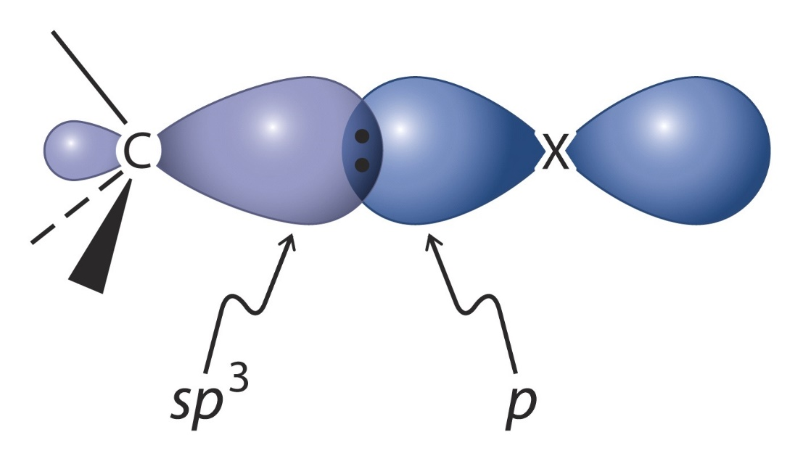
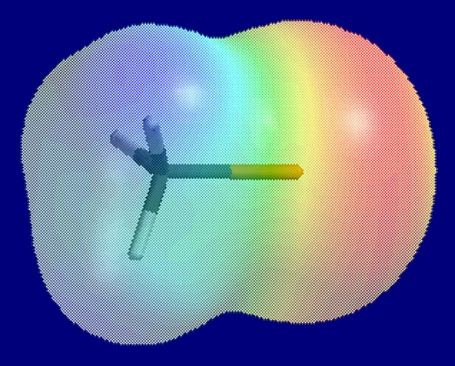
The C-X Bond is Polarized
Dipole
+
-
CH₃
Cl
Electrophilic

Slide 4
Physical Properties of R-X
Bonds get longer and weaker along the series F→I
Boiling points are higher than for R-H and increase along the series F→I
and
London forces (polarizability)
X gets larger and less electronegative

Slide 5
Nucleophilic Substitution: General
Color scheme: Nu, E, L, and curved arrows: e-flow
-
-
Nu
+
C
X
Nu
C
+
X
Nucleophile (Nu)
Electrophile (E)
Leaving group (L)

Slide 6
Remember Acid-Base Reaction
-
-
B + H A B H + A
Conjugate acid
Conjugate base
-
-
B = Nu
When H is attacked, we call the e-rich species a base B.
When C (or other nuclei) are attacked, we call it a nucleophile Nu.

Slide 7
Large Number of Reactions
Tertiary halides are notably absent from this list.
Note: no (simple) ΔH º calculations possible on ionic reactions; bond strengths refer to homolytic, not heterolytic, dissociation.

Slide 8
Mechanism
How do we study it ?
Kinetics (rates and their dependence on concentration and temperature)
Stereochemistry (R, S, cis, trans)
Modify substituents: look for electronic and steric effects
Modify reagents/subtrates: Nu, E, L, solvent

Slide 9
Kinetics
-
-
For HO + CH₃ Cl CH₃OH + Cl
-
Rate = k [CH₃Cl][ OH] 2nd order
Points to bimolecular mechanism, i.e. both starting materials are incorporated in the transition state.
Hence name: S_{N}2 bimolecular, nucleophilic substitution

Slide 10
The Transition State
Bimolecular nucleophilic substitution goes in one-step (i.e. no intermediates). Bond making occurs at the same time as bond breaking. Such a process is called a concerted reaction.
―
?
What is the TS structure?
We can look at stereochemistry:
[HO···CH₃Cl]‡
E
CH₃Cl
+ ⁻OH
CH₃OH
+ Cl⁻
Two extreme approaches of Nu :
C
X
Back
Front

Slide 11
Stereochemical Test
Frontside attack: Retention of configuration.
Backside attack: Inversion of configuration.
chiral
Which one is it? Perform the reaction on an enantiomer of a chiral haloalkane
*
C
X

Slide 12
Experiment
H
H
-
S
-
R
C
Br
+
I
I
C
+
Br
H₃C
CH₃
CH₃CH₂
CH₂CH₃
Result: Inversion (no S -product). The reaction is said to be stereospecific.

Slide 13
The S_{N}2 Transition State
PotE
Segov
Lip
Notes:
1:45SwingBrotherSwing

Slide 14
Chemical Consequences of Inversion
1. Retention by double inversion
-
-
H
+
H
+
H
I
H S
C
Br
I
C
C
SH
-
-
R
-
Br
R
-
R
I
CH₃
CH₃
CH₃
2. Inversion does not necessarily mean: R S
CH₃S
a
SCH₃
b
-
-
S
a
b
S
+
CH₃CH₂O +
X
H
C
Br
CH₃CH₂O
C
H
H₃C
CH₃
c
c

Slide 15
3. Diastereoisomerization (same for racemates)
CH₃
CH₃
-
S
Br
I
- Br
I
R
H
H
R
-
R
CH₃CH₂
H
CH₃CH₂
H
CH₃
CH₃
Br
H
H
CN
-
S
CN
- Br
S
S
R
-
H₃C
H
H₃C
H
Br
-
I
I
-
- Br
Cis
(racemic)
Trans
(racemic)
CH₃
CH₃

Slide 16
Leaving Group Ability of “L”
(a kinetic measure)
compare
-
Nu
+
C
L
B + H A
A good L⁻ is also a weak base A⁻.
Remember from the discussion on acidity:
A weak base can accommodate e-pair (charge) well:
electronegativity and (indirectly) bond strength, resonance, size of A (polarizability)

Slide 17
Halides as L
-
-
-
-
F < Cl < Br < I
L increasing going down periodic table (PT). Same trend as acidity in HX:
HF HCl HBr HI
pK_{a} 3.2 -2.2 -4.7 -5.2
Why?
Because:
DHº 135 103 87 71
Goes down in PT
and orbital size increases from 2p to 3p to 4p…
As noted earlier: This trend is opposite that expected on the basis of electronegativity (goes down in PT).

Slide 18
Along A Row of PT: L Increases To The Right
(same trend as acidity)
R L or H A
CH₃< NH₂< OH< F :
pK_{a} 50 35 15.7 3.2
decreases, but
DHº 105 107 119 135 increases
and size of orbital decreases.
Electronegativity wins !
-
In practice: only F is a (poor) leaving group in this row. Hydroxide can be, in rare special cases.

Slide 19
Resonance and L
Generally: L increases to the right and down PT. But, superimposed on these trends: Resonance.
-
RO :
For example, for same leaving atom, e.g.,
O
O
-
-
-
CH₃O < CH₃CO < CH₃S O
O
pK_{a} : 15.5 4.7 -1.2
(of acid)

Slide 20
Neutral L Is Good
(relatively nonbasic)
Examples:
1. Protonated alcohols: L = H₂O
+
-
+
H
Nu
R OH
+ H
R O
R Nu + H₂O
H
Pulls electrons
+
Generally: R L: + acid A R L A
2. Diazonium ions: L = N₂ , a superleaving group
+
-
R N N + Nu R Nu + N N

Slide 21
Nucleophilicity “Nu”
(a kinetic measure)
Affected by charge, basicity, solvent, polarizability, sterics.
1. Charge (for same atom):
-
-
2-
-
HO > H₂O ; H₂N > H₃N ; SO₄ > ROSO₃
The more charged, the more nucleophilic

Slide 22
2. Basicity: Decreases to the right in periodic table, so does Nu:
-
-
-
-
H₃N > H₂O ; H₂N > HO ; HO > F
Neutral versus charged Nu: (see pK_{a} table)
-
-
-
H₂N > HO > H₃N > F > H₂O
As expected: Trend is opposite L ability

Slide 23
Solvation
3. Basicity: Decreases down the periodic table, but Nu: increases. The reason: Solvent effects and polarizability (deformability of orbital of ) have a strong influence.
For charged Nu⁻ : mainly solvation by protic or highly polar solvents, used frequently to dissolve Nu⁻ salts.
Nu
-
+
+
Protic solvents have acidic H ; e.g., RO H. They surround charged Nu using hydrogen bonds:
-
RO H
-
Nu H OR
RO H

Slide 24
Protic Solvents: Fluoride is a Worse Nucleophile Than Iodide
Hydrogen bonds
-
Solvent shell increases “size” of Nu , hence nucleophilicity increases going down PT.

Slide 25
Polarizability
Nucleophilicity increases going down PT for another reason: Larger elements have larger, more diffuse, and more polarizable electron clouds. This allows for more effective orbital overlap in the S_{N}2 transition state.
Applies also to uncharged Nu, for which solvation effects are minor: H₂O < H₂S < H₂Se (CH₃)₃N < (CH₃)₃P

Slide 26
Polar Aprotic Solvents
Dissolve salts without forming H bonds. Hence the Nu is much less impeded: “naked” anions. This causes large rate increases and trend in nucleophilicity follows basicity.
-
MeOH
DMF

Slide 27
Steric Effects
-
-
Nu
+
C
L
Nu
C
+
L
Nucleophile (Nu)
Electrophile (E)
Leaving group (L)
Sterics for L: Larger = better leaving group
Sterics for Nu: Larger = worse nucleophile
e.g., CH₃O > (CH₃)₃CO (CH₃)₂NH > [(CH₃)₂CH]₂NH
-
-
Sterics around C are the most significant.

Slide 28
Steric Hindrance At The Electrophilic Carbon Center Slows the S_{N}2
-
-
R Br + I R I + Br relative rates
S_{N}2
Alpha versus beta branching:
Reaction center
γ
C
α
“Lingo”:
C
β
C
C
L
α :
CH₃ CH₃CH₂ (CH₃)₂CH (CH₃)₃C
145 1 0.078 0
By S_{N}2. We shall see that these do transform, but by another mechanism
CH₃CH₂ CH₃CH₂CH₂ (CH₃)₂CHCH₂ (CH₃)₃CCH₂
β :
1 0.8 0.03 slow! 10⁻⁵

Slide 29
Alpha Branching

Slide 30
Beta Branching
DireS
Walba

