Slide 1
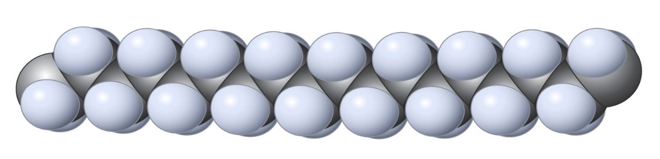
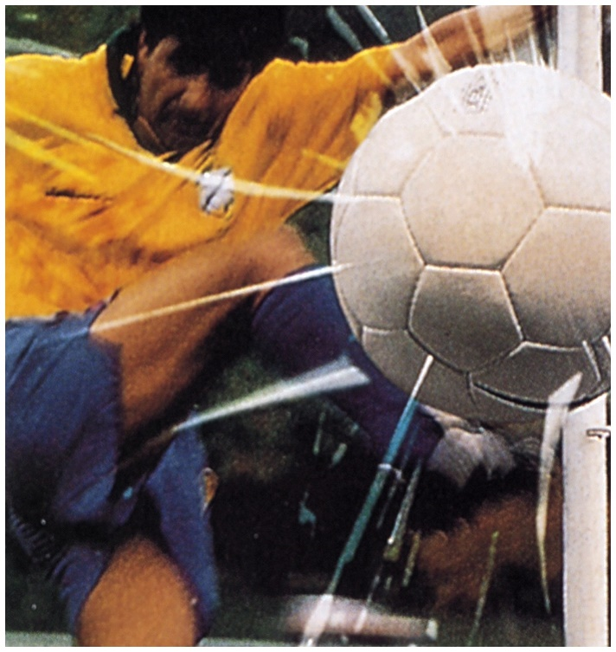
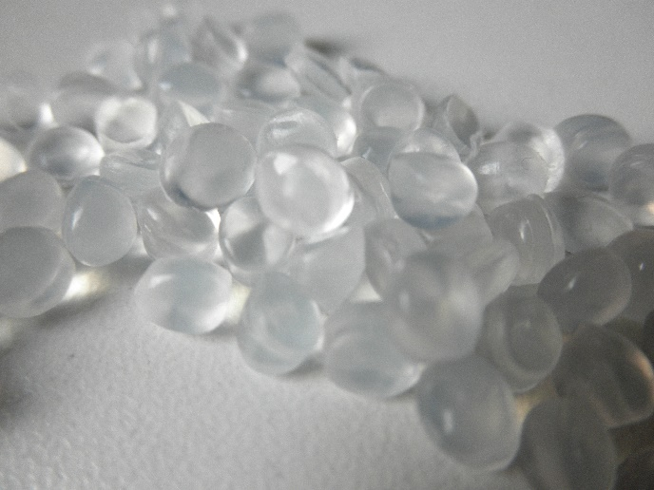
Chapter 12: Reactions Of Alkenes
Fundamental building blocks for organic transformations and polymer materials synthesis
Polyethylene
Tear resistant

Slide 2
Addition Reactions Of Alkenes
π Bond is unsaturated: Reacts by addition.
C
C
+
A
B
C
C
exothermic (usually)
A
B
We can calculate ∆Hº of addition reaction from bond strength data, using DHº_{π-bond} = 65 kcal mol⁻¹. Note, however: ∆Sº is negative (~ -30 e.u.)

Slide 4
1. Catalytic Hydrogenation
+
H
H
Catalyst
Typical catalysts are heterogeneous: insoluble solids
C
C
C
C
H
H
H₂
Pd/C, PtO₂ ( Pt)
Why catalysts? Enable a lower E_{a} mechanism.
Alkenes + H₂ no reaction without catalyst
Uncatalyzed pathway
E
Catalyzed pathway

Slide 5
Stereochemistry
Stereospecific H-H addition from the same side (syn) of double bond.
H
CH₃
cat.
cis
+
H₂
CH₂CH₃
H
H
D
cat.
+
D₂
+ SS
R
R
H
trans
D

Slide 6
Mechanism
Reversibility causes cis to trans isomerization

Slide 7
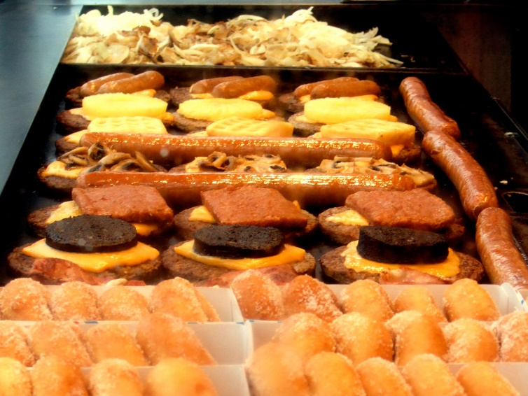


Hydrogenation “Hardens” Oils, But Generates Trans Fatty Acids
The fatty acid molecules in butter and hard (stick) margarines are highly saturated, whereas those in vegetable oils have a high proportion of cis-alkene functions (more than 90%). Partial hydrogenation of these oils yields soft (tub) margarine. Conditions of hydrogenation also isomerize cis double bonds to trans.
Trans fatty acids are not metabolized in same way as cis counterparts: accumulate in cell membranes Ù increased risk of breast cancer and heart disease.
FDA: phase out by 2018.
Oleic acid is a cis unsaturated fatty acid making up 55–80% of olive oil
Elaidic acid is the principal trans unsaturated fatty acid often found in partially hydrogenated vegetable oils.
Stearic acid is a saturated fatty acid found in animal fats and is the intended product in full hydrogenation.
Notes:
On 7 November 2013, the FDA issued a preliminary determination that trans fats are not "generally recognized as safe", which was widely seen as a precursor to a reclassification of trans fats as a "food additive," meaning they could not be used in foods without specific regulatory authorization. This would have the effect of virtually eliminating trans fats from the US food supply.^{[148][149]} The ruling was formally enacted on 16 June 2015, requiring that within three years, all food prepared in the United States must not include trans fats, unless approved by the FDA.^{[150]}Themicrobiology and historical
safety of margarine
S. Delamarre and C. A. Batt*
Themicrobiology and safety ofmargarine are reviewed fromthe perspective of itsmaterial composition
and the historical absence of foodborne illness incidents associated with the consumption of this pro-
duct. Intrinsic factors limit the growth of most micro-organisms, including pathogens. Margarine is a
water-in-oil emulsionwith a high fat content that limits the growth of most prokaryotic and eukaryotic
micro-organisms.The size of the aqueous phase droplets and the inability ofmicro-organisms tomove
between droplets also reduce the ability of margarine to support microbial growth. In addition, de-
pending upon the formula, up to 2% salt may be added which further reduces the ability of most mi-
cro-organisms to grow. The addition of preservatives such as sorbates can reduce spoilage problems.
Spoilage,when it is observed, is typically caused bymoldswhich can extendmycelia into the oil phase.
The use of raw material speci¢cations and the implementation of a Hazard Analysis Critical Control
Point systemcan be e¡ective in enhancing the microbiological quality of margarine.The safety ofmar-
garine is documented by the lack of any veri¢ed incidences of foodborne illness resulting from the
consumption of margarine. # 1999 Academic Press
Introduction
Margarine is one of many types of edible ta-
ble spreads that includes milk-fat spreads,
fat spreads of the margarine type and mixed
fat or blended spreads. Margarine is used for
a variety of purposes ranging fromcooking to
application on bread as well as host of other
foods. Margarine, and yellow fat spreads, like
butter, are water-in-oil emulsions where the
fat is continuous throughout the matrix and
may comprise up to 80% fat. Concern about
the consumption of excessive fat in the over-
all diet has prompted the formulation of
lower fat products where a number of
ingredients are added to stabilize the pro-
duct and substitute for the mouth feel and
other organoleptic properties conferred by
the fat. Margarines with fat levels as low as
3%, and fat-free (within the de¢nition of
NLEA) have been reported. More recently,
an interest in limiting the amounts of satu-
rated fats in the diet have motivated the mar-
keting of margarines high in polyunsatu-
rated fatty acids.
Composition
In many countries, the formulation of mar-
garine is strictly mandated. For example, in
the United States, the Food and Drug
Administration states that, `Margarine (or
REVIEWARTICLE
*Corresponding author.
Received:
1 June 1999
Department of Food
Science, Cornell
University, Ithaca,
NewYork14853, USA
0740-0020/99/040327 + 07 $30.00/0 #1999 Academic Press
FoodMicrobiology, 1999, 16, 327^333 Article No. fmic.1999.0304
Available online at http://www.idealibrary.com on
oleomargarine) is the food in plastic or liquid
emulsion containing no less than 80% fat'
(FDA 1991). In Europe, these products are `ob-
tained from vegetable and/or animal fats with
a fat content of not less than 80%but less than
90%' (EC 1995).
Products that are classi¢ed as margarines
are made from water, oil and fat, with minor
ingredients such as milk (and milk products),
preservatives, acidulants and salt. Lard and
other animal fats such as tallow were used to
produce margarine during the early part of
the century, although they have been largely
replaced by vegetable oils and fats. Variations
in the formulation of margarine are mainly
governed by a desire to create products with
a particular cooking performance, spread-
ability at refrigerator temperatures, and £a-
vor release and stability. Other optional
ingredients also include vitamin A and D. Ci-
tric and lactic acid are used to acidify the pro-
duct. Preservatives are sometimes used in
margarine to increase shelf life of the pro-
duct. Sorbate and benzoate up to 0?1% indivi-
dually and 0?2% in total are allowed in the
US. In addition, calcium disodium ethylene-
diaminetetraacetic acid (EDTA) up to
0?0075% is also allowed.
The process for making margarine typically
involves the formation of an emulsion by mix-
ing a pasteurized aqueous phase that contains
all of the water-soluble ingredients, including
preservatives, with the oil phase that consists
of oil-soluble emulsi¢ers and £avors. The ob-
jective of the emulsifying process is to make
the mixture a stable fat-continuous product
with the aqueous phase distributed in it. The
product is worked through a series of pumps
and heat exchangers into a ¢ne emulsion.
Most margarine processes are carried out in
batch. The small water droplet size in the
emulsion makes it a unique and relatively in-
hospitable environment for the growth of mi-
cro-organisms. Fine water droplets ranging
in size from 1±20 mm are dispersed in the oil
phase (Fig. 1).
The composition and processing regiment
will determine the type of margarine pro-
duced, ranging from soft spreadable products
that are packed in tubs to hard sticks or blocks
that are packaged in wrappers.
Intrinsic factors a¡ecting
microbial growth
The composition of margarine precludes the
growth of most micro-organisms, especially
those that are considered to be potential patho-
gens (Table 1). The composition of margarine
coupled to the process by which micron-size
aqueous phase droplets are formed to create
an emulsion are very e¡ective barriers to
microbial growth.
One of the most likely intrinsic factors limit-
ing the ability of micro-organisms to grow in
margarine is the sequestering of the aqueous
phase in the oil phase. The ¢ner the emulsion
and hence the smaller the aqueous phase drop-
let size, the more limited the interior area avail-
able for microbial growth and the lower the
quantity of nutrients available in a droplet. Con-
sequently, a ¢ne emulsion limits the number of
generations a bacteria can replicate (Catteau
1985). Comparative measurements of the
growth rate of non-lipolytic bacteria in water-
in-oil emulsions as compared to water phase
alone reveal that they are less likely to grow in
the former rather than the latter (Verrips and
Zaalberg 1980).While the growth ofEnterobacter
and Staphylococcus is robust in a water phase
whose composition simulates that of margar-
ine, they do not grow in margarine. In margar-
ine, the increase in the number of Enterobacter
was not signi¢cant as compared to a four-log
increase in a simulated water phase at abuse
temperature of 208C. Similarly, the increased
Figure 1. Photomicrograph of margarine emul-
sion using di¡erential interference contrast optics.
(Total magni¢cation:61000.)
328 S. Delamarre and C. A. Batt
number of cfuml71 of Staphylococcus was not
signi¢cant in margarine while increasing
three-log in the analogous water phase over a
4-day period at abuse temperature of 208C.
There is also some evidence to indicate the pre-
sence of hydrogen peroxide in edible oils would
provide another measure of bacteriocidal char-
acteristics to margarine (Coxon et al. 1987).
The emulsion characteristics of margarine
help to determine its stability and shelf-life.
Models have been reported to quantify the rela-
tionship between microbial stability and emul-
sion droplet size. Such models require that the
microbiological growth characteristics of the
relevant micro-organisms, the concentration
of nutrients and the emulsion characteristics
are known (Klapwijk 1992) (Fig. 2). The emul-
sion can be characterized by pulsed ¢eld gradi-
ent NMR which can be used to assess the mean
diameter of the droplet. Although this can also
be done microscopically, it is not practical to
generate quantitative data due to the tedious
method for manual data collection. In margar-
ines, the average droplet size is 4±5 mm with a
range from 1 to 20 mm.When the droplet size is
less than 10 mm, it is doubtful that these restric-
tive environments will allow a micro-organism
to grow.
Beyond the limited growth of micro-organ-
isms in the droplet, only a small fraction of the
droplets would be expected to be contaminated
with even a single micro-organism. Therefore,
one control point in margarine production that
has a positive a¡ect on safety is creating and
Table 1. The principal ingredients permitted by the IDFand IFMA amended draft Codex Standard which
a¡ect the microbiology of edible table spreads (Codex 1993)
Processing aids
Bacterial cultures Lactococcus lactis subsp. lactis, L. lactis subsp. cremoris
and L. lactis subsp. lactis biovar diacetylactis
Food additives
Preservatives Sorbic acid (E200)
Sodium (E201), potassium (E202) and calcium (E203) sorbate
Benzoic acid (E210)
Calcium (E211), sodium (E212) and potassium (E213) benzoate
pH correcting agents Acetic acid (E260)a
Lactic acid (E270)
Sodium (E325), potassium (E326) and calcium (E327) lactates
Citric acid (E330)
Sodium (E331), potassium (E332) and calcium (E333) citrates
Calcium orthophosphate (E341)a
Potassium orthophosphate (E340)a
Sodium carbonate (E500a)
Sodium hydrogen carbonate (E500b)a
Sodium hydroxide (E524)a
Calcium hydroxide (E526)a
Miscellaneous Gases such as argon (E938), nitrogen (E941), nitrous oxide (E942),
hydrogen (E947), oxygen (E948) and carbon dioxide (E290)
Sorbitol (E421) and mannitol (E421)
L-cysteine (E920) and L-cysteine hydrochloride (E921)
Othera Emulsi¢ers
Thickeners/stabilizers
Antioxidants
Antioxidant synergists
Optional ingredients
Miscellaneous Sodium chloride, egg yolk, sugars, edible protein, natural starches, milk
and its constituents, mono-, di- and oligosaccharides and maltodextrins
a Permitted in all products except butter.
Margarine safety 329
maintaining a ¢ne emulsion that is stabilized
and not allowed to coalesce. In the industry of
reduced fat margarines, constant vigilance
must be maintained because of the higher con-
tent of water in these products. Models are
then established to predict the stability of aqu-
eous phases and the stabilizing contribution of
the emulsion.
The water-in-oil emulsion base of margarine
is a relatively inhospitable environment for the
growth of micro-organisms. As with all ingre-
dients, their quality should be commensurate
with the desired shelf-life of the product. Oils
do not appear to cause anymicrobiological pro-
blem. Spores can be found as contaminants but
their development in fat is stopped. Above all,
thewater used for manufacturing should be po-
table. Salt may be added up to 2% in the overall
product, which can be as high as 8%in the aqu-
eous phase, depending on water content. Other
ingredients added to margarines, and margar-
ine blends can be a source of contamination.
Milk and dairy-based ingredients are one
potential source and in the single report of
enterotoxin contamination of margarine-like
products, the dairy ingredients are suspect.
Milk destined for margarine manufacturing is
pasteurized and as such meets those microbio-
logical criteria. It is eventually acidi¢ed by in-
oculation with a selected acid bacterium and
fermented. In addition to acidi¢cation by pro-
duction of lactic acid, the fermentation devel-
ops a particular £avor (diacetyl) (Catteau
1985), which has also been reported to have
antimicrobial properties (Jay 1982). Spore form-
ing bacteria, notably Bacillus cereus frequently
contaminate whey powders. Other ingredients
may also be sources for micro-organisms in-
cluding spices and herbs; typically, the aqueous
phase containing those ingredients is pasteur-
ized prior to the formulation of the emulsion.
As with all food ingredients, speci¢cations to
insure that they are free of pathogens if subse-
quent processing steps are not su¤cient to vir-
tually eliminate them are recommended.
Spoilage
Spoilage is an issue with margarines and is the
major problem considering the relative physi-
cal stability of the product in the absence of
severe temperature abuse.Vegetable oils are be-
lieved to be more resistant to lipolysis than, for
example, butterfat. Yeasts and molds are
among the most frequently encountered spoi-
lage organisms associated with margarine.
Among the yeasts and molds that have been
isolated from margarine are Trichoderma vir-
ide, Aspergillus spp., Geotrichium candidum,
Cladosporium, Alternaria, Paecylomyces, Rhizo-
pus, Candida lipolytica and Penicillium spp.
INPUT OUTPUT
(1) Chemical composition of the aqueous
phase (derived fromthe product
formulation)
Ðconcentration of carbon source
Ðconcentration of energy source
(2) Physiological characteristics of the
micro-organism
Ðbiomass per individual cell
Ðmaximum density
Ðsize
Ðbiomass yield on carbon-source
Ðmaintenance energy demand
Computer program
öööööööööö"
Growth factor allowed
by the water-in-oil
emulsion (calculated
multiplication rate),
assuming a certain
microbiological
contamination
(3) Water droplet size distribution
Ðvolume weighted mean
Ðdistribution width
Figure 2. Predictive modelling of growth in water droplets in water-in-oil emulsions (Klapwijk 1992).
330 S. Delamarre and C. A. Batt
(Beerens 1980). Spoilage of margarine by molds
may be visually manifested by the appearance
of mycelia growing on and into the margarine.
Unlike bacteria and yeasts, molds have the
ability to transit through the oil phase. Mold
growth, however, may not be evident but they
generate free fatty acids which produce o¡-£a-
vors and break down the emulsion. From di¡er-
ent spoiled margarines, salted and non-salted,
several strains of the yeast Candida lipolytica
were isolated and identi¢ed (Castanon and In-
igo 1971b). The organisms' predominant role in
margarine and yellow fat spread degradation
was suggested due to the large number of isola-
tions which were found in all examined sam-
ples. Hocking (Hocking 1994) examined a total
of 42 spoiled margarine samples collected from
1991 to 1993 (Table 2). The predominant mold
genus was Penicillium and accounted for ap-
proximately 95% of the spoilage.The most com-
mon species was P. expansum and spoilage
occurred mainly in low salt varieties. The
growth rate of yeast and molds in a margarine
water phase over a 72-h period at abuse tem-
perature of 208C, was as high as 230-fold for
the yeast Candida lipolytica and as low as 0?1
for Fusarium (TuynenburgMuys 1971).
While not a safety hazard, many of the spoi-
lage molds including P. expansum produced
geosmin (trans-1,10-dimethyl-trans-9-decalol),
which is responsible for the earthy note ob-
served in spoiled margarine. Other o¡-£avors
resulting from the production of metabolites
by Penicillium solitum include ketones (heptan-
2-one to undecan-2-one); small quantities of
2-methylisoborneol have also been reported
(Hocking et al. 1998).While many compounds
have been identi¢ed which adversely a¡ect the
odor of margarine, no contamination by myco-
toxins has been reported.Toxins are thought to
remain in the cattle cake during oil extraction.
Direct challenge of margarine with Byssochla-
mysfulva failed to show the production of bysso-
chlamic acid even after 7 months of growth
(Schmidt and Rehm 1969).
The predominant bacterial micro£ora asso-
ciated with margarine spoilage tends to be
lipolytic organisms. They can cause a break-
down in the emulsion due to the production of
various extracellular compounds including
lipases and surfactants. Lipolytic bacteria
associated with the spoilage of margarine
include Pseudomonas, Flavobacterium, Micro-
cocci, Zymomonas and Bacillus. In non-salted
margarines with a pH around 5, Pseudomonas,
notably P. oleovarans and P. fragi,may lead to in-
tense lipolysis but may also cause proteolytic
spoilage (Beerens 1980). In addition, micrococ-
caceae may develop in margarines of such com-
position and most of these are also strongly
lipolytic. Sweet margarines have Zymomonas
as the most important population (Castanon
and Inigo 1971b, Beerens 1980). The growth of
organisms other than lipolytic bacteria is
Table 2. Fungi isolated from 42 samples of spoiled margarine, 1991±1993 (Hocking 1994)
Frequency
Species Numbera Percentageb
Penicillium expansum 20 47?6
P. chrysogenum 5 11?9
P. glabrum 3 7?1
P. commune 2 4?8
P. corylophilum 2 4?8
Cladosporium 2 4?8
cladosporioides
Species isolated once (2?4%):
Alternaria alternata, Aspergillus niger, Cladosporium herbarum, Curvularia clavata, Fusarium oxysporum,
Gliocladium species, Mucor piriformis. Oidiodendron griseum, Penicellium brevicompactum, P. crustosum,
P. decumbens, P. echinulatum, P. olsonii, P. roqueforti, P. spinulosum, P. verrucosum, Phoma species,
Trichoderma harzianum,Trichoderma species.
a Number of isolates obtained from all samples.
b Percentage of margarine samples containing the species (n = 42).
Margarine safety 331
highly dependent upon the nature of the aqu-
eous phase and the resultant emulsion quality,
i.e. water droplet size as discussed earlier.
Anaerobic conditions retard the growth of
most microorganisms associated with margar-
ine spoilage. As a consequence, most spoilage
appears on the surface of the product.
Foodborne illness
An exhaustive literature search fails to identi-
fy any con¢rmed cases of foodborne illness as-
sociated with the consumption of margarine.
While the possibility cannot be eliminated be-
yond any doubt, the absence of incidents is cur-
ious documentation as to the likelihood that
this product is safe within the context of rea-
sonable manufacturing practices and product
handling.
A number of microbiological surveys of mar-
garine have been carried out addressing both
the spoilage and pathogenic micro£ora. In
addition, surveys for indicator organisms
have been carried out to explore potential
standards. Bacteriological surveys in which
Enterobacteriaceae, Staphylococcus aureus and
streptococci of Lance¢eld's group D were deter-
mined in a total of c.1000 samples, taken at ran-
dom from The Netherlands' production of
margarine, have not provided any indication
for potential risks of foodborne disease (Mos-
sel 1970). In a total of 214 margarine samples,
for example, neither Salmonella nor Shigella
was found. Most Enterobacteriaceae occurring
in margarine were innocuous types (Mossel
1970, Drion andMossel 1977).
Two of the most widely cited incidents
involving margarine is the detection of entero-
toxin from a blended margarine and a case
of fatal listeriosis by a woman who consumed
margarine.
In 1992, the US Food and Drug Administra-
tion recalled a blended margarine and butter
product due to discovery of Staphylococcus en-
terotoxin. Approximately 1?66 million pounds
were manufactured as part of this lot and a
Class III recall was issued. Class III recalls in-
volve a violative product but one which is un-
likely to cause adverse health consequences. It
has been suggested, given the inability of
margarine to support the growth of Staphylo-
coccus aureus, that the enterotoxin entered the
product via butter used in the blended product
(Charteris 1996).
One of the more purported incidents of food-
borne illness associated with the consumption
of margarine was in 1989 and involved a case of
listeriosis resulting in the death of an elderly
woman (Barnes 1989). Listeria is ubiquitous in
the environment although the incidence of ill-
ness associated with it are relatively infre-
quent compared to other pathogens. It can
grow at refrigerated temperatures and sur-
vives at relatively low pH values of approxi-
mately 48. Dairy products have been a vehicle
for Listeria and more recently meat products
including hotdogs and cold cuts have been
implicated. The incident in 1989 involved an
88-year-old woman in the UK who died from
listeriosis. Listeriosis a¥icts the very young,
the elderly and any immunocompromised per-
son.Newspapers reported that Listeriawas iso-
lated from margarine in her refrigerator.
Subsequently, approximately 130 samples of
the margarine were tested and none were
shown to be contaminated with Listeria. Since
Listeria is found in a variety of environments,
isolation from a patient and a suspect food
source do not prove a causal relationship. Only
signi¢cant epidemiological linkage coupled
with molecular typing can provide some level
of proof to link a foodborne pathogen with a
case of illness.
Conclusions
The lack of any con¢rmed foodborne illness
outbreaks over the more than 100 years of mar-
garine consumption suggests that intrinsic fac-
tors in the product limit the survival of
pathogens. Assuring the quality of margarine
and similar products is a function of the selec-
tion of satisfactory rawmaterials and adjuncts,
as well as the implementation of processing
and distribution controls that minimize micro-
bial growth (Chateris 1995). As with most other
food manufacturing processes, the design and
implementation of a Hazard Analysis Critical
Control Point plan will help to de¢ne the essen-
tial points in the process which require
332 S. Delamarre andC. A. Batt
attention enhancing the quality and further in-
suring the safety of margarine (Klapwijk 1992).
References
Barnes, P. (1989) Listeria, a threat to margarine.
LipidTech. 1, 46±47.
Beerens, H. (1980) Hygiene des fabrications et pro-
prietes bacteriologiques des margarines. Rev. Fr.
Corps. Gras 27, 221±223.
Castanon, M. and Inigo, B. (1971b) Estudio micro-
biologico de margarinas alteradas. Microbiol.
Espan. 24, 49±56.
Catteau, M. (1985) Les corps gras alimentaires: as-
pects microbiologiques. Rev. Fr. Corps Gras 32,
55±56.
Charteris, W. P. (1996) Microbiological quality
assurance of edible table spreads in new
product. J. Soc. DairyTech. 49, 87±98.
Chateris,W. P. (1995) Physicochemical aspects of the
microbiology of edible table spreads. J. Soc. Dairy
Tech. 48, 87±96.
Coxon,D.T., Rigby,N.M. et al. (1987) The occurrence
of hydrogen peroxide in edible oils; chemical and
microbiological consequences. J. Sci. Food Agr.
40, 367±379.
Drion, E. F. and Mossel, D. A. A. (1977) The reliabil-
ity of the examination of foods, processed for
safety, for enteric pathogens and Enterobacteria-
ceae: a mathematical and ecological study. J. Hy-
giene 78, 301±324.
EC (1995) Council directive 95/2/EC on food addi-
tives other than colours and sweetners. O¡. J.
Eur. Comm. L61, 1±40.
FDA (1991) Code of Federal Regulations. Margarine.
Washington, D.C., U.S. Government Printing
O¤ce.
Hocking, A. D. (1994) Fungal spoilage of high-fat
foods. Food Australia 46, 30±33.
Hocking,A.D., Shaw,K. J., et al. (1998) Identi¢cation
of an o¡-£avour produced by Penicillium solitum
in margarine. J. Food.Mycol. 1, 23±30.
Jay, J. M. (1982) E¡ect of diacetyl on foodborne
microorganisms. J. Food Sci. 47, 1829±1831.
Klapwijk, P.M. (1992)Hygienic production of low-fat
spreads and the application of HACCP during
their development. Food Control 3, 183±189.
Mossel, D. A. A. (1970) The role of microbiology and
hygiene in the manufacture of margarine.Margar-
ineToday, 104±124.
Schmidt, I. and Rehm, H.-J. (1969) Mykotoxine in
lebensmitteln. Z. Lebensmittel-Untersuch. Forsch.
141, 313±317.
Tuynenburg Muys, G. (1971) Microbial safety in
emulsions. Proc. Biochem. 6, 25±28.
Verrips, C.T. and J. Zaalberg (1980) The intrinsic mi-
crobial stability of water-in-oil emulsions. Eur. J.
Appl.Microbiol. 10, 187±196.
Margarine safety 333

Slide 8
2. Electrophilic Additions
π Bond is electron-rich. Polar reagents A ―B add to it.
+
-
+
+
Mechanism for A = H : Reverse of E1!
H
H
B
-
:B
+
+
C
C
+ H
C
C
C
C
-
:B
Both syn and anti addition
Note: Carbocation intermediate spells trouble → rearrangements

Slide 9
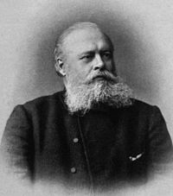
+
-
a. Hydrohalogenation H X
-
+
I
I
+ HI
Reverse of elimination
0ºC
H
H
Br
H
Regioelective:
HBr
Cl
+ HCl
Markovnikov’s Rule
H⁺ (A ⁺) adds to less substituted carbon
Vladimir Vasilyevich Markovnikov 1837-1904
Why? Makes the more substituted cation
Notes:
Vladimir Vasilevich MARKOVNIKOV
(mahr-kuv'nih-kuv), also spelled Markowinkoff
Born: December 22, 1838, Nizhny Novgorod, Russia; Died: February 1904, Moscow, Russia
Markovnikov studied under Butlerov in Kazan and St. Petersburg. After graduation in 1860 he went to Germany for two years where he studied under Erlenmeyer and Kolbe. He returned to Russia, and succeeded to Butlerov's professorship at the Kazan University. He also taught at Odessa and Moscow.
Markovnikov is best known for predicting the regiochemistry of addition reactions of hydrogen halides, sulfuric acid, water, ammonia, etc. to unsymmetrical alkenes. This is known as the Markovnikov Rule which he developed in 1869. Since he refused to publish in a foreign language, these findings were unknown outside of Russia until 1899. According to this rule, the electrophilic X- adds to the carbon atom with fewer hydrogen atoms, while the proton adds to the carbon atom with more hydrogen atoms bonded to it. Thus, hydrogen chloride (HCl) adds to propene, CH3-CH=CH2 to produce 2-chloropropane CH3CHClCH3 rather than the isomeric 1-chloropropane CH3CH2CH2Cl. The rule is useful in predicting the molecular structures of products of addition reactions. Why hydrogen bromide exhibited both Markovnikov as well as reversed-order, or anti-Markovnikov, addition, however, was not understood until Morris Selig Kharasch offered an explanation in 1933.
He also contributed to the structures of cyclic molecules. It was thought that only six-atom rings can exist, but Markovnikov broadened this view by preparing rings with four carbon atoms in 1879 and then seven carbon atoms in 1889.
Markovnikov also showed that butyric and isobutyric acids have the same chemical formula but different structures; i.e., they are isomers.

Slide 10
Origin Of Markovnikov’s Rule
PropeneHCl

Slide 11
Potential Energy Diagram
Burdon
Lipshutz
Notes:
2:19 Caruso Tosca Recondita Armonia

Slide 12
b. Markovnikov Hydration
+
H₂O, H catalyst
CH₃
Equilibrium! Shifted to the right by excess H₂O
H₂SO₄
+
H
OH
OH
H
Solvent
Reversible hydration of 2-methylpropene (H⁺ catalyst):
H⁺ consumed
H⁺ regenerated

Slide 13
Alkenes And Catalytic Acid
Catalytic H⁺ with a nonnucelophilic counter ion (e.g., H₂SO₄) effects alkene isomerization:
H⁺
H⁺
At equilibrium (0ºC): 2 : 27 : 81
1
..
>99%
The equilibrium concentrations reflect relative thermodynamic stabilities
25

Slide 14
Mechanism Of Equilibration
Reversible E1:

Slide 15
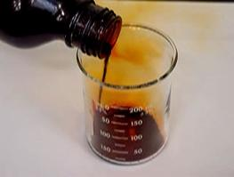
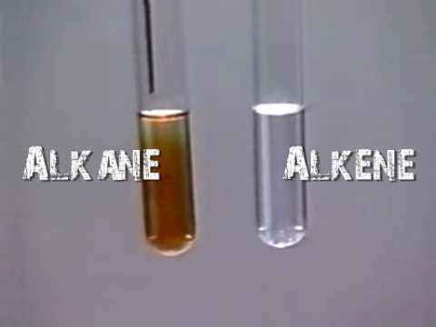
c. Halogenation
Br₂
+
-
X X gets polarized during approach to alkene.
+ Br₂
Br
Br
Racemic
Stereospecific : anti (not syn)
C
C
or
C
C

Slide 16
Stereospecificity
Racemic
Stereospecific 2-Butene Bromination

Slide 17
Mechanism
-
Octet
Br
+
+
Br
Br
Br
-
+
Br
C
C
C
C
C
C
Br
anti
“Precomplex”
Django
Lip
Immelcis
Immeltrans
Notes:
2:46

Slide 18
Time Out: Alkenes As Nucleophiles/Bases
Base :
Nucleophile :
General :

Slide 19
Halonium Ions Can Be Intercepted By Other Nu
+
Br
Br
CH₃
+ Br₂ + H₂O
CH₃
CH₃
OH₂
-H⁺
OH
+
H
Haloalcohol
Cf.
O
+
Or X₂, ROH Haloethers (all anti and Markovnikov)
Nu
H₃C
CH₃OH
OCH₃
+
+ Cl₂ + CH₃OH
+
-H⁺
Cl
H₃C
Cl
Haloether

Slide 20
General For A ―B
+
-
Synthetically useful in oxymercuration-demercuration

Slide 21
d. Oxymercuration-Demercuration
A Markovnikov hydration that avoids cations
O
1. Hg(OCCH₃)₂, HOH
CH₃
2. NaBH₄
OH
O
1. Hg(OCCH₃)₂, ROH 2. NaBH₄
CH₃
OR

Slide 22
Mechanism
Goes through radicals

Slide 23
3. Hydroboration-Oxidation
Allows anti-Markovnikov hydration:
RCH=CH₂ + H₂O RCH₂CH₂OH
Key reaction: B H adds to π-bonds.
Time out: Borane, BH₃, exists as dimer to get octet
H
+
-
H₂B BH₂; in THF: H₃B O
H
In hydroboration, all three B-H bonds react:
H
H
3
C
C
+
B
H
C
C
B
Trialkylborane
H
3

Slide 24
Mechanism Of Hydroboration

Slide 25
Hydroboration Is Regioselective
Steric control of B-H addition
+ BH₃
B
less hindered end
Why is hydroboration useful? Oxidation of alkylboranes with H₂O₂, OH gives ROH [+ B(OH)₃]:
-
H₂O₂
+ BH₃
BR₂
OH
-
OH
anti-Markovnikov hydration

Slide 26
Hydroboration Is Stereospecific:
Syn addition of B—H :
CH₃
H₃C
H
H₃C
H
+ BH₃
-
CH₃
CH₃
H₂O₂, OH
CH₃
B
OH

Slide 27
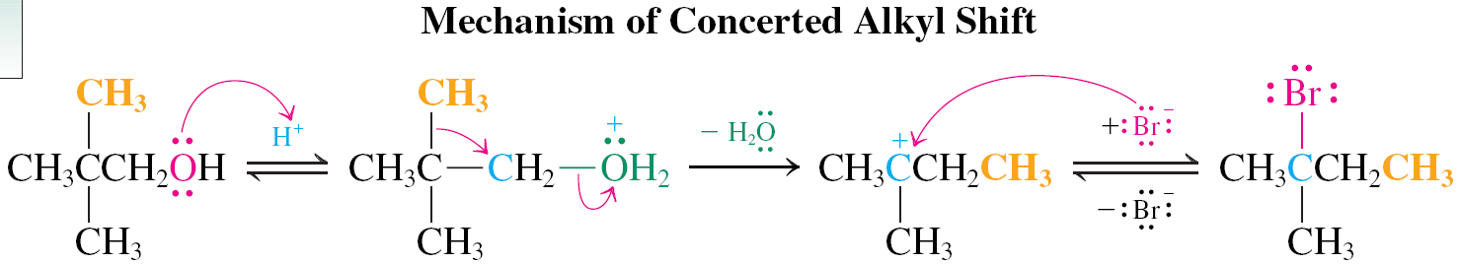
Mechanism Of Alkylborane Oxidation
Negative charge pushes
Look familiar? Recall:
Positive charge pulls
BH3

Slide 28
Applications
Think retrosynthetically:
H
OH
H₃C
H
C
C
C
C
H₃C
H
CH₃CH₂
CH₃
CH₃CH₂
CH₃
CH₃
Cl
I
OH
H

Slide 29
4. Electrophilic Carbene Additions
Carbenes, :CR₂, are 6-electron species, the parent of which is methylene, :CH₂. They can be thought of being derived by deprotonating carbocations:
Methylene
Carbenes are electron deficient: electrophilic.

Slide 30
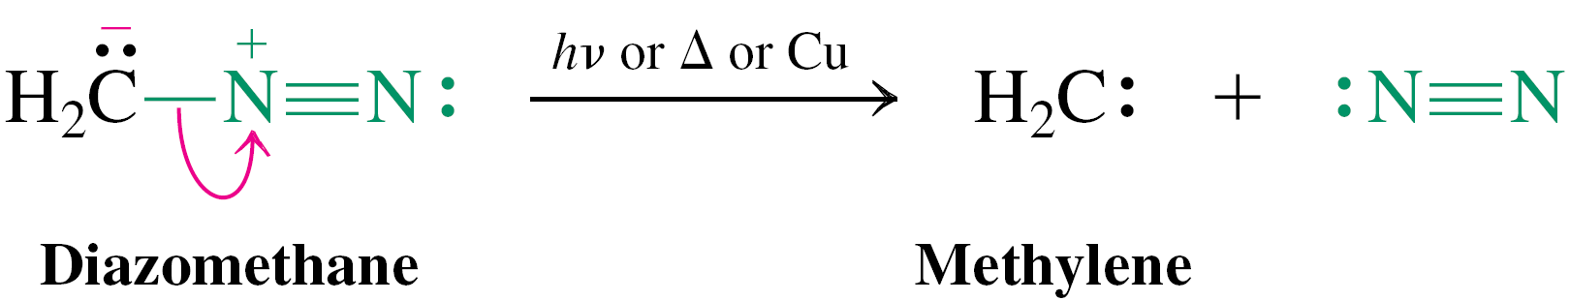
Carbenes As Reactive Intermediates
a. Methylene from diazomethane, CH₂N₂
b. Dichlorocarbene from chloroform
c. Simmons-Smith reagent
Carbenes pick up the two π electrons of alkenes to form cyclopropanes.
CH₂I₂ + Zn-Cu → “CH₂”

Slide 31
Carbene Additions Are Stereospecific
a.
b.

Slide 32
c. Simmons-Smith reagent in cyclopropane synthesis
H
CH₃
CH₂
Zn Cu, (CH₃CH₂)₂O
C
C
+ CH₂I₂
C
C
-Metal iodide
H
CH₃
H₃C
H
H₃C
H
Cyclopropanes are made by nature…
(+)- Chrysanthemic acid
(used by flowers against insects); the “mother” of the Pyrethroids.
US market: 1.5 billion $!!
H₃C
COOH
H₃C
H₃C
CH₃
Notes:
PYRETHROID INSECTICIDES
Pyrethroids are chemicals that kill insects, including mosquitoes. They can be an important tool in helping to prevent the spread of West Nile virus. Mosquito control professionals mix pyrethroids with water or oil and apply it as an ultra low-volume spray that kills flying adult mosquitoes. When used properly, pyrethroids have been found to pose very little risk to human health and the environment. If you want to reduce your exposure to pyrethroid spray, stay indoors during spraying and for about 30 minutes afterwards. What are pyrethroid insecticides and how are they used?Pyrethroids are a group of man-made pesticides similar to the natural pesticide pyrethrum, which is produced by chrysanthemum flowers. Although more than 1,000 pyrethroids have been made, only a few are used in the U.S. These include permethrin (Biomist®), resmethrin (Scourge®) and sumithrin (Anvil®). Pyrethroids are found in many commercial products used to control insects, including household insecticides, pet sprays and shampoos. Some pyrethroids also are used as lice treatments applied directly to the head and as mosquito repellents that can be applied to clothes. How are pyrethroids used in adult mosquito control?Most pyrethroid mosquito control products can be applied only by public health officials and trained personnel of mosquito control districts. Mosquito control professionals apply pyrethroids as an ultra low-volume (ULV) spray. ULV sprayers release very tiny aerosol droplets that stay in the air and kill adult mosquitoes on contact. Pyrethroids are often mixed with water or oil and applied at rates less than 1/100th of a pound of active ingredient per acre. These pesticides are approved by the U.S. Environmental Protection Agency (USEPA) for control of adult mosquitoes.What happens to pyrethroids after they are sprayed?After spraying, pyrethroids settle onto the ground and flat surfaces. Because pyrethroids are mixed with water or oil before being applied, the amount of insecticide left on surfaces is very small. Pyrethroids are broken down by sunlight and other chemicals in the atmosphere. Often, they last only one or two days in the environment. Pyrethroids are not easily taken up by the roots of plants because they bind to the soil. Because of this, pyrethroids usually do not get into groundwater and do not contaminate drinking water supplies. Pyrethroids are eventually broken down in the soil.How can pyrethroid exposure affect my health?Pyrethroids are applied at very low levels to control mosquitoes. USEPA has evaluated these chemicals for this use and they have been found to pose very little risk to human health and the environment when used according to label directions. Exposure to the spray may aggravate existing respiratory conditions or affect sensitive individuals. Pyrethroids that enter the body leave quickly, mainly in the urine, but also in feces and breath. Persons who apply pyrethroids and are accidentally exposed to very large amounts of these chemicals might experience dizziness, headache and nausea. Children exposed to large amounts of pyrethroids would be expected to be affected in the same way as adults. Adverse health effects would not be expected when pyrethroids are used according to label directions. There is no evidence that pyrethroids cause birth defects in humans or affect the ability of humans to have children. Pyrethroids do not cause cancer in people.

Slide 33
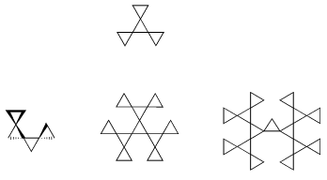
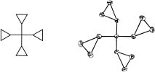
…as drugs:
…for “fun”:
Antifungal
OH
HO
Chiral

Slide 34
5. Electrophilic Oxidation
O
-
+
a. Peroxycarboxylic acids
RCO
OH
O
O
O
C
C
+
RCO
OH
C
C
+
RCOH
Commonly used peroxycarboxylic acids:
O
O
O
COOH
CH₃COOH, CF₃COOH,
Meta-chloroperbenzoic acid
Peracetic
acid
Trifluoro-peracetic acid
Cl
“MCPBA”

Slide 35
Examples:
O
O
C
O
OH
COH
+
CHCl₃
+
90%
O
Cl
Cl
Stereospecific: syn
O
O
D
H
O
C
C
+
RCOOH
+
RCOH
H
D
95%
D
H
H
D
Aqueous work up
trans-2,3-Di-deuteriooxa-cyclopropane

Slide 36
Mechanism:
O
R
C
O
R
C
C
O
C
+
O
C
C
O
H
O
H
Application:
Ocacp
O
HO
H
:Nu¹
CH₃
C
C
1.CH₃SO₂Cl
H₃C
2. :Nu²
H₃C
CH₃
H
Nu¹
Turns OH into mesylate leaving group
H₃C
H
CH₃
H
C
C
Double nucleophilic syn – addition to double bond
Nu²
Nu¹

Slide 37
Rates of oxacyclopropanation increase with alkyl substitution:
O
CHCl₃
+ CH₃COOH
O
10ºC
1 equiv
86%
Sequence 1. RCO₃H, 2. H⁺, H₂O or –OH, H₂O constitutes an anti-dihydroxylation of alkenes.
O
H₃C
H
C
C
RCO₃H
H₃C
H
H
CH₃
H
CH₃
HO
H
CH₃
H⁺, H₂O
C
C
or –OH, H₂O
H₃C
meso
H
OH

Slide 38
b. OsO₄ syn-dihydroxylation
O
O
OsO₄
Os
is reduced to Os^{VI}.
O
VIII
O
OH
1. OsO₄
2. H₂S, H₂O
OH
cis-1,2-Cyclohexanediol
Gives complementary stereochemistry to anti-dihydroxylation

Slide 39
Mechanism:
C
O
O
O
O
H₂O
C
VI
VIII
Os
Os
C
C
O
O
O
O
Six electron TS
Osmate ester
OH
HO
O
C
+
VI
Can be reoxidized by added oxidant, therefore can be made catalytic in Os
Os
C
OH
HO
O
Good because Os is expensive; OsO₄, H₂S are toxic.
Conditions: stoichiometric H₂O₂ and catalytic OsO₄

Slide 40
c. Ozonolysis
Complete oxidative cleavage by 1. O₃, 2. Reduction of “ozonide”
Ozone generator:
Arc discharge
+
O₂
-
O
2-4% in O₂
O
O
1. O₃
C
C
C
O
+
O
C
2. Reduction
O
O
CH₃CH₂
CH₃
C
C
1. O₃
CH₃CH₂CCH₃ + CH₃CH
H₃C
H
2. Zn, CH₃COOH
90%
Zn²⁺
CH₃
1. O₃
O
2. H₂ , Pt
H
85%
H₂O
Ring opening
O

Slide 41
H₃C
H₃C
O
1. O₃
76%
2. (CH₃)₂S (CH₃)₂SO
Clipped off carbon atom
H
H
)3

Slide 42
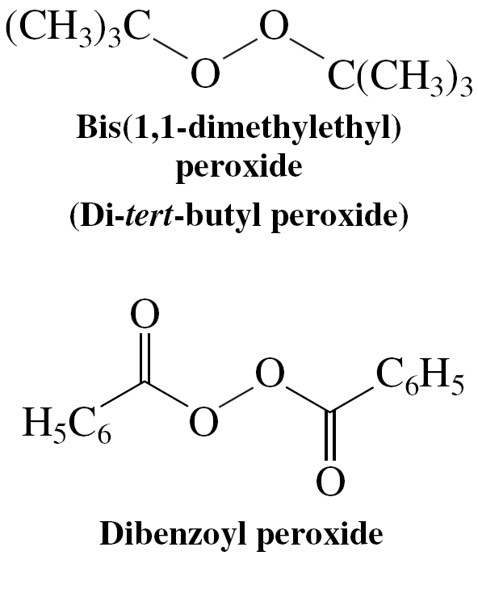
6. Radical Hydrobromination
Recall:
+ HBr
Markovnikov
Br
RO-OR
Anti-Markovnikov!
But:
+ HBr
Br
70%
Mechanism different; goes via faster, radical chain.
Popular peroxide radical initiators (the O-O bond is weak, ~39 kcal mol⁻¹):

Slide 43
Mechanism Of Radical Hydrobromination
Compare to radical halogenation of hydrocarbons (Chapter 3):
RadicalHbr

Slide 44
Does not work for HCl, HI: One of the propagation steps endothermic:
Which one? → homework problem
Hence radical mechanism too slow, and ionic mechanism of Markovnikov addition wins.
But works for RSH anti-Markovnikov addition:
Initiation:

Slide 45
7. Alkene Polymerization

Slide 46
R
R
a. Cationic:
+ H⁺
etc.
C
C
H
C
C
+
R
R
RO +
etc.
b. Radical:
C
C
RO
C
C
H
H
N
N
C
-
C
etc.
-
B +
c. Anionic:
C
C
B
C
C
Resonance
d. Metal (Ti, Zr, lanthanides): Ziegler-Natta; now Kaminski-Brintzinger. Organometallic mechanism
R
R
Insertion
CH₃
CH₃
R
Ti
CH₃
R
Ti
Ti

Slide 47
a. Acid-catalyzed Polymerization
Proceeds through carbocations! Polymerization is yet another complication of carbocations, in addition to S_{N}1, E1, and rearrangements; dominates at high concentrations.
At low concentrations: dimerization……oligomerization:
Dimerization of 2-methylpropene

Slide 48
Continued oligomerization:
Can lead to synthetically useful cyclizations:
Mechanism:

Slide 49
b. Radical Polymerization

Slide 50
c. Base-catalyzed Polymerization
Facilitated by resonance stabilization of anionic centers:

Slide 51
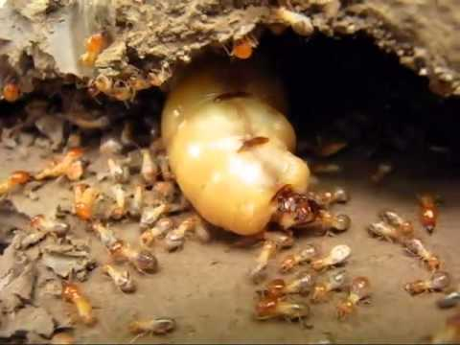
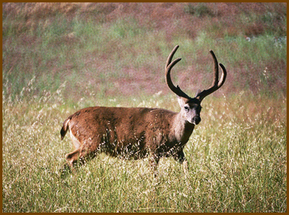
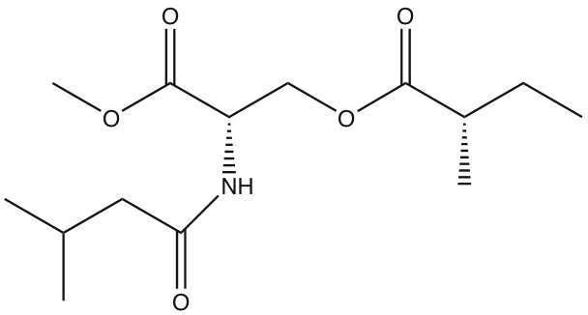
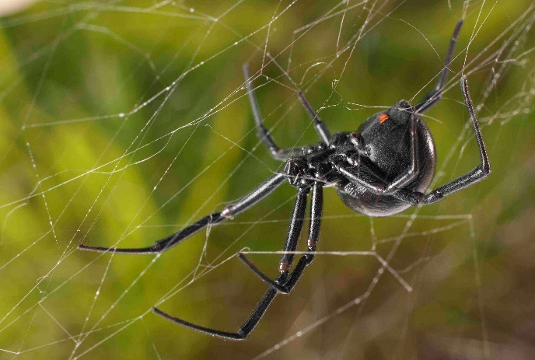
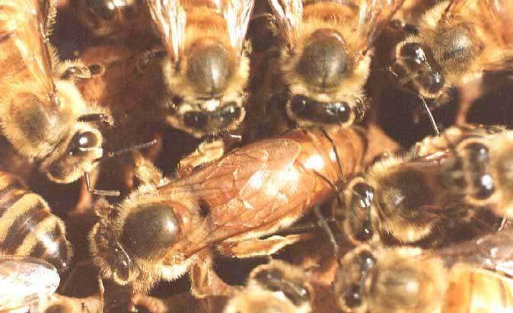
8. Alkenes in Nature: Pheromones
Sex, war, communication (trail, alarm, defence)
NO₂
Termite defence
O
O
O
O
Black tail deer (hoof excretion); recognition and status
OH
“Queen bee substance”, inhibits ovary development in workers, attracts–excites drones
Sex pheromone of the western black widow (Latrodectus hesperus)

Slide 52
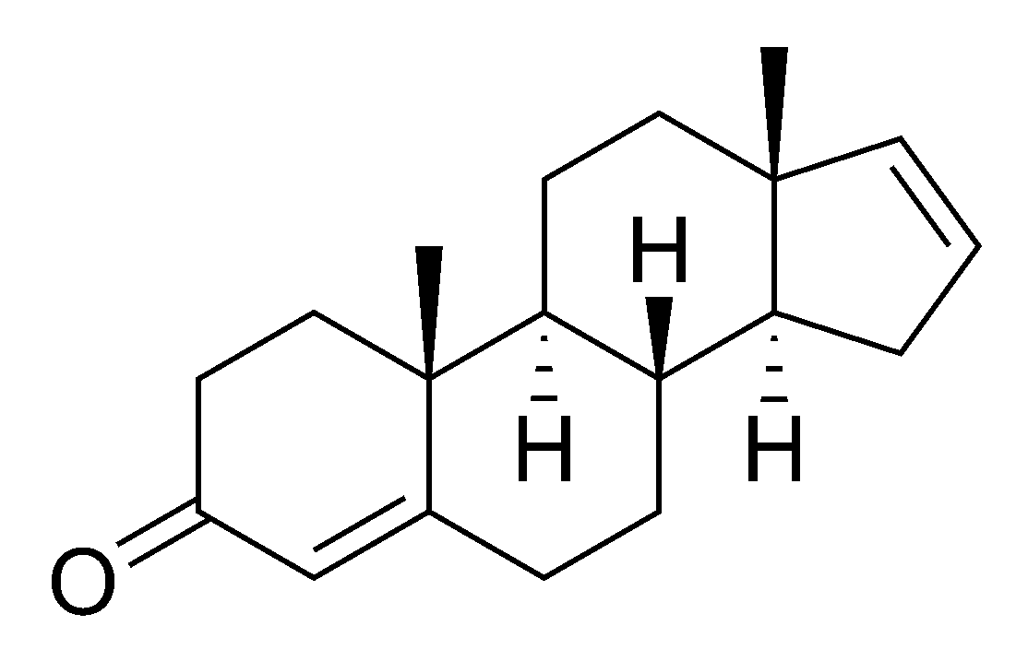
The Holy Grail: Human Sex Pheromones
Androstadienone
Component of male sweat; has been suggested to be a human sex pheromone. Controversial: the olfactory sense organ responsible for the detection of pheromones as more than just an odor has no active function in humans.
Notes:
The attractive powers of pheromones (scented sex hormones) have often been exaggerated – not least by advertisers trying to sell pheromone-based scents and sprays which they claim will make men irresistible to women.
Widely publicised research findings on female sensitivity to male pheromones have also led some men to believe that the odour of their natural sweat is highly attractive to women.
Women are indeed highly sensitive to male pheromones, particularly around ovulation, but many popular assumptions about the effects of these pheromones are the result of misinterpretation and over-simplification of the research results.
All male pheromones are not equally attractive, and some of the myths stem from an understandable confusion over their names. The male pheromone androstenone is not the same as androstenol. Androstenol is the scent produced by fresh male sweat, and is attractive to females. Androstenone is produced by male sweat after exposure to oxygen – i.e. when less fresh – and is perceived as highly unpleasant by females (except during ovulation, when their responses change from ‘negative’ to ‘neutral’).
So, men who believe that their ‘macho’, sweaty body-odour is attractive to women are deluding themselves, unless they are constantly producing fresh sweat and either naked or changing their clothes every 20 minutes to remove any trace of the oxidised sweat. Generally, the female-repelling androstenone is the more prominent male body odour, as the fresh-sweat odour of androstenol disappears very quickly. In terms of scent, the sweaty macho-man is therefore likely to be unattractive to most women, most of the time – at best, he may elicit a grudging ‘neutral’ response from women who happen to be ovulating (which of course excludes all those taking oral contraceptives).
Although the male pheromone androstenol has been shown to be attractive to women, men’s use of pheromone-based scents to attract women may not have the desired effect. An experiment in which a pheromone-sprayed chair in a dentist’s waiting room was most frequently chosen by women is often cited in support of the attractive power of male pheromones. The problem with this conclusion is that the pheromone in question can only be detected at a distance of about 18 inches, so the women would have to have selected the chair and sat down before becoming aware of its scent.
A further difficulty in this context is that although pheromone-based scents may have an arousing effect on women, the women will not be aware of the source of their arousal. A man wearing pheromone scent at a crowded party will still have to compete with the other men present for the attention of the women. Only in a strictly one-to-one, intimate encounter could the arousing effect of the scent actually benefit the man wearing it – and to achieve such an encounter, the man must presumably be capable of attracting the woman by some other means. In the context of social situations, it is perhaps also worth noting that androstenol has been shown to be attractive to men, as well as women!
Another experiment showed, however, that daily use of pleasant-smelling colognes significantly improves the mood of middle-aged men, reducing mood disturbances such as tension, depression, anger, fatigue and confusion which are associated with the ‘mid-life crisis’. This personal sense of well-being, good humour and confidence, which will inevitably be reflected in behaviour, may be of more help in attracting potential partners than the fickle and unreliable effects of pheromone-sprays.
Similar mood-improvements have been observed in studies of the effects of perfume use on middle-aged women. Women at mid-life, particularly post-menopausal women taking hormone treatments, tend to suffer fewer mood disturbances than middle-aged men. (Contrary to popular opinion, the so-called ‘male menopause’ seems to involve more pronounced emotional disorders than the female version.) But regular use of pleasant fragrances still had a significant beneficial effect on the emotional well-being of mid-life females, and another study showed that young women experience equally positive effects. Again, the cheering effect of pleasant fragrances may also make women more attractive to potential partners.
Women who believe that the use of ‘sexy’ perfumes will attract men, however, may be misguided. Women’s sensitivity to musk, an ingredient commonly used in perfumes, is 1000 times greater than men’s. ‘Sexy’ perfumes containing musk are therefore much more likely to arouse the woman wearing them than any potential male partners. But by making a woman feel more sensual, the perfume may affect her behaviour and thus indirectly increase her attractiveness.
A number of women’s magazines have recently carried good-news reports claiming that the smell of cinnamon buns has been proven to ‘boost male erections’ – some use the more scientific-sounding euphemism ‘increase penile blood-flow’. A few reports also mention lavender.
In fact, the study in question – conducted by the Smell and Taste Research Foundation in Chicago – discovered only that ‘in those with a normal olfactory ability, a variety of odours can increase penile blood-flow’. These odours included pumpkin pie, liquorice, doughnuts and lavender, and various combinations of these, as well as oriental spice and cola. The most effective were a lavender/ pumpkin pie mixture, a doughnut/ black liquorice mixture and a pumpkin pie/doughnut mixture – but the results depended on other factors such as whether the participants’ partners wore cologne and how many times they had had intercourse in the last month.. In short, the only reliable conclusion to be drawn from this is, as the authors themselves admit, that all sorts of smells can increase penile blood flow.
Even this is not very surprising, as any strong odour will have a stimulating effect, which will cause a general increase in blood flow to the extremities – inevitably including the penis. A very powerful odour, such as smelling-salts, can even revive someone from a dead faint. If your partner is actually asleep or unconscious, this old-fashioned remedy may be more effective than the lavender/pumpkin pie mixture – and probably no more offensive.

