Slide 1
Chapter 11: Alkenes

Slide 2
Degree Of Unsaturation
Molecular formula tells us how many rings and/or π bonds are present in a molecule. Reference is a saturated acyclic hydrocarbon: C_{n}H_{2n+2}.
Simple examples:
C₆H₁₂, not C₆H_{14.}
C₆H₁₀, not C₆H_{14.}
We need to determine the deviation of the molecular formula from C_{n}H_{2n+2} (in increments of 2 H = degree of unsaturation). Every ring or double bond takes away 2 H, triple bond 4 H from C_{n}H_{2n+2}.

Slide 4
Heteroatoms and Degree Of Unsaturation
Depends on valency of element:
S, O no effect on count (still C_{n}H_{2n+2} + S_{x} or O_{y})
C
H
C
O
H
Halogen:
-1;
C
H
C
X
H
Nitrogen:
+1;
C
H
C
N
R

Slide 5
Examples:
C₁₀H₁₆
1. H_{sat} = (2x10) + 2 = 22
2. Degrees of unsaturation?:
or
or…..
C₅H₅N
H_{sat} = 10 + 2 + 1 = 13
2. degrees of unsaturation: ?
or
or…..
C
N
N
Pyridine

Slide 6
Relative Stability Of Alkenes
Measure heat of hydrogenation ΔH_{H2} of isomers, e.g., butene
ΔH_{H2} (kcal mol⁻¹)
cat.
+
H₂
-30.3
cat.
+
H₂
-28.6
cat.
+
H₂
-27.6
Realtive stability:
Internal
>
terminal
trans
>
cis

Slide 8
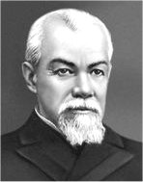
Synthesis of Alkenes
E revisited. Best: E₂ on RX. Regioselectivity?
CH₃
CH₃
H₃C
CH₃
H₂C
CH₃CH₂O⁻Na⁺, CH₃CH₂OH
CH₃CH₂ C CH₃
C
C
+
C
CH₂
Small base
H
70%
CH₃
H₃C
30%
X
More stable
Less stable
Saytzev-Rule
Non-bulky base leads to more stable internal double bond.
Alexander M. Zaitzev
1841–1910)

Slide 9
Saytzev’s Rule: The Transition State
The transition states begin to look like product double bond.

Slide 10
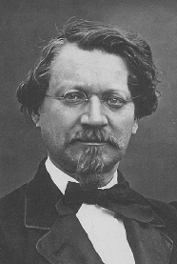
Hofmann Rule
Bulky base leads to less stable terminal double bond
August Wilhelm von Hofmann (1818–1892),
Largebase

Slide 11
Elimination Is Stereoselective
Recall: Stereoselectivity is the preferential formation of one stereoisomer over possible others. Here: cis or trans product?
Yes, but not completely.
Br
-
+
Na OCH₃
+
+
CH₃OH
51%
18%
31%
Non-bulky base: Zaitzev
Mainly trans

Slide 12
Elimination Is Stereospecific
Recall: Stereospecificity is the selective conversion of one stereoisomer of starting material to one of the product. Here: One diastereomer of
*
*
gives only E product, the other gives only Z.
C C
H
X

Slide 13
Alkenes From ROH By Dehydration
Acid, Δ
C
C
C
C
+
HOH
Dehydration
H
OH
Can be messy!
R_{prim}
OH
+ H₂SO₄ conc., goes by E2, requires heat:
H
+
+
-
:
:
+
HSO₄
CH₃CH₂OH + H
CH₂ CH₂ O
:
H
H
CH₂ CH₂
+
:
+
H₂SO₄
H₂O
:
+
R_{sec}, R_{tert} OH + H : E₁ + rearrangements

Slide 14
Relative Reactivity
R = primary < secondary < tertiary

Slide 15
Major Problem: Rearrangements
CH₃
OH
H₃C
H
H₂SO₄, Δ
CH₃C
CH₂
CCH₃
C
C
-HOH
H₃C
CH₂CH₃
H
H
54%
CH₃
+
CH₃CCH
CHCH₃
+ other isomers
H
8%

Slide 16
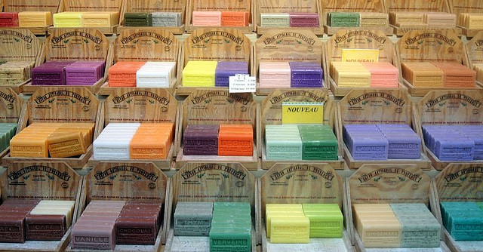
33% H₂SO₄, 1 h, 100°C
+
+
-H₂O
OH
α-Terpineol cajuput oil, pine oil, and petitgrain oil
15%
9%
28.5%
Terpinolene
Limonene
α-Terpinene
+
+
Terpenes: the scent of soap
18.5%
15%
Isoterpinolene
γ-Terpinene

