Slide 1
Chapter 10: Nuclear Magnetic Resonance (NMR) Spectroscopy

Slide 2
Alkanes, alkyl halides, alcohols

Slide 3
What is spectroscopy?
Molecular response to radiative stimulus is quantized (“geared”). (Molecule = nuclei + electrons).
ΔE = hν ν = c/λ
Excitation:
1. Electronic (UV-visible spectra)
2. Vibrational (IR)
3. Rotation (microwave)
4. Nuclear spin orientation in magnet (NMR)
Spectrometer scans ν to find ΔE : The spectrum

Slide 4
What is spectroscopy?
kcal mol⁻¹

Slide 5
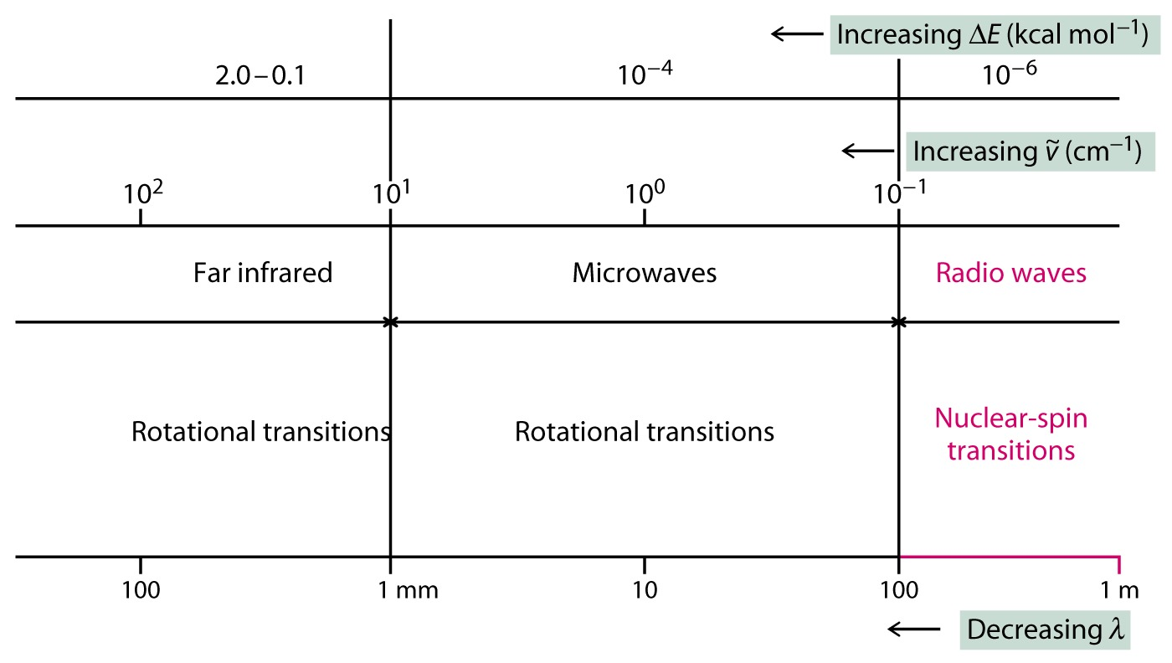

Slide 6
Excitation causes
an “absorption”, a
peak in a graph

Slide 7
NMR Spectroscopy
Protons and neutrons in a nucleus behave as if they are spinning
ODD number of neutrons OR protons (or both) is an, the atoms will have net nuclear spin
Examples: ¹H, ¹³C, ¹⁵N, ¹⁹F, ³¹P
The spinning charge in the nucleus creates a magnetic moment (vector)

Slide 9
What is ∆E in NMR? Nuclei behave as tiny magnets (random orientation).

Slide 10
Protons as Tiny Magnets Line Up With and Against an External Magnetic Filed
If the normally disordered magnetic moments of atoms are exposed to an external magnetic field, their magnetic moments will align
B_{o} = O
B_{o} or H_{o}
B_{o} or H_{o}
Ratio α:β ~ 1:1
External Magnetic Field is referred to as B_{o} or H_{o}

Slide 11
Absorption of Light, Spin Flip, and Resonance ⇒ Spectral Line

Slide 12
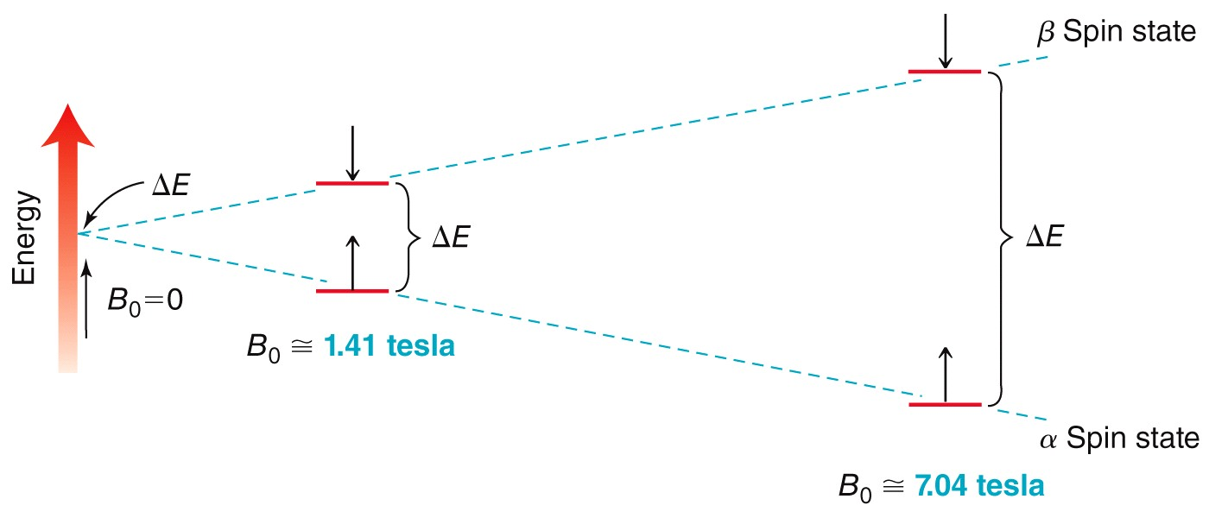
Acquiring a ¹H NMR Spectrum
NMR requires a strong magnetic field and radio wave energy
The strength of the magnetic field affects the energy gap

Slide 13
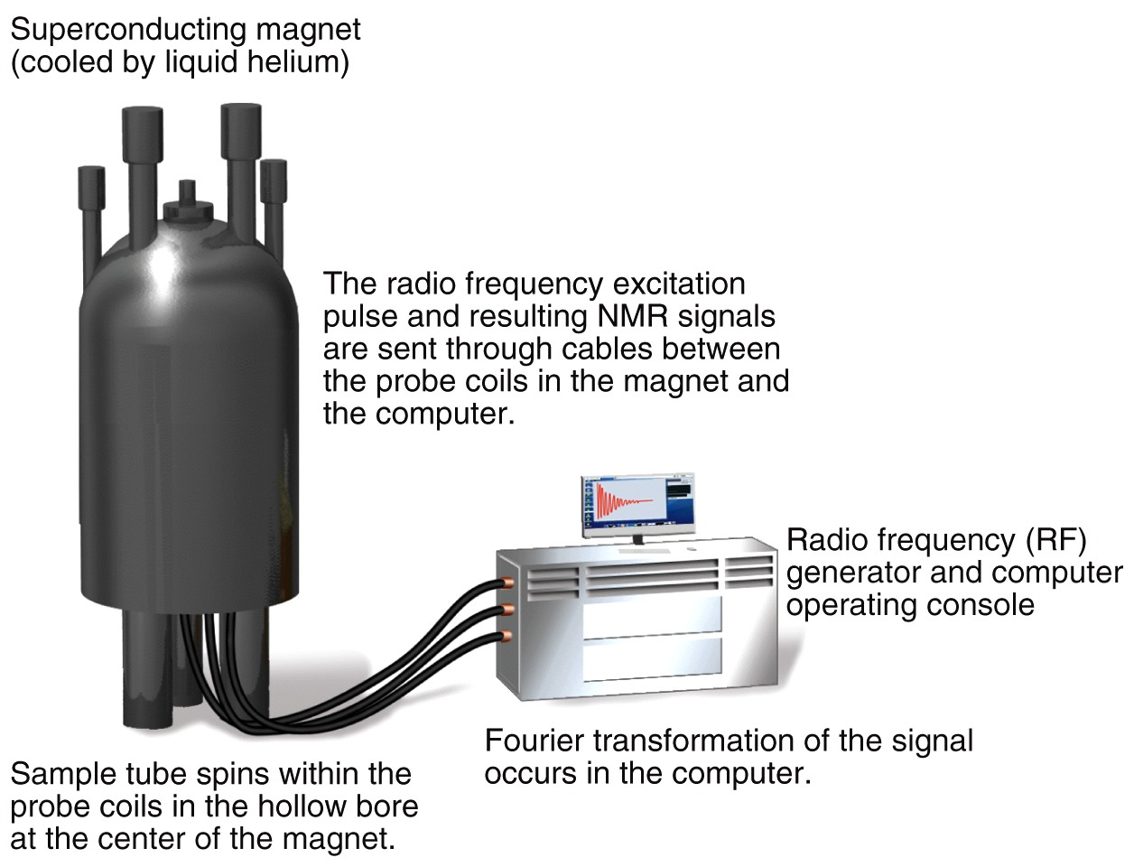
Acquiring a ¹H NMR Spectrum
Solvents are used such as chloroform-d. WHY?
The magnet is super-cooled, but the sample is generally at room temp

Slide 14
The NMR Spectrometer
Solvents: CDCl₃, CD₂Cl₂, THF-d₈, etc.

Slide 16
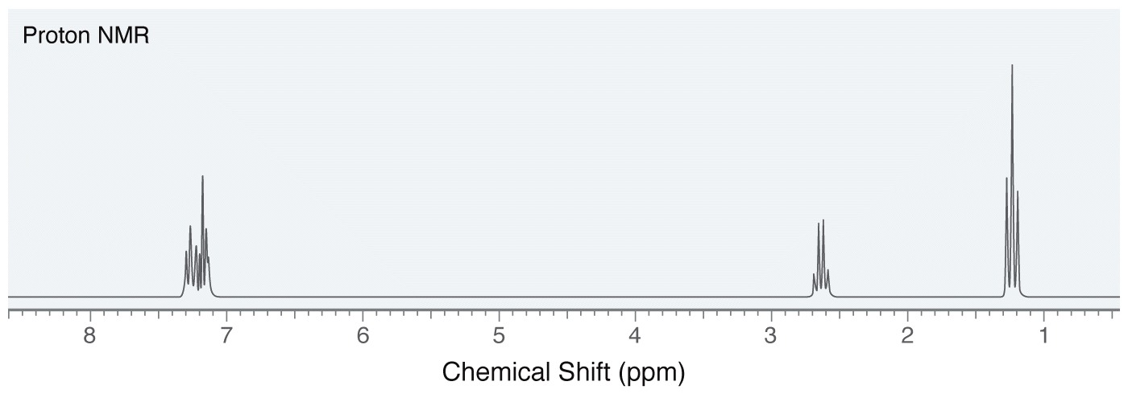
Characteristics of a ¹H NMR Spectrum
NMR spectra contain a lot of structural information
Number of signals
Signal location – shift
Signal area – integration
Signal shape – splitting pattern

Slide 17
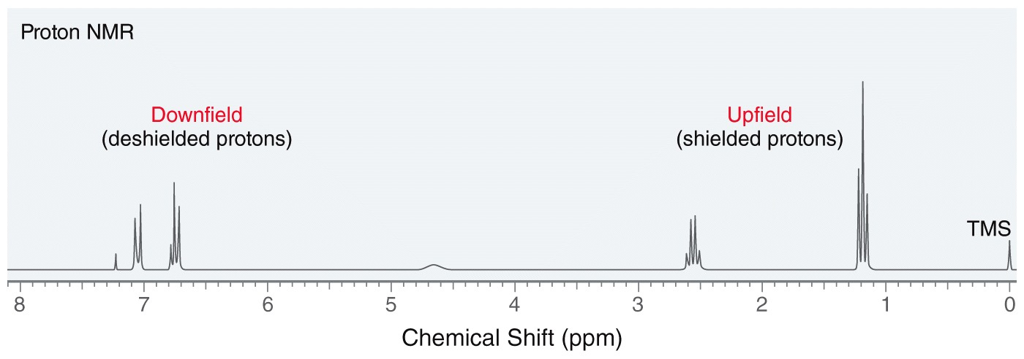
Chemical Shifts
Early NMRs analyzed samples at a constant energy over a range of magnetic field strengths from low field strength = downfield to high field strength = upfield
δ = ppm

Slide 18
The Chemical Shift δ
The position of peak relative to an internal standard. Most common is
Tetramethylsilane: (CH₃)₄Si or “TMS”, the “zero” point in the spectrum.
ν (from TMS) Hz
δ
=
ppm,
RF (e.g., 300 MHz)
is independent of machine (90, 300 MHz, etc.)

Slide 19
Why are there two peaks? ➔The Chemical Shift

Slide 20
Electrons in Vicinity of Nucleus Affect ν
Causes shielding, i.e.,
Peak moves to the right

Slide 21
Acquiring a ¹H NMR Spectrum
NMR requires a strong magnetic field and radio wave energy
The strength of the magnetic field affects the energy gap

Slide 22
Electrons in Vicinity of Nucleus Affect ν
Causes shielding, i.e.,
Peak moves to the right

Slide 23
Why are there two peaks? ➔The Chemical Shift

Slide 24
Consider H⁺: No e, no shielding, peak furthest to the left.
But:
H
H
C
H
Electrons cause shielding: Peak moves upfield (to right).
H
When we add an e-withdrawing group:
+
-
e.g., CH₃ Cl, causes deshielding (to left).
Chemical shift provides a finely tuned picture of electronic environment around each H.

Slide 25
If we substitute with e-negative groups, shielding of observed nucleus is diminished; or nucleus is “deshielded” (relatively).

Slide 26
Electrons in Vicinity of Nucleus Affect ν
Electronegative atoms move the electron crowd toward them, therefore orbit of e- is moved and the shielding vector movesl
Causes shielding, i.e.,
Peak moves to the right

Slide 27
Two e-poor neighbors
One e-poor neighbor

Slide 28
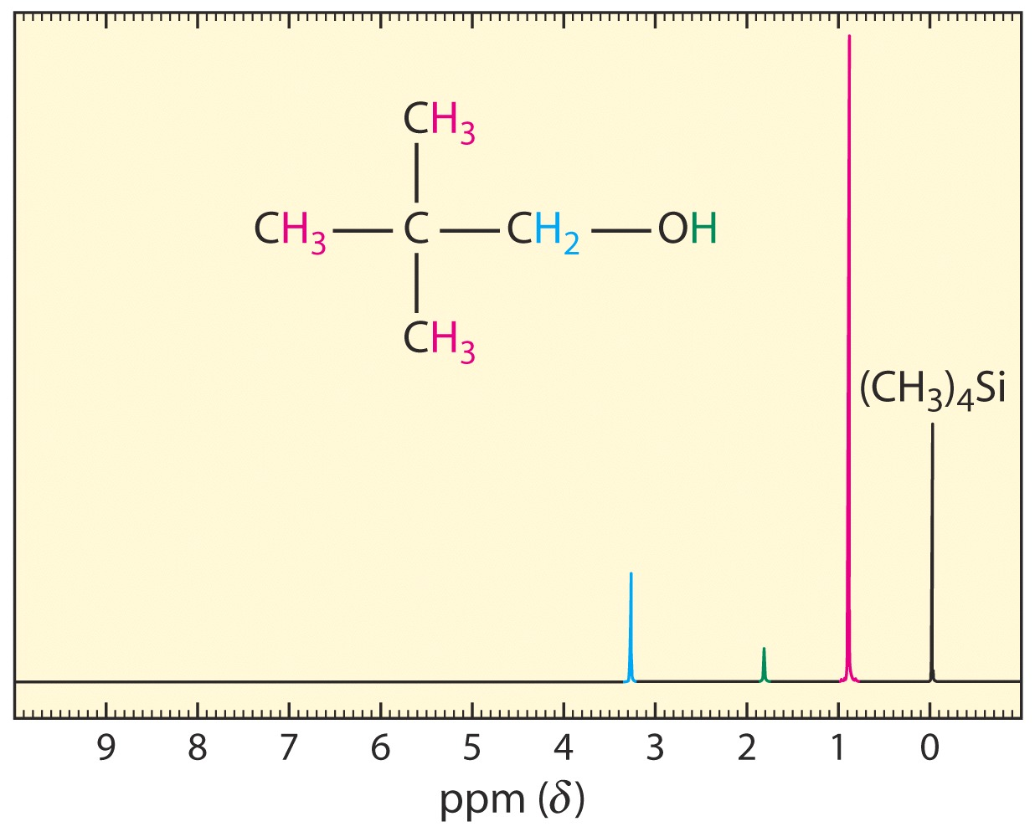
266 Hz
0.89 ppm
978 Hz
3.26 ppm
Distance from TMS in Hz/300 MHz in ppm
541 Hz
1.80 ppm

Slide 29
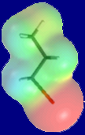
Application of δ
2 signals
Br₂
CH₃ CH₃ CH₃CH₂Br
hυ
Most deshielded of all
+ CH₃CHBr₂ + BrCH₂CH₂Br
2 signals
1 signal
EPM of 1-bromopropane

Slide 30
1-2
2+
3-4
Variable

Slide 31
Chemically equivalent Hs: same δs. Use symmetry operations: rotation, mirror planes.

Slide 32
“Fast” processes, such as methyl rotation, equilibrate Hs:
NMR time scale < 1 sec.
E_{a}
For calibration: A B
k
E_{a} ~ 20 kcal mol⁻¹, k ~ 10⁻² sec⁻¹, t_{1/2} = 1 min
E_{a} ~ 25 kcal mol⁻¹, k ~ 10⁻⁶ sec⁻¹, t_{1/2} = 66 h

Slide 33
Integration
Area under peak = relative # of associated Hs. Computer-automated.
e.g. (CH₃)₃CCH₂OH 9:2:1
CH₃OCH₂CH₂OCH₃ 3:2
Helps in peak assignments.

Slide 34
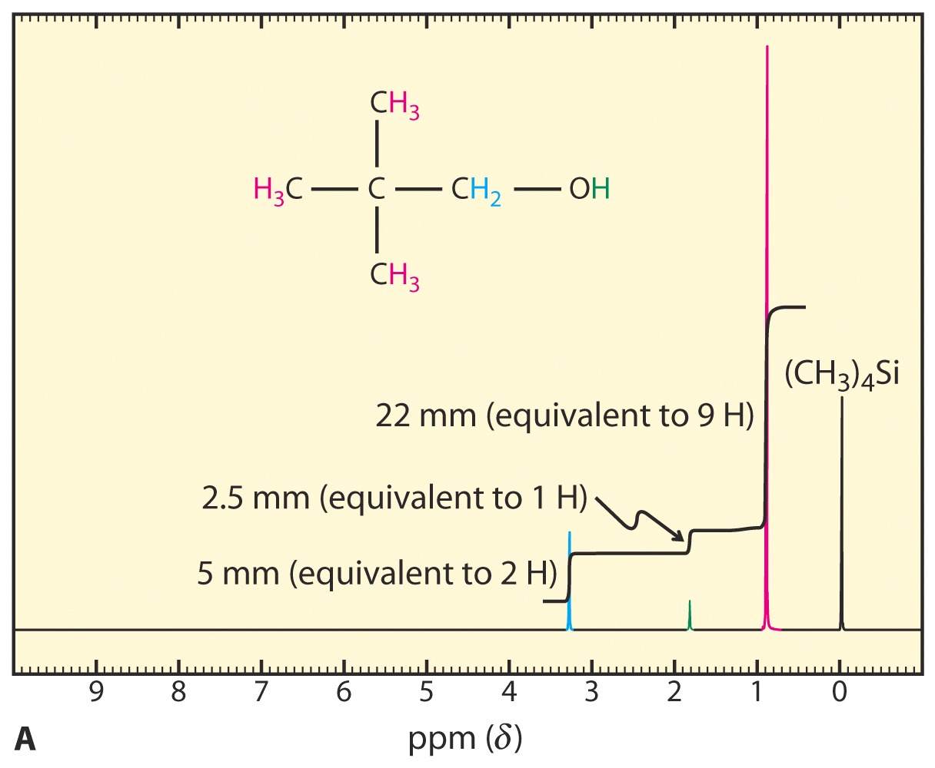

Slide 35
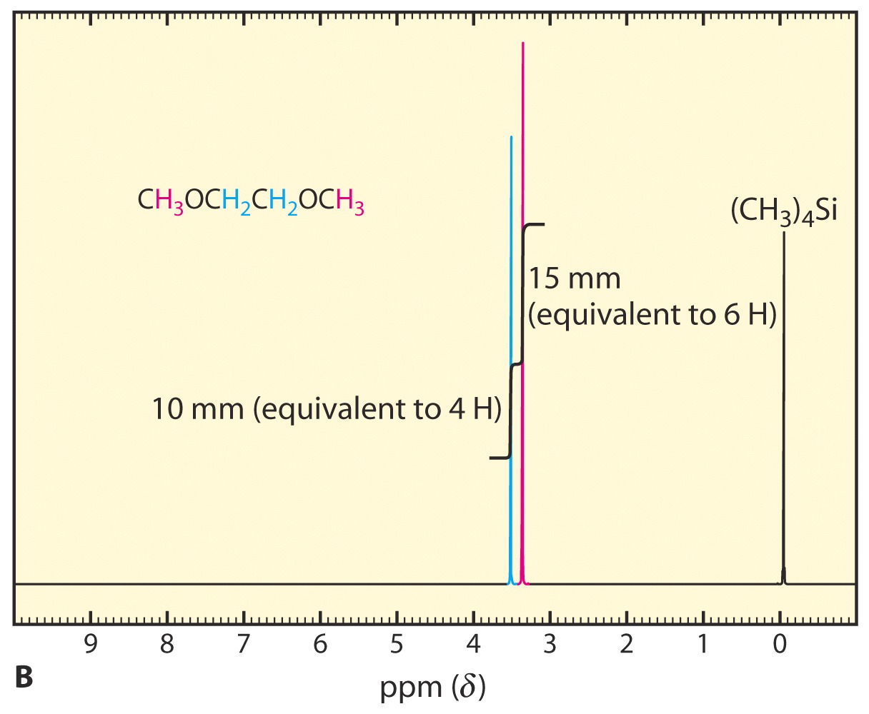

Slide 36
Spin-Spin Splitting

Slide 37
(N+1) Rule
N equivalent adjacent hydrogens (i.e. on neighboring carbons) give rise to (N+1) peaks.
e.g., doublet (d), triplet (t), quartet (q), quintet (quin), etc.

Slide 38
d
d
H_{a}
H_{b}
q
t
Why ?
Cl C C O CH₂ CH₃
Cl
OCH₂CH₃
In a magnetic field, all H_{s} exist as H_{α}:H_{β} ~ 1:1.
H_{a} “sees” two types of H_{b} neighbors (through bond): H_{bα} and H_{bβ}
H_{bα} strengthens H₀ around H_{a} : deshielding
H_{bβ} weakens H₀ around H_{a} : shielding
Result: two lines (1:1 ratio, d) instead of one. Distance between them in Hz is the coupling constant J.

Slide 39
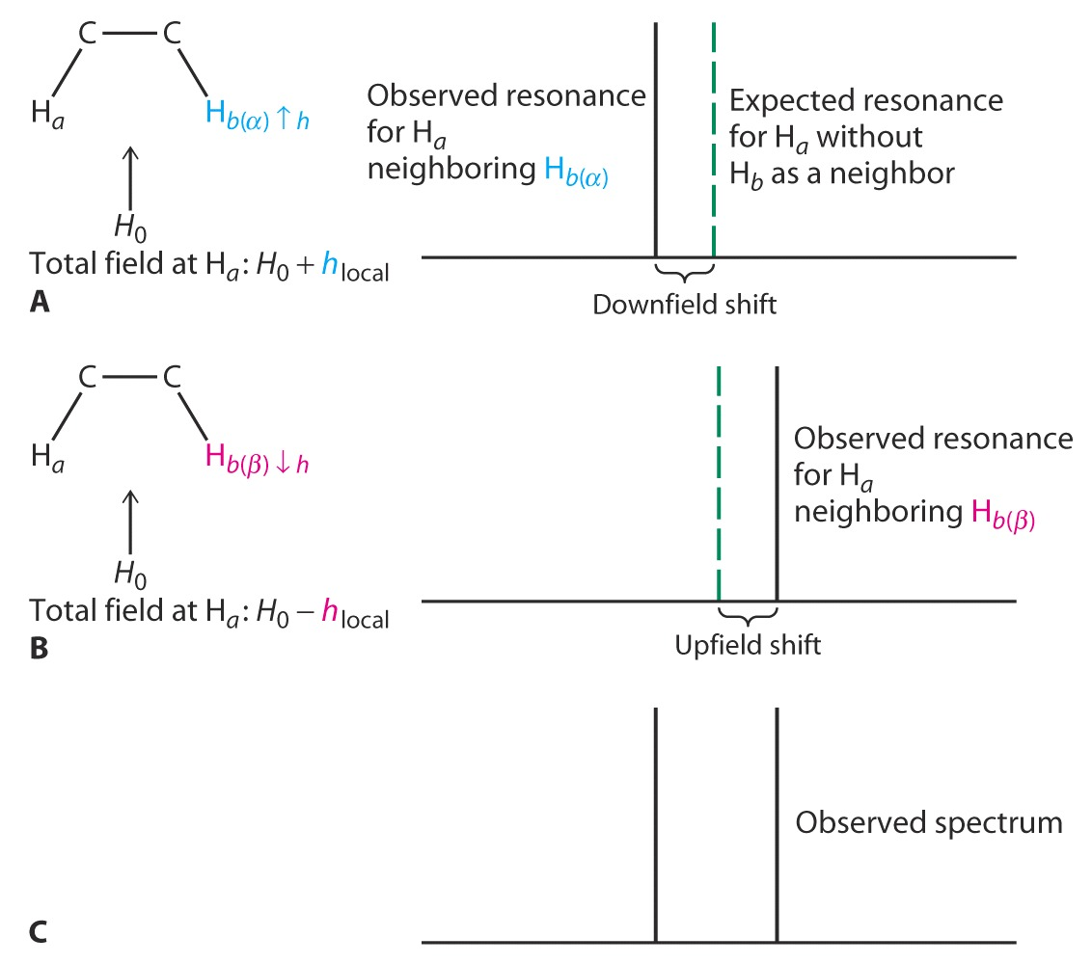

Slide 40
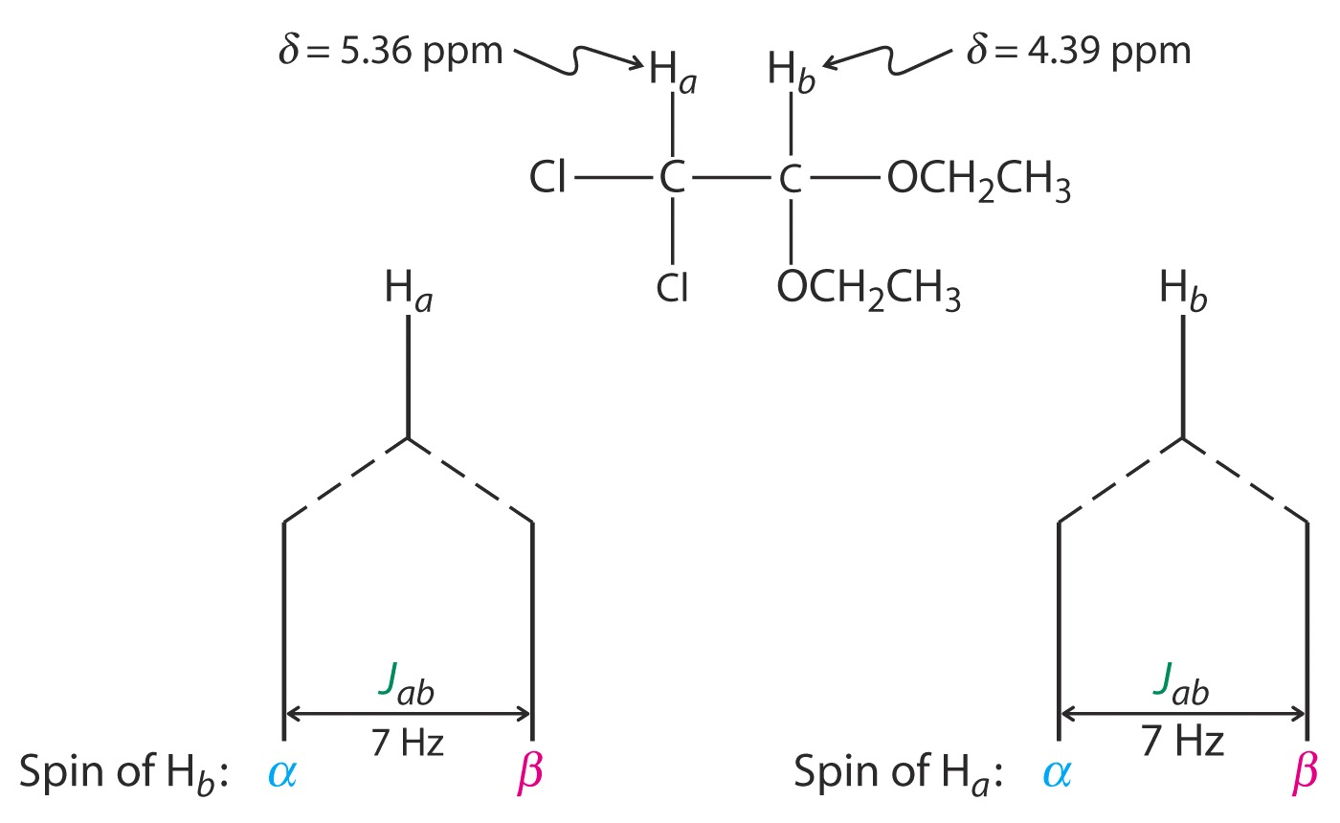
Same value
H_{a} and H_{b} are said to “split” each other with a J of 7 Hz.

Slide 41
J is field independent: Same at 90, 300, etc. MHz
Range: 1-18 Hz.
For more than one neighbor : H “sees” all α, β combinations of neighbors. Thus, two neighboring Hs:
αα, αβ, βα , ββ: 1:2:1 triplet
Three neighboring Hs:
ααα, ααβ, αβα, βαα , αββ, βαβ, ββα , βββ
1:3:3:1 quartet

Slide 44
quintet
d
decet
t
(CH₃)₃CH
O
O
s
All –CH₂- hydrogens are equivalent:
t
Four mirror planes
tridecet

Slide 45
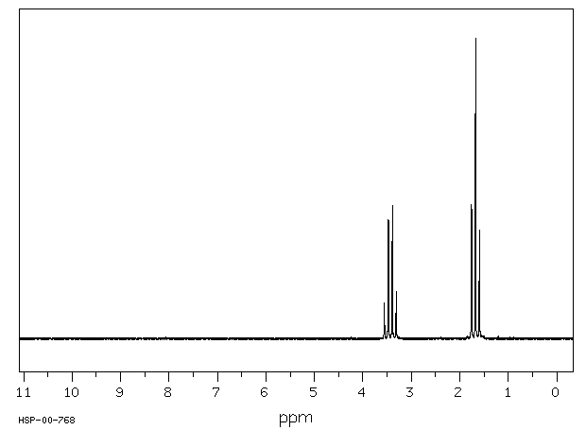
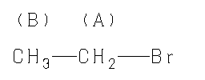
Br₂
CH₃CH₃ CH₃CH₂Br + CH₃CHBr₂ + BrCH₂CH₂Br
h
t
q
d
q
singlet
A 3.427 B 1.679 ppm
http://www.aist.go.jp/RIODB/SDBS/cgi-bin/cre_index.cgi

Slide 46
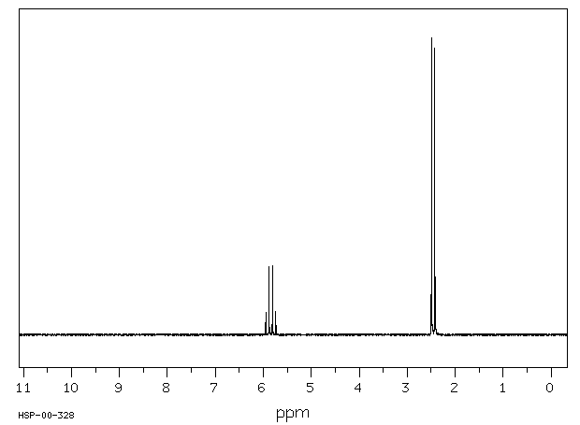
A 5.842 B 2.458 ppm

Slide 47
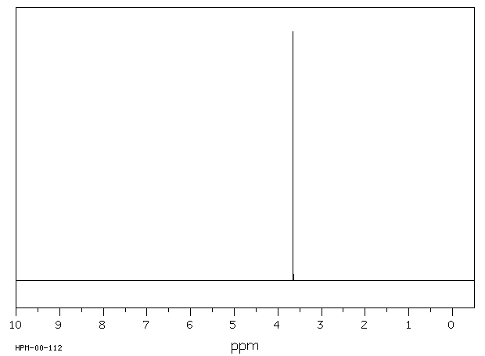
A 3.654 ppm

Slide 48
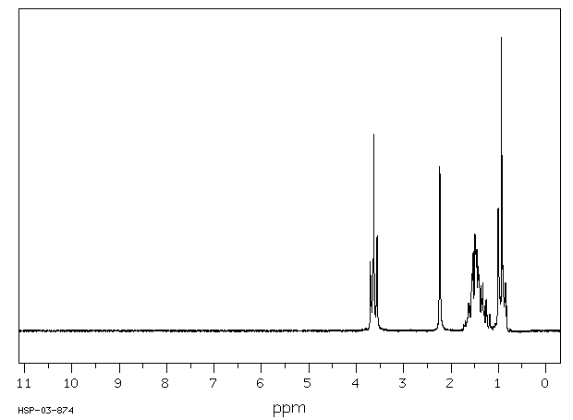
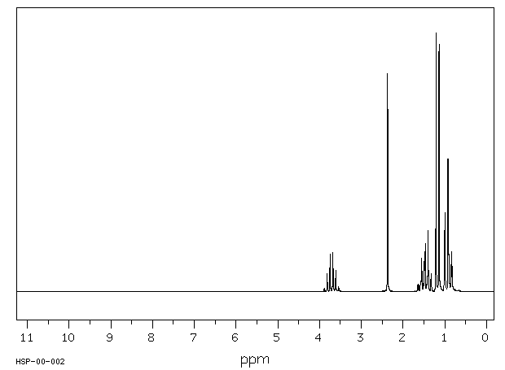
Problem:
2 H
3 H
1 H
4 H
The two butanols:
CH₃CH₂CH₂CH₂OH
CH₃CH₂CHCH₃
Which is which?
1 H
3 H
OH
3 H
2 H
1 H

Slide 50
Summary Points
1. Equivalent protons show no splitting.
2. J is independent of H₀.
H
H
3. Nonadjacent Hs J ~ 0.
C
X
C
4. (N+1) Rule. Ratio from Pascal’s triangle.
5. Splitting is mutual. If there is one split peak, there has to be (at least) one other.

Slide 53
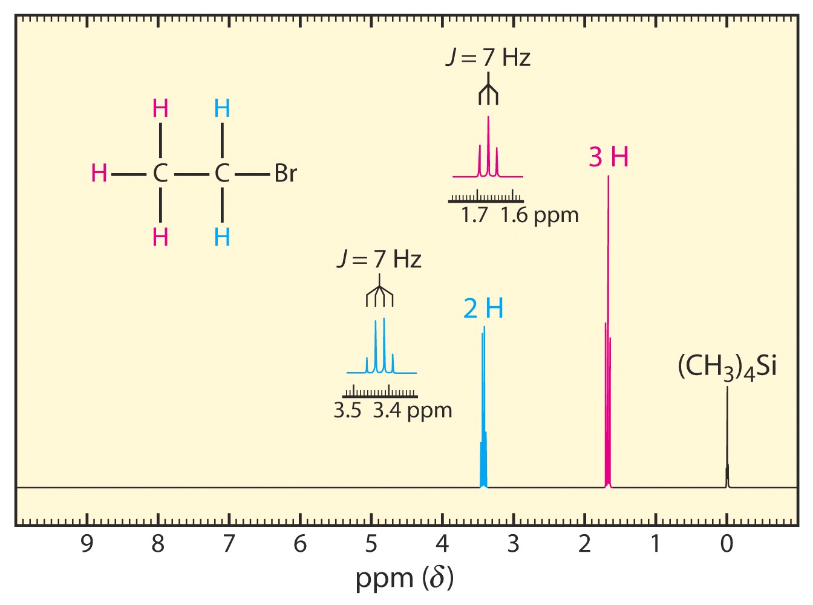

Slide 54
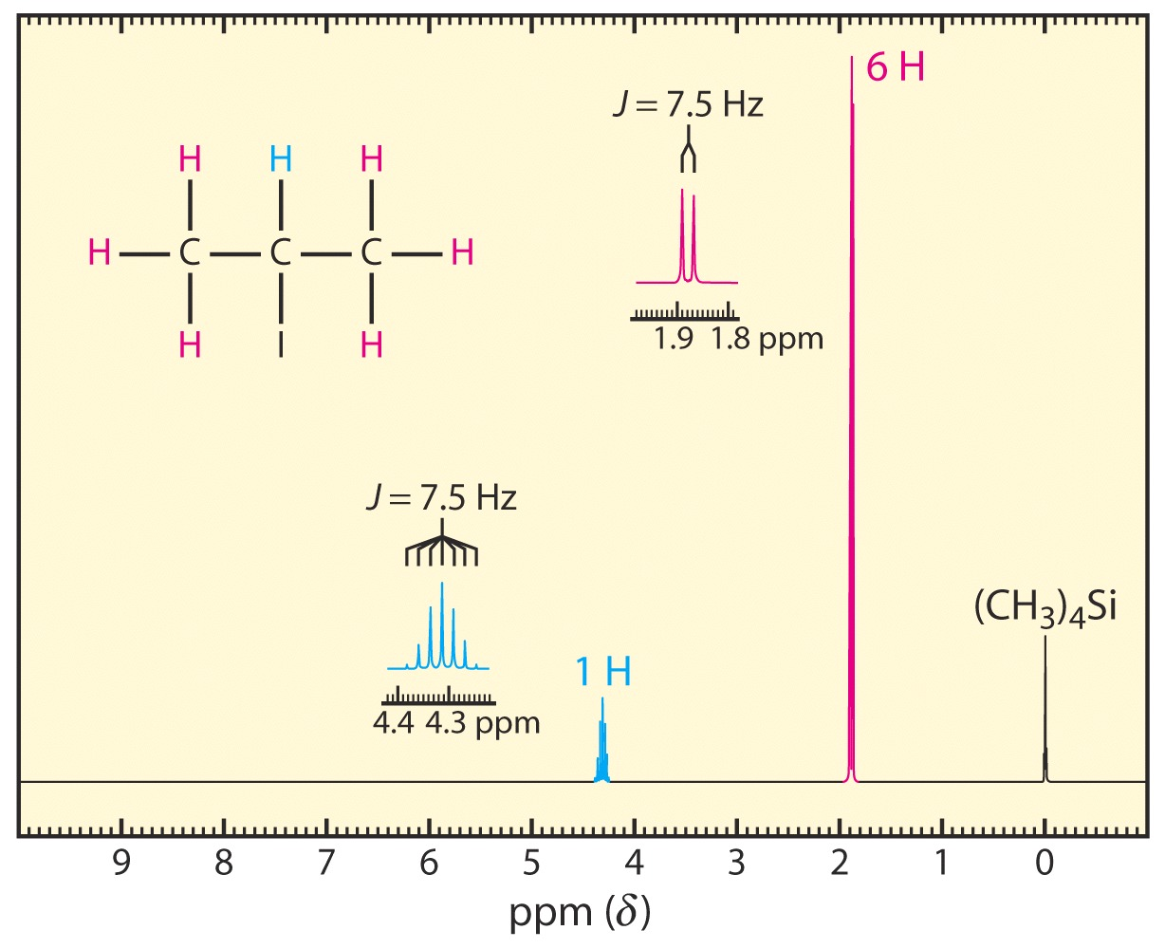
1:6:15:20:15:6:1

Slide 55
Number of Signals
Identify all the groups of equivalent protons in the molecules below and describe their relationships

Slide 56
Number of Signals
Protons with different electronic environments will give different signals
Protons that are homotopic will have perfectly overlapping signals
Protons are homotopic if the molecule has an axis of rotational symmetry that allows one proton to be rotated onto the other without changing the molecule
Find the rotational axis of symmetry in each molecule below

Slide 57
Number of Signals
Another test for homotopic protons is to replace the protons one at a time with another atom
If the resulting compounds are identical, then the protons that you replaced are homotopic

Slide 58
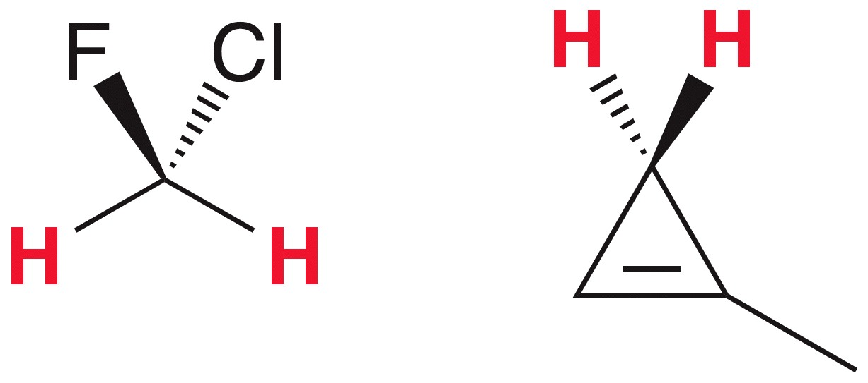
Number of Signals
Protons that are enantiotopic will also have perfectly overlapping signals
Protons are enantiotopic if the molecule has a plane of symmetry that makes one proton the mirror image of the other

Slide 59
Number of Signals
The replacement test is universal
These equivalents protons are enantiotopic
If the resulting compounds are enantiomers, then the protons that you replaced are enantiotopic

Slide 60
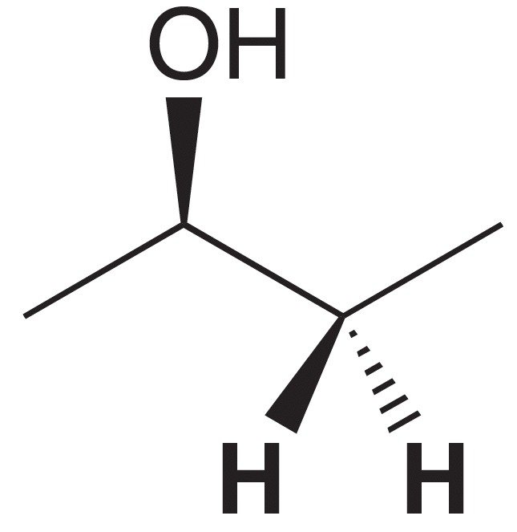
Number of Signals
If the protons are neither homotopic nor enantiotopic, then the are NOT chemically equivalent
Perform the replacement test on the protons shown in the molecule below

Slide 61
Number of Signals
If the protons are neither homotopic nor enantiotopic, then the are NOT chemically equivalent
Perform the replacement test on the protons shown in the molecule below
Diastereotopic

Slide 62
Number of Signals
There are some shortcuts you can take to identify how many signals you should see in the ¹H NMR
The 2 protons on a CH₂ group will be equivalent if there are NO chirality centers in the molecule: Homotopic

Slide 63
Number of Signals
There are some shortcuts you can take to identify how many signals you should see in the ¹H NMR
The 2 protons on a CH₂ group will NOT be equivalent if there is a chirality center in the molecule: Diastereotopic

Slide 64
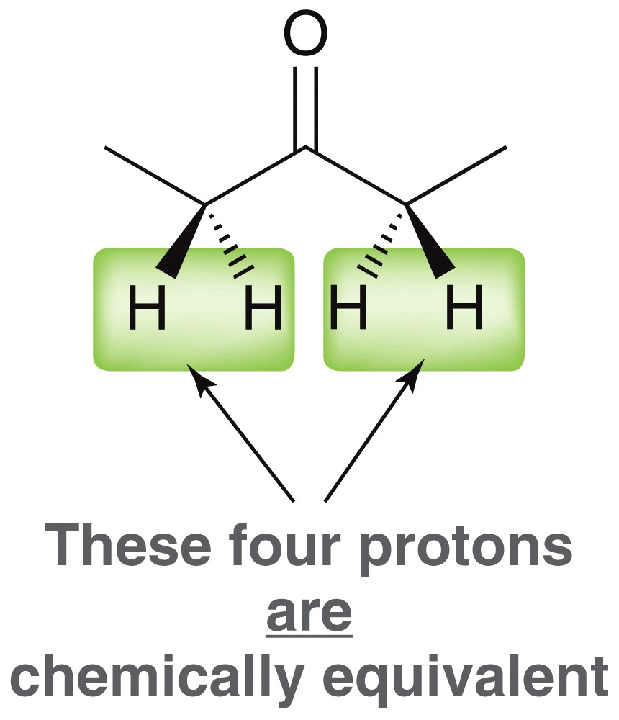
Number of Signals
There are some shortcuts you can take to identify how many signals you should see in the ¹H NMR
The 3 protons on any methyl group will always be equivalent to each other
Multiple protons are equivalent if they can be interchanged through either a rotation or mirror plane

Slide 65
“Sequential” [N+1] Rule
1st Order patterns can be analyzed for neighbors with differing Js.
Js should differ for non-equivalent neighbors.
H_{b}
H_{a}
J_{ab} = 3.6 Hz
J_{bc} = 6.8 Hz
c
CH₃
C
C
Cl
Cl
Cl
Apply split sequentially

Slide 67
The following slides provide addnl detail on this.
OH, NH, SH protons usually singlets and don’t split adjacent H signal

Slide 68
H_{b}
H_{a}
c
CH₃
C
C
Cl
Cl
Cl
J_{ab} = 3.6 Hz
J_{bc} = 6.8 Hz

Slide 69
Quartet of triplets or triplet of quartets or….. ?
J₁ > J₂ :
J₁
J₂
CH₃—CH₂—CH₂—Br
t
?
(J₁)
t
J₁ < J₂ :
qt or tq
(J₂)
J₂
J₁

Slide 70
If Js accidentally the same: [N+1] rule
J_{ab} = J_{bc} ➔ N + 1 Rule
Sextet

Slide 71
Sextet

Slide 72
Stereocenters and Methylene Groups

Slide 73
H Bonded/Acidic Protons: OH, SH, N H
Variable δ (concentration and moisture-dependent) and no coupling !
s !
Recall CH₂ O H
Why? Fast H⁺ exchange (H_{α} and H_{β} trade places) “decouples” hydrogens.
Variable δ

Slide 74
Coupling is restored on cooling, because proton exchange is “frozen” (on the NMR time scale).
CH₃OH
OH peak often broad; disappears on addition of D₂O to the sample (H/D exchange).

Slide 75
¹³C NMR Spectroscopy
Only 1% ¹³C in nature: No ¹³C—¹³C splitting, since chances of finding two ¹³C adjacent are small (~0.01%).
(For the same reason: No ¹³C—H seen in ¹H NMR. 99% of sample is ¹²C).
But: ¹³C—H visible in ¹³C NMR.
Large Js ¹³C H J ~ 100-150 Hz
¹³C C H J ~ 5-10 Hz

Slide 76
Triplet of quartets
Quartet of triplets

Slide 77
Coupling to H can be removed by “broad band” irradiation of all Hs
averages H_{α/β}
Hence: all lines are singlets !

Slide 78
Symmetry
C₇H₁₄ isomers
Number of Cs:
5
5
4
4
3
1
7

Slide 79
Chemical shift range : 200 ppm (¹H: 10 ppm)
Rules for deshielding same as in ¹H NMR (multiply by a factor of 10-20)

Slide 80
Chemical Shift Range

Slide 82
Advanced Techniques
Distortionless polarization transfer (“DEPT”) ¹³C NMR spectrum. Tells us whether the carbon is attached to 3, 2, 1 or no hydrogen, i.e. CH₃, CH₂, CH, or C. Requires running the spectrum in three different ways (using specific laser pulse sequences).
Example : Limonene.

Slide 83
Normal spectrum
DEPT-90 spectrum:
only CH
DEPT-135 spectrum:
CH and CH₃ positive
CH₂ negative peaks

