Slide 1
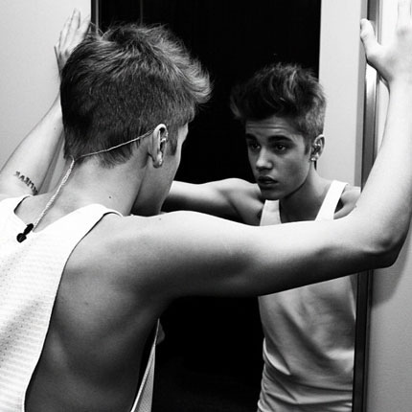
Chapter 5: Image And Mirror Image

Slide 2
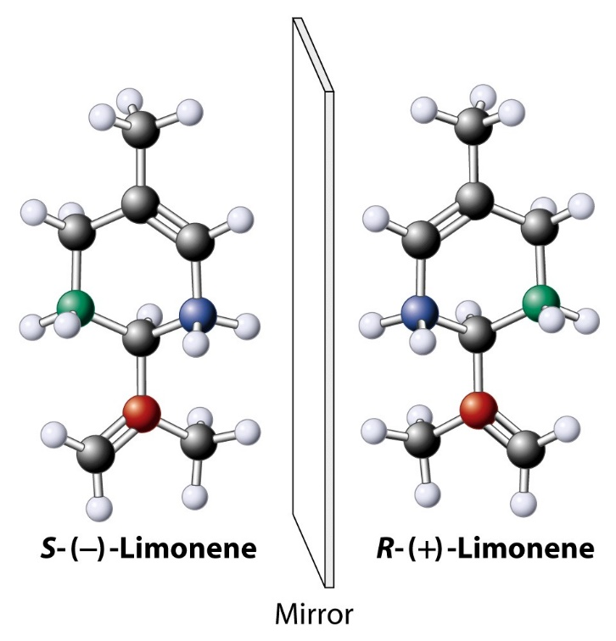
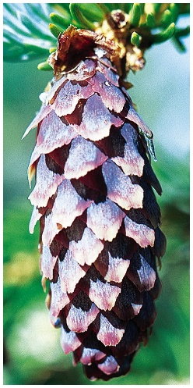
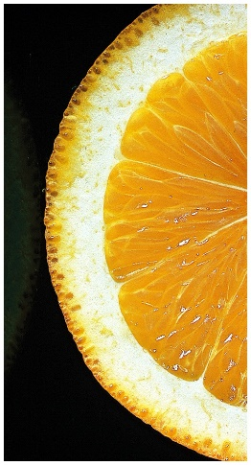
Image And Mirror Image Of Limonene
Spruce tree
Orange
“Handedness”

Slide 3
A New Type Of Stereoisomerism
Recall: a. Constitutional isomers (butane, 2-methylpropane)
b. Stereoisomers (cis-trans cycloalkanes)
c. Image-mirror image stereoisomers
Now:
Remember the bromination of butane:
50:50 chance
50:50
mixture
We thought these were identical……..

Slide 4
Enantiomers
The two 2-bromobutanes are not identical, because they are not superimposable: They are image and mirror image.
The two isomers are labelled enantiomers. Molecules that lack reflection symmetry are called chiral (from Greek: cheir, hand → “handedness”).
50:50 Mixture of enantiomers: Racemic mixture or racemate
Notes:
enantios, Greek, opposite

Slide 5
Stereocenters
Most organic molecules owe their chirality to the presence of a stereocenter, usually a carbon with 4 different substituents: an asymmetric carbon.
C
Stereocenter
*
labelled
If image and mirror image of a molecule are superimposable it is achiral. Quick test: presence of a mirror plane. Chiral molecules lack a mirror plane.

Slide 6
Asymmetric Carbon:
No Mirror Plane

Slide 7

Symmetry In Nature

Slide 8
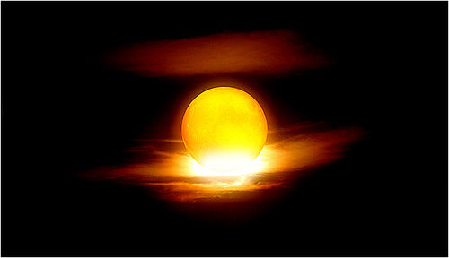

Slide 9
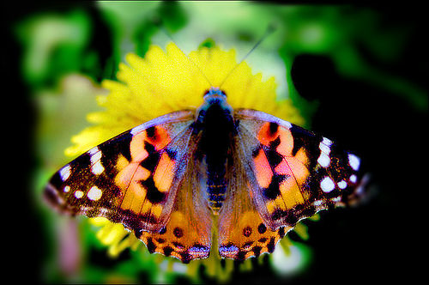

Slide 10
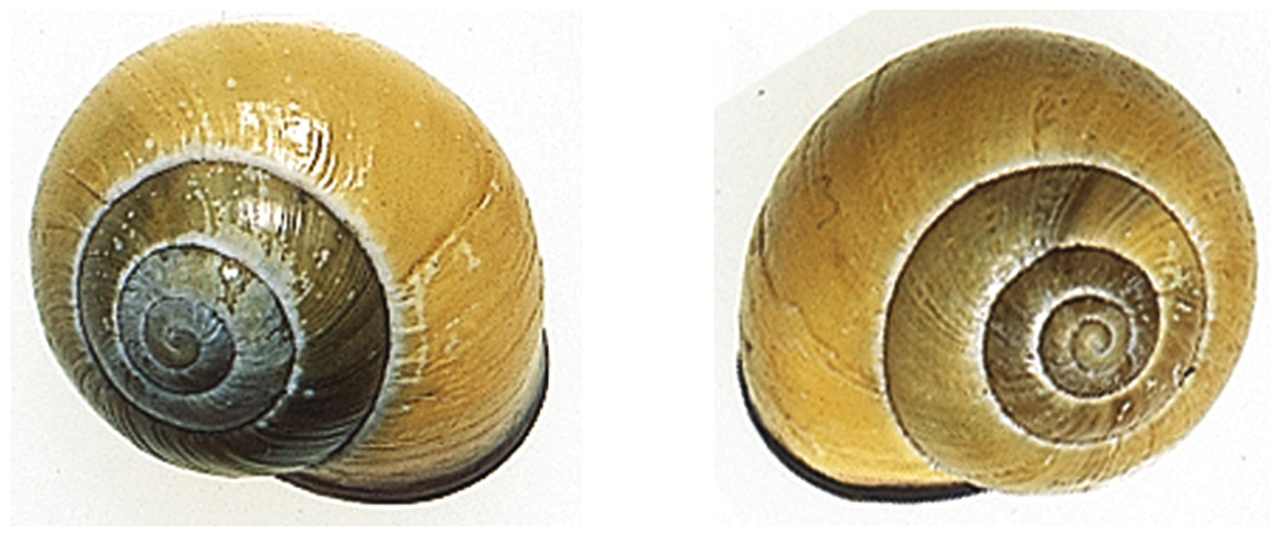
Escargot
20,000 : 1

Slide 11
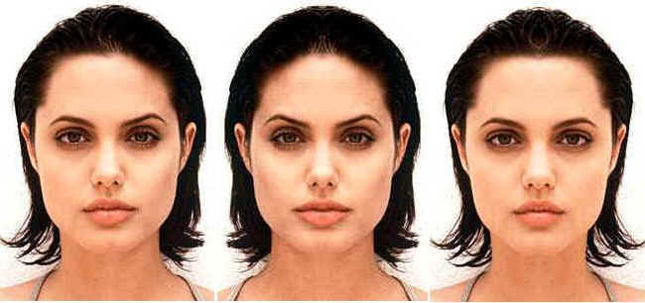
Symmetry is beautiful, or is it ?

Slide 12
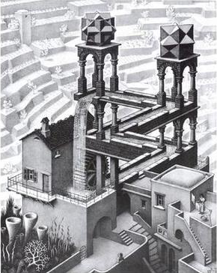
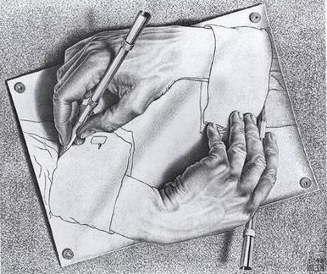
Symmetry in Art: M. C. Escher
Drawing Hands
Waterfall

Slide 13
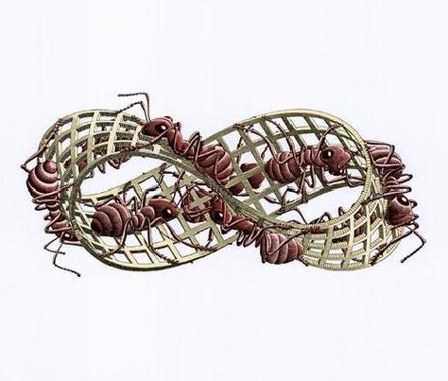
Möbius Strip
Notes:
August Ferdinand Möbius Born: 17 Nov 1790 in Schulpforta, Saxony (now Germany)
Died: 26 Sept 1868 in Leipzig, Germany

Slide 14
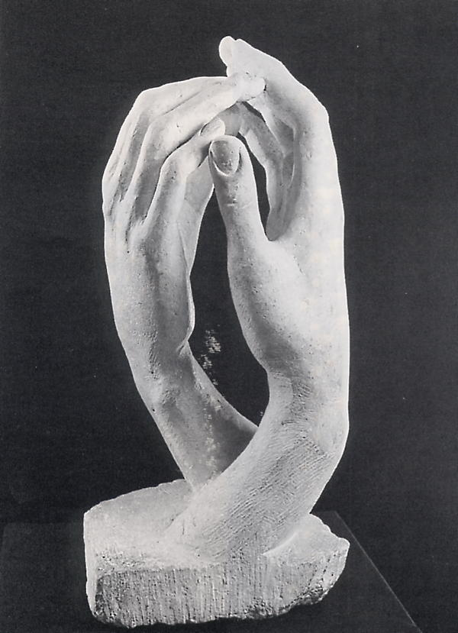
Auguste Rodin: La Cathedral

Slide 15
The Various Kinds Of Isomers
THeads
Walba
Notes:
Movie 5:04 min-Takemetotheriver

Slide 16
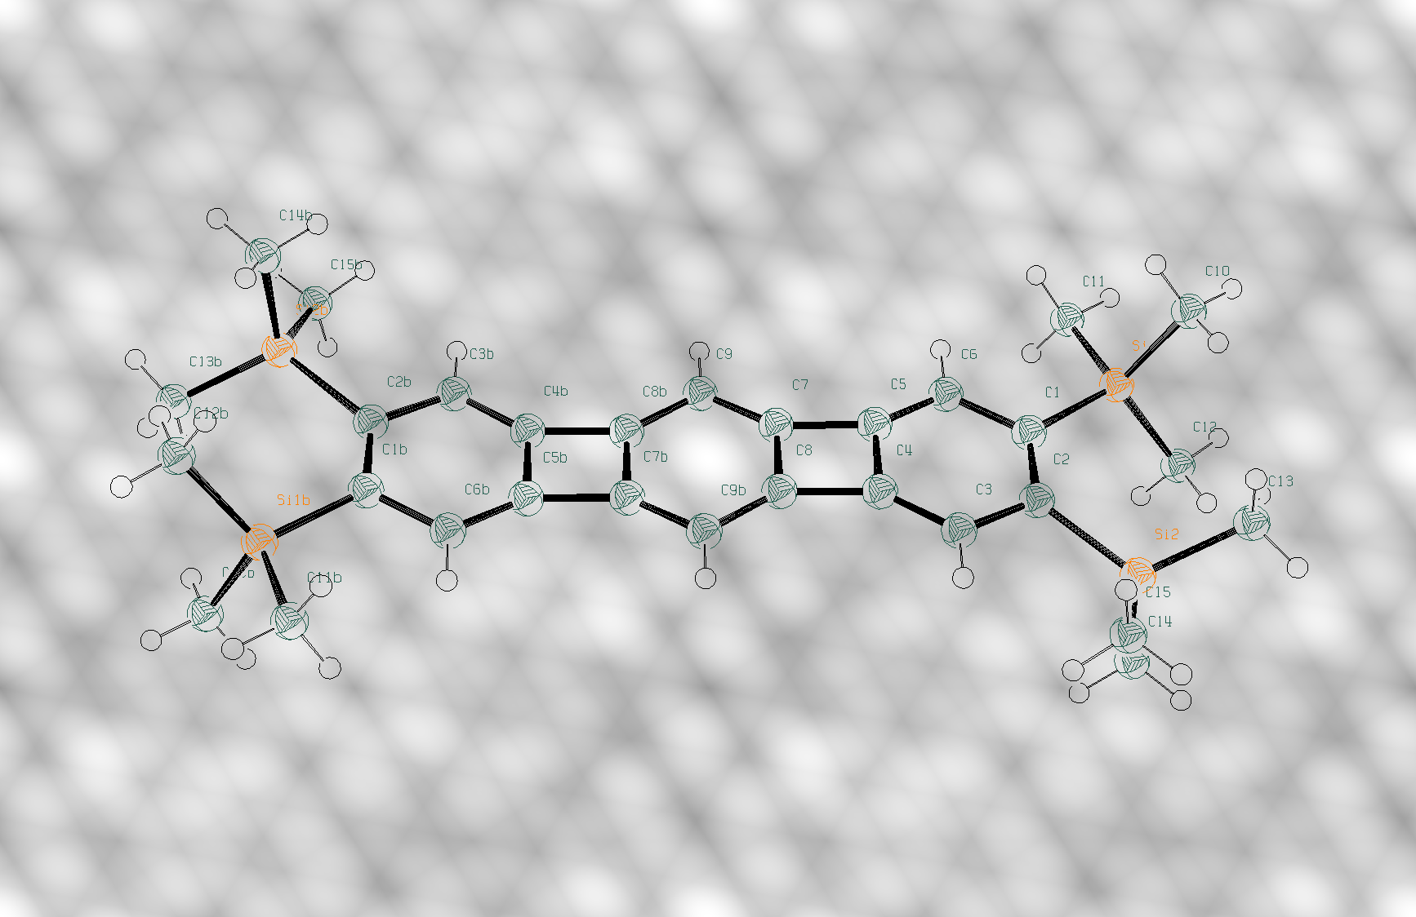
Enantiomers: How To Tell Which Is Which
“Handedness” (i.e., left or right) is called the absolute configuration. Measured by:
X-ray crystal structure = “Photo.”

Slide 17
The Polarimeter
2. Polarimeter: Rotation of plane polarized light
One enantiomer (image) → rotates light dextrorotatory (clockwise), (+)-enantiomer
The other enantiomer (mirror image) → rotates light levorotatory (counter-clockwise), (-)-enantiomer.

Slide 18
Optical Rotation
Enantiomers are optically active. Racemates are not.
Optical rotation:
α
Measured rotation
[α]_{λ}^{t(ºC)} =
lc
H₃CH₂C
CH₂CH₃
Concentration (g ml⁻¹)
*
*
Length of vessel (in dm, usually = 1)
C
C
H
CH₃
H₃C
H
Br
Br
[α] is called specific rotation
-23.1
+23.1
Mirror
plane
Note: Sign of rotation does not tell you absolute configuration

Slide 19
Examples of [α]

Slide 20
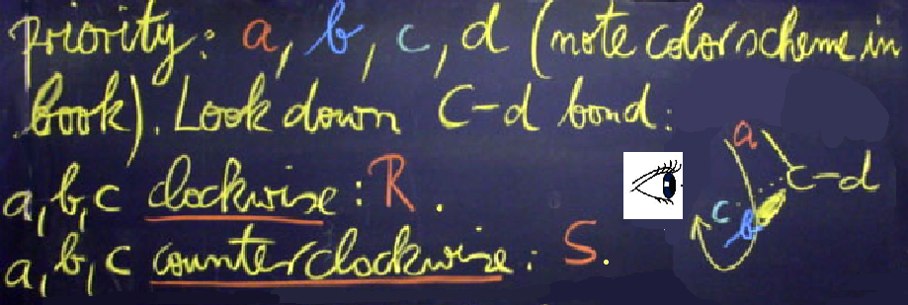
Naming Enantiomers
Or, How To Describe Absolute Configuration At A Stereocenter
Cahn-Ingold-Prelog R,S-Nomenclature
Label all substituents at stereocenter, starting at point of attachment, according to the sequence rules (to come next) in order of decreasing priority: a, b, c, d (note color scheme). Face the molecule, looking down C-d bond:
a
a, b, c clockwise: R
C
d
c
a, b, c counterclockwise: S
R
b

Slide 21
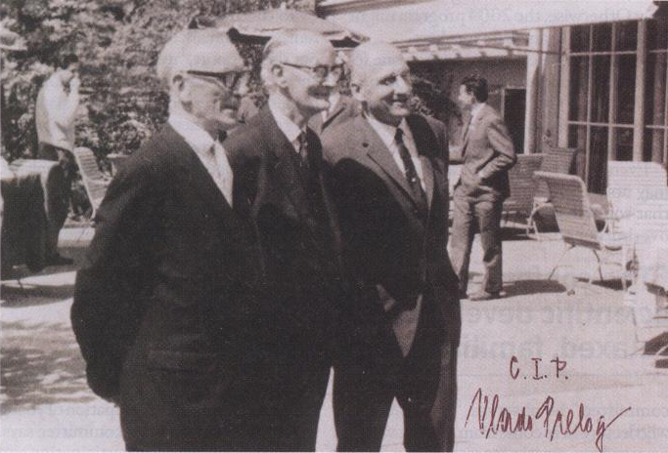
Cahn-Ingold-Prelog
1966
Robert Sidney Cahn (1899-1981)
Sir Christopher Kelk Ingold (1893–1970)
a, b, c, d
Vladimir Prelog (1906–1998)

Slide 22
The Sequence Rules
1. Order by atomic number, i.e. H = 1, lowest.
d
H
*
a
C
Exception: lone pair,
# “zero”. E.g., amines:
:
c
N
I
R
CH₃
Br
d
b
2. If same priority at first atom: Go to first point of difference.
CH₃
‹
‹
-CH₂CH₃
-CCH₃
-CH₂CH₂SH
-CH₂CH₂SCH₃
H
CH₃
D
‹
‹
-CH₂CH₂OH
-CHCH₃
-CH₂CBr₃
-CHCH₃

Slide 23
3. Multiple bonds: Add double or triple representations of atoms at the respective other end of the multiple bond.
H
H
C
C
H
H
C
C
C
C
C
C
C
C
C
C
C
C
N
C
C
O
H
C
O
C
N
C
N
H
O
C
N
C

Slide 24
Procedure For Assignment
Of R And S

Slide 25
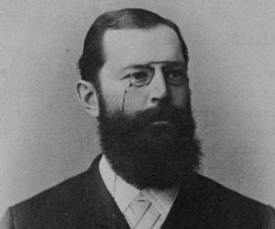
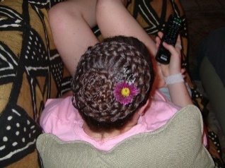
Fischer Projections
To help keeping schematic track of stereochemistry: A flat stencil for stereocenters
Emil Fischer (1852–1919)
Br
Br
H
CH₃
C
CH₂CH₃
H
Br
CH₃
CH₂CH₃
Eyes in the plane of the board
H
Depending on your starting dashed-wedged line structure, several Fischer projections are possible for the same molecule.

Slide 26
A Mental Exercise

Slide 27
Rules For Handling Fischer Projections
1. Rotate by 180°: absolute configuration stays same; rotate by 90°: absolute configuration switches.
2. The single mutual exchange of any pair of substituents gives the other enantiomer. Hence: Two exchanges leave absolute configuration.
Example: (2R)-bromobutane
Br
CH₃
CH₂CH₃
R
R
R
CH₃
CH₂CH₃
Br
H
H
Br
H
CH₂CH₃
CH₃

Slide 28
Use Of Fischer Projections In Assigning R,S
Example: a 2-bromobutane 1. Draw (any) Fischer projection. 2. Do two exchanges to place d on top (if not already there fortuitously).
a
a
d
Br
c
b
CH₃
CH₂CH₃
c
b
b
c
R !!
H
d
a
d
Note: There are three possible arrangements with d on top; all are R :
d
R
d
R
d
R
c
a
b
c
a
b
b
a
c

Slide 29
Problem: Are these two molecules the same
or opposite enantiomers? R or S ?
F
F
H
CH₃
I
H
I
CH₃

Slide 30
Solution:
b
F
F
d
H
CH₃
H
CH₃
b
a
d
c
S
I
I
c
a
b
F
F
d
I
H
I
H
c
b
a
d
S
CH₃
CH₃
a
c

Slide 31
Diastereomers
Two Stereocenters: C-3-chlorination of 2-bromobutane
Cl
Generates all combinations:
RR, RS SR, SS
Four stereoisomers
C3
*
*
Cl₂, hν
*
C2
-HCl
Br
Br
RR SS and RS SR are enantiomer pairs
Diastereomers
Diastereomers are stereoisomers that are not related as image / mirror-image.
Notes:
Selective for vicinal Bridging haloradical
Vicinal chlorination of alkyl chlorides with molybdenum(V) chloride
Quick View Other Sources
By San Filippo, Joseph, Jr.; Sowinski, Allan F.; Romano, Louis J.
From Journal of Organic Chemistry (1975), 40(23), 3463-4. | Language: English, Database: CAPLUS
The reaction of alkyl chlorides with molybdenum(V) chloride (1:2) in methylene chloride results in vicinal chlorination in fair to excellent yields. Primary chlorides are unaffected. The reaction is regiospecific; thus, halogenation at a tertiary center is favored exclusively over halogenation at a secondary center which in turn is favored exclusively over chlorination at a primary center. Chlorination of either cyclohexyl or cyclopentyl chloride yields the cis vicinal dichloride, exclusively. Vicinal chlorination of alkyl bromides is accompanied by halogen interchange. Aryl halides are recovered unchanged under the reaction conditions.
~2
4. α-​Chlorination of alkyl bromides by antimony pentachloride
Quick View Other Sources
By Luche, J. L.; Bertin, J.; Kagan, H. B.
From Tetrahedron Letters (1974), (9), 759-62. | Language: French, Database: CAPLUS
Cycloalkyl and sec- and tert-​alkyl bromides with SbCl5 in CCl4 gave 61-​98​% vicinal chlorobromides. The reaction was stereospecific for cycloalkyl bromides. E.g., cyclohexyl bromide gave 81​% trans-​1-​chloro-​2-​bromocyclohexane. Alkyl bromides gave mixts. of erythro- and threo-​dihalides. Migration of Br occurred in some cases.
~1

Slide 32
Fischer Projections

Slide 33
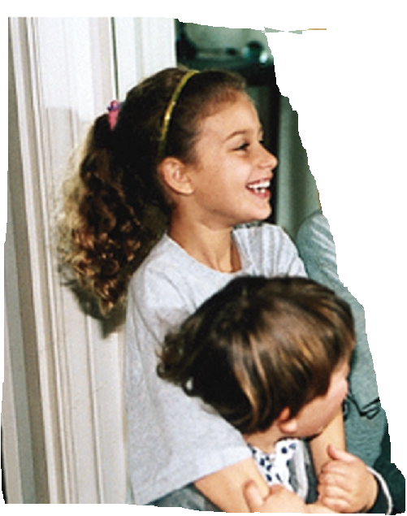
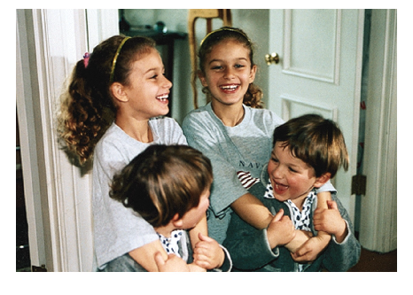
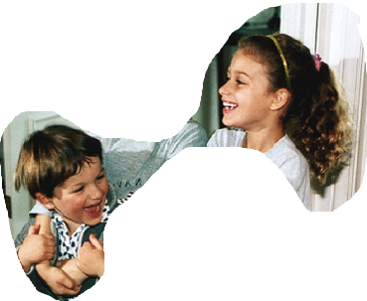
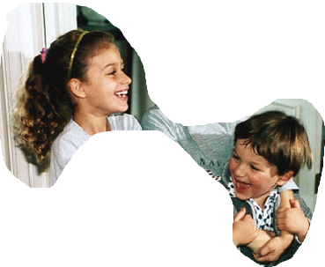
Julien and Paloma: Two Stereocenters
S
R
R
S
S
=
R
R
S
R
S
S
R

Slide 34
Assigning R,S In Diastereomers
Remember: a b c d
Fischer projection is “artificial”—eclipsed
Mozart
Walba
Notes:
3:24 Souslecieldeparis

Slide 35
Cyclic Cis And Trans Isomers Are Diastereomers!
Link termini
R,R (and S,S) = trans
R,S (and S,R) = cis

Slide 36
Assigning R,S In Cyclic Analogs

Slide 37
Two Stereocenters With The Same Substituents
Br
Br_{2,} hv
Will give: SS SR RS RR
*
*
-HBr
*
Br
Br
Diastereomers
CH₃
CH₃
CH₃
CH₃
H
Br
Br
H
H
Br
Br
H
Br
H
H
Br
H
Br
Br
H
CH₃
CH₃
CH₃
CH₃
This diastereomer is special: Image is superimposable with mirror image!!! The molecule has an internal mirror plane.

Slide 38
The Achiral Meso Diastereomer
The diastereomer with a mirror plane is achiral; such diastereomers are called meso. 2,3,-Dibromobutane has only three stereoisomers.

Slide 39
Visualizing The Mirror Plane In A Meso Diastereomer
Rory
Walba
Notes:
5:37 RoadtoHell

Slide 40
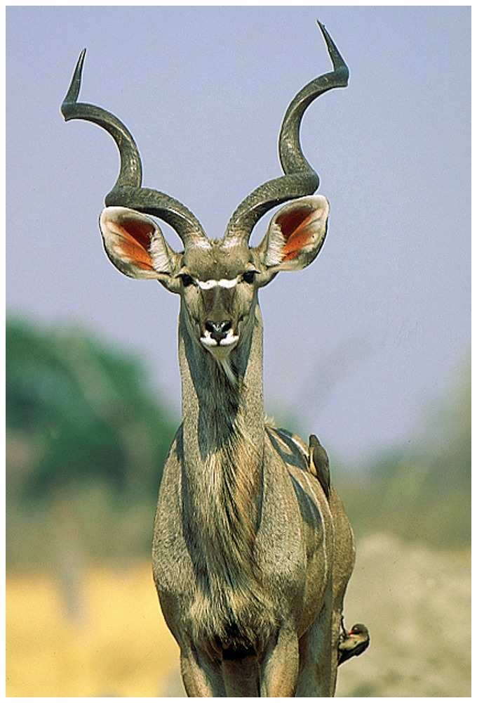
The Great Kudu
Is Meso

Slide 41
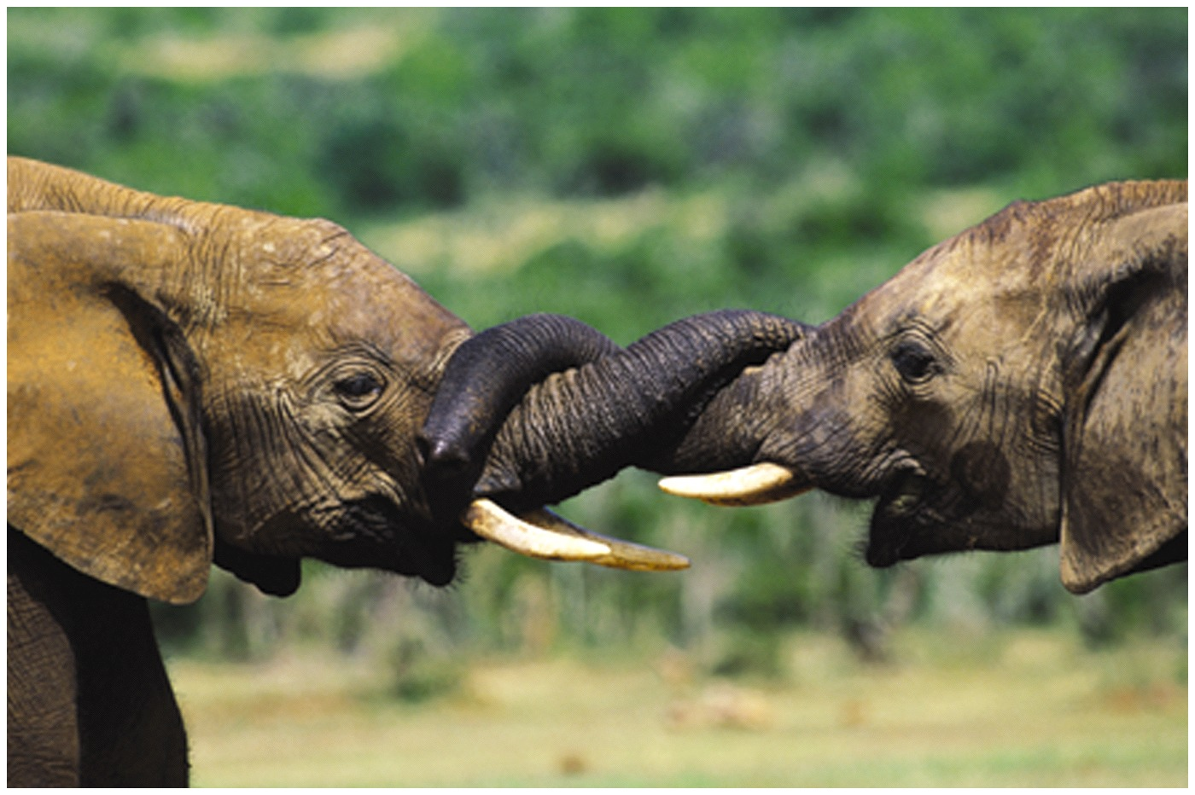
Teaser: The Kiss of the Elephants
Chiral or Meso?

Slide 42
Cyclic Meso Molecules: Cis
achiral

Slide 43
Three Stereocenters
RRR
SSS
RRS
SSR
SRS
Diastereomers
RSR
SRR
RSS
8 Stereoisomers (maximum): 4 Diastereomeric pairs of enantiomers.
Enantiomers
Less if meso present, e.g., meso-2,3,4–tribromopentane:
CH₃
CH₃
H
Br
H
Br
H
Br
Br
H
H
Br
H
Br
CH₃
CH₃

Slide 44
Stereoisomerism Increases Chemical Space Drastically
n Stereocenters give rise to a maximum of 2^{n} stereoisomers, e.g., 2, 4, 8, 16, 32…
Note: Stereocenters need not be adjacent for these relationships to hold:
*
*
*

Slide 45
Stereochemistry In Chemical Reactions
Ground Rule: We cannot get excess of one enantiomer from achiral starting material or from a racemate. I.e., we cannot “engender” optical activity from optically inactive ingredients.
Br_{2,} hv
*
Chiral, but racemic
50:50 mix of R and S
-HBr
achiral
achiral ingredients
Br

Slide 46
Why? The Intermediate Radical Is Achiral
50/50 Chance of attack from either side:
R :S = 1 : 1

Slide 47
Mechanisms Are Important:chlorination Of (S)-2-bromobutane At C2
CH₃
CH₃
CH₃
S
Br
S
Br
R
H
Cl·
Br
Cl₂
Cl
Br
Cl
2
C
CH₂CH₃
H
H
-
CH₃
H
H
H
HCl
H
CH₃
Same environment (mirror plane)
CH₃
CH₃
Optically active
Racemate Optically inactive Formed in equal amounts
Note: If you start from the racemate: same outcome.

Slide 48
Leaving The Stereocenter Untouched:Chlorination At C3
CH₃
CH₃
CH₃
H
S
S
S
H
Br
H
Cl₂
Br
Br
Cl·
H
H
C
C
S
-
CH₃
R
S
H
3
HCl
CH₃
H
H
Cl
Cl
H
Br
CH₃
Different environment
CH₃
CH₃
Diastereomers Both optically active
Note: If you start from the racemate, you still form diastereomers, but they are racemic (not optically active).
Formed in unequal amounts:
“Stereoselectivity”

Slide 49
Optically Active Or Racemic? Wrting Conventions
Usually, it is assumed that all ingredients in a reaction are racemic. To save time, typically only one enantiomer is written. For example, the chlorination of racemic 2-bromobutane at C3 is written as follows:
Equimolar presence of the other enantiomer is assumed
If the starting material or products are optically active, it is indicated by the R/S notation, the sign of optical rotation, or some surrounding text. For example,

Slide 50
Stereoselectivity
Stereoselectivity:
Preferential formation of one stereoisomer over
the other.

Slide 51
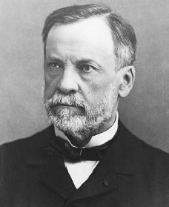
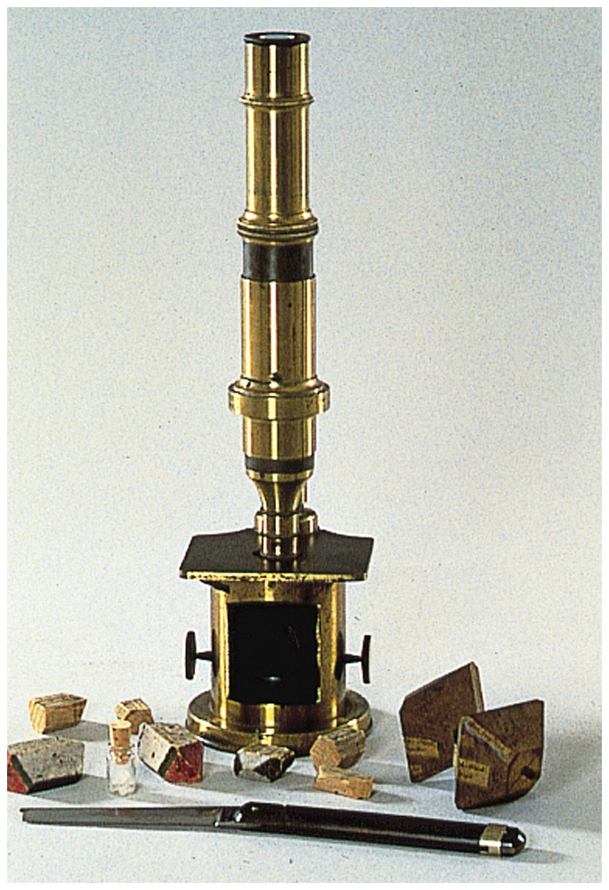
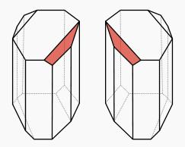
How Do We Get A Pure Enantiomer?
Louis Pasteur (1822–1895)
Separation of enantiomers from the racemates:
resolution
Pasteur was lucky: the enantiomers of racemic ammonium tartrate separate as two “enantiomeric crystals”.

Slide 52
Usually: Chemical Separation Of Enantiomers
Use a cheap (typically a natural product) pure enantiomer as an auxiliary to bind to components of racemate: gives diastereomers, which can be separated. Like using a left hand (auxiliary) to sort another person’s right and left hands:
After separation, the auxiliary is removed to leave pure enantiomers of original racemate.

Slide 53
From wine fermentation
Similar value
coincidental

Slide 54
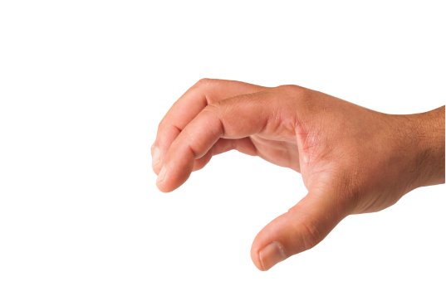
Enantioselectivity:
Generating One Enantiomer From Achiral Material
X
X
Br
*
C
CH₂CH₃
C
CH₃
CH₂CH₃
Br
CH₃
A “handed” reagent or catalyst can tell the difference between top and bottom: different energies

Slide 55
Enantiomer Recognition In Nature
Receptor sites in enzymes: the “active site”

Slide 56
Enantiomers And Physiological Activity

Slide 57
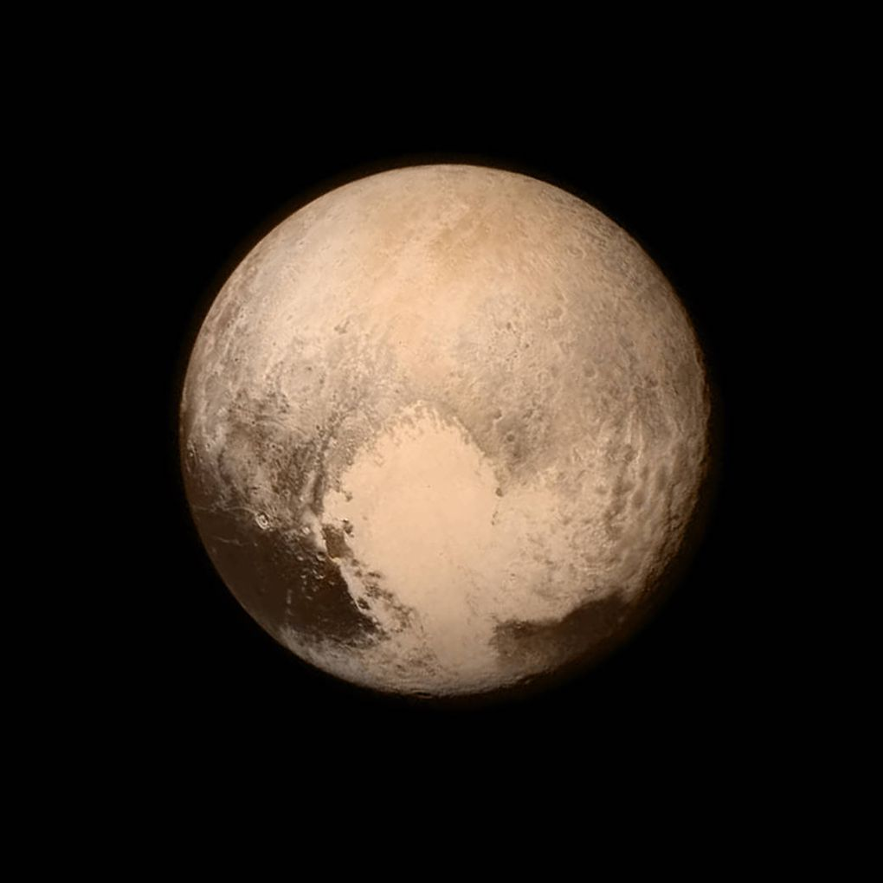
The Origin Of Our Enantiomer World:
Many Theories
Space (begs the question), “spontaneous resolution” and amplification, crystal surfaces or clays, earth’s rotation, parity violation at the atomic level (measured in radioactive decay of ⁶⁰Co), circularly polarized “chiral” light………
Is there chiral life out there?
New Horizons spacecraft: Pluto
July 18, 2015 02:00 pm

