Slide 1
Chapter 4: Cycloalkanes
Notes:
Diosgenin was first extracted from the Mexican yam in 1941 and this continues to provide a source for the production of sex steroids including norethisterone (norethindrone in the USA) and progesterone
CHEMICAL HIGHLIGHT 4-2
Controlling Fertility: From “the Pill” to RU-486
The menstrual cycle is controlled by three protein hormones from the pituitary gland. The follicle-stimulating hormone (FSH) induces the growth of the egg, and the luteinizing hormone (LH) induces its release from the ovaries and the formation of an ovarian tissue called the corpus luteum. The third pituitary hormone (luteotropic hormone, also called luteotropin or prolactin), stimulates the corpus luteum and maintains its function.
As the cycle begins and egg growth is initiated, the tissue around the egg secretes increasing quantities of estrogens. When a certain concentration of estrogen in the bloodstream has been reached, the production of FSH is turned off. The egg is released at this stage in response to LH. At the time of ovulation, LH also triggers the formation of the corpus luteum, which in turn begins to secrete increasing amounts of progesterone. This last hormone suppresses any further ovulation by turning off the production of LH. If the egg is not fertilized, the corpus luteum regresses and the ovum and the endometrium (uterine lining) are expelled (menstruation). Pregnancy, on the other hand, leads to increased production of estrogens and progesterone to prevent pituitary hormone secretion and thus renewed ovulation.
The birth control pill consists of a mixture of synthetic potent estrogen and progesterone derivatives (more potent than the natural hormones), which, when taken throughout most of the menstrual cycle, prevent both development of the ovum and ovulation by turning off production of both FSH and LH. The female body is essentially being tricked into believing that it is pregnant. Some of the commercial pills contain a combination of norethindrone and ethynylestradiol. Other preparations consist of similar analogs with minor structural variations.
A fertilized human egg before cleavage (zygote), approximately 100 mm in size.
RU-486 (mifepristone) is a synthetic steroid that blocks the effects of progesterone. The fertilized egg is not implanted, because the necessary preparation of the endometrium has been prevented. RU-486 has been used in France since 1988 as a “morning after” pill. After much discussion and testing, the Food and Drug Administration approved the drug for the U.S. market in 2000.
Journal of Young Investigators
Undergraduate, Peer-Reviewed Science Journal Volume Six FEATURE ARTICLE RECENT ISSUES | ARCHIVES | RESOURCES | JYI NEWS | ABOUT JYI Issue 7, February 2003
Yams of Fortune: The (Uncontrolled) Birth of Oral Contraceptives
Mandy Redig
Biochemistry, University of Arizona
redig@jyi.org
Russell Marker hated wasting time. Upon qualifying for a doctoral degree in chemistry as a twenty-three-year-old student at the University of Maryland in 1925, all that stood between him and his degree were several required physical chemistry courses. But Marker didn't want to take physical chemistry, as he already had a master's degree in the subject. The university refused to modify its graduation requirements and Marker's own advisor threatened him with the dead end career of "urine analyst" if he didn't complete his coursework. Marker refused and left the university without his degree, an independent scientist in search of a job. Russell Marker during his years at Pennsylvania State University
Courtesy of Pennsylvania State University
Despite his advisor's lack of optimism, Marker did indeed go on to make tremendous scientific contributions throughout his career. While not the only scientist or social visionary involved, Marker's work formed the scientific cornerstone for the development of oral contraceptives, among the most socially significant scientific discoveries ever made. Yet despite such professional achievements, Marker's story remains marked by the combination of independence, good fortune, and ingenuity that led him to walk away from a Ph.D. because of a disagreement over coursework.
In the words of Steven Weintraub, the Russell and Mildred Marker Professor of Natural Products Chemistry at Pennsylvania State University, "There are more stories told about Russell Marker than perhaps any chemist. Although many of these stories are apocryphal, they are so fascinating that most of us cannot bear to stop repeating them. This is the oral history of our profession that we pass to our colleagues and our students. They are the campfire stories that bind our profession together."
Following his less-than-glorious send-off from the University of Maryland, Marker's interest in hydrocarbon research led him to Ethyl Corporation. While at Ethyl, he developed an octane rating system for gasoline that is still used today. However, after a few years Marker's chemical interests changed, and he left Ethyl to work as an organic chemist at the Rockefeller Institute. Here too he met with success; over a six-year period he produced many publications focusing on molecular configurations and their relationship to reaction chemistry. Eventually, Marker's background in hydrocarbon chemistry and molecular orientation led him to the developing field of steroid research. In 1938, he accepted a funded position at Pennsylvania State University.
The power of hormones
Figure 1: An overview of the menstrual cycle. Progesterone is critically important in controlling this progression of events and thus the ability to medically manipulate progesterone led to the development of birth control.
(Click on image to see larger version)
Courtesy of Holistic Online
Of particular interest at this time in chemical history were the recently discovered sex hormones, or androgens, molecules such as testosterone, estrogen, and progesterone (see Figure 1). Of these, progesterone was perhaps the most interesting because it is the chemical precursor for another class of steroids, the glucocorticoids. Glucocorticoids and androgens are instrumental in controlling many of life processes. Metabolic disposal of carbohydrates, proteins, and lipids, inflammatory responses vital to a functioning immune system, maintenance of blood hydration, pH and salt levels, as well as sexual development and function all rely on the proper functioning of various steroids.
The vast power of such hormones was not lost on physicians, and by the 1930s, progesterone was used to treat menstrual disorders, problem pregnancies, and gynecological cancers. However, progesterone was so expensive to purchase that both research and medical endeavors were often stymied. The only known way to isolate the hormone involved laborious and inefficient synthesis exploiting the byproducts of cholesterol oxidation. In a price comparison, at today's market value, gold sells for about $11 a gram; in the 1930s, progesterone sold for $80 a gram. And so, despite the potential medical benefits of steroid hormones, progress in the field remained frustratingly slow.
It may have been his unusual academic background or work experience that contributed to Russell Marker's breakthrough in the field of hormone synthesis. In 1938 he presented a chemical hypothesis that contradicted prevailing chemical beliefs of the time. He proposed that the side chain of sarsasapogenin, a plant steroid derived from the sarsparilla plant, was not chemically inert but actually chemically reactive. As a result, if chemical groups were removed from the sarsasapogenin side chain, then what remained was no longer sarsasapogenin but progesterone (see Figure 2). In a series of reactions now known as Marker degradation, Marker had found a way to synthesize progesterone. Figure 2: The molecular structure of diosgenin, the precursor for progesterone isolated from yams
Courtesy of www.friedli.com/herbs/phytochem/ glycosides.html
There was only one problem - sarsasapogenin was also extremely expensive. However, rather than give up on his idea, Marker began studying botany, trying to find a less-expensive chemical relative of sarsasapogenin with which to further his studies. His search led him south, to the Mexican-American border in the Southwest, and finally into Mexico itself.
A trip to Verzcruz, Mexico
In November 1941, he found his steroid source in the most unlikely of plants, the wild yam Dioscorea that grows near the city of Oriziba in the state of Veracruz (see Figure 3). Marker went on a field trip, collecting two large sacks of the tuber in the mountains of Veracruz. With this precious luggage he headed back to Oriziba to return to his position at Penn State.
Unfortunately, when he went to claim his yams, he discovered that they had disappeared from the top of the bus; luckily he was able to bribe a police officer for their release. He later smuggled the yams across the border. Once back in Pennsylvania, Marker demonstrated that diosgenin, the compound extracted from the yams, could be efficiently synthesized into progesterone. Yet despite this achievement, not a single American pharmaceutical company wanted to commercialize Marker's process. In a 1979 interview, Marker recounted his tale of frustration:
Figure 3 : Veracruz, Mexico, in the eastern region of Mexico, was the source of Marker's wild yams
(Click on image to see larger version)
Courtesy of http://shunya.net/Pictures/Mexico/mexico-map.jpg
"After I was convinced that Parke-Davis would not go into it, I tried other companies to get support. For instance, I tried Merck and they said that since Parke-Davis turned me down they would not go into it. … Then I decided that I was going to have to go into it myself."
And so, with the determination that had once led him to walk out on a Ph.D., Marker resigned his position at Penn State, withdrew all of his savings, and moved to Veracruz. He soon became an expert on yams, harvesting 10 tons of them from the Mexican jungle. The yams were dried and reduced to a syrup that was easily transported back to the United States. Marker borrowed a friend's lab to convert his yam syrup into three kilograms of progesterone, at that time the largest batch ever produced, with a 1943 market value of about $240,000. Convinced that his idea was commercially viable, Marker decided to return to Mexico in search of partners in industry.
Arriving in Mexico City, he turned to the phonebook. In 1944 a small company called Syntex was formed as a result of a partnership between Marker, Emerik Somolo, a Hungarian immigrant to Mexico, and Dr. Federico Lehmann, a German-trained scientist. Unfortunately, this relationship was not to last. Following disputes over profits, Marker pulled out of Syntex by the end of 1945 and established his own company. For personal reasons he retired from this position, and from chemical research itself, in 1949 at the age of 47.
Continuing on Marker's foundation
Yet Syntex as well as other companies were able to continue on the foundation Marker had pioneered. Back in the early 1920s when Marker was still a graduate student, experimental manipulation in rats proved that an unknown compound secreted from the ovaries of a pregnant mammal prevented ovulation, in a process called hormone regulation.
By 1950 two additional discoveries had been made. First, the "magic substance" first described in 1921 was properly identified as progesterone. Second, following the achievements of Russell Marker and succeeding chemists, progesterone had become one of the cheapest and most readily available of all hormones. Thanks to Syntex, the price of progesterone had plummeted from $80 to $1 per gram.
Oral Contraceptives Timeline
The development of the first oral contraceptives was a cumulative event following the work and visions of many people on an international scale - men and women as well as scientists and social activists. This timeline is an attempt to place Russell Marker, credited with inventing "the pill," in historical and scientific perspective.
1916
Margaret Sanger opens the first birth control clinic in the United States.
1921
Austrian endocrinologist Ludwig Haberlandt begins experiments on the role of progesterone.
1925
Russell Marker leaves his doctoral work and begins a career in industry.
1938
Marker proposes the Marker degradation for the synthesis of progesterone from plant products.
1942
Marker demonstrates that diosgenin, extracted from wild yams, can be used to synthesize progesterone.
1944
Syntex, a joint venture between Marker, Emerik Somlo, and Federico Lehmann, is launched.
1945
Marker leaves Syntex.
Syntex recruits Dr. George Rosenkranz, a Hungarian émigré in Cuba, as research director.
1949
Marker retires from chemical research.
Carl Djerassi, a chemist at Ciba Pharmeceutical Company in New Jersey, is recruited by Rosenkranz to go to Mexico as director of steroid research at Syntex
1951
Norenthindrone, an orally active variant of progesterone, is discovered in a Syntex lab under the direction of Rosenkranz and Djerassi.
Sanger challenges her friend Dr. Gregory Pincus to find an oral contraceptive. Katherine McCormick, a friend of Sanger, donates research funds.
1953
Carl Djerassi leaves Mexico but retains a research connection with Syntex.
Dr. Gregory Pincus begins testing oral contraceptives using G.D. Searle's norethynodrel.
1960
The Food and Drug Administration approves the first oral birth control pill using the norethynodrel produced by G.D. Searle.
1962
The FDA approves a birth control pill containing norethindrone, the Syntex compound.
1970 Senate hearings held on the safety of oral contraceptives.
These discoveries became reality just as social consciousness was beginning to explore the concept of contraception; hormonal manipulation of the female reproductive system seemed an ideal possibility for birth control. However, progesterone itself wasn't the best candidate because it required injection; an orally-active mimic of progesterone was a better alternative.
In 1951, Carl Djeressi, the scientist who succeeded Marker at Syntex, filed for a patent on a compound he called norethindrone, a modification of progesterone. In 1953, the pharmaceutical company G.D. Searle obtained a patent on the work of Frank Colton, a chemical variant they dubbed norethynodrel. The irony of this dual discovery is that neither scientist had a birth control pill in mind when developing the compounds. There was greater interest in using progesterone mimics to synthesize cortisol, a compound already in use as a treatment for inflammatory disease.
However, eventually the connection was made between orally active "progesterone" and birth control. After several years of testing, G.D. Searle obtained the first FDA patent for an oral contraceptive in 1960. This was followed in 1962 by a Syntex patent now marketed as part of Johnson & Johnson. Norethindrone, the chemical that got its start in a small lab in Mexico, is the active ingredient in nearly half of all oral contraceptives used today.
The birth control pill today
The work that began with the study of sex hormones in the early 20th century involved many research scientists, physicians, and social visionaries. Indeed, there is a dialogue that continues today concerning the long-term effects of hormonal manipulation (see a timeline of the history of oral contraceptives). However, it cannot be denied that the science begun by Russell Marker has had tremendous repercussions in many different fields. With more than 10 million users in the United States alone, "the pill," as it is commonly known, is the most common form of non-surgical birth control. Also used in the developing world, the ability to control pregnancy and family development has had an undeniable affect on women's health and social opportunities. Says Susan Scrimshaw, dean of the University of Illinois public health school:
Oral Contraceptives - "the Pill" that developed out of Marker's work
Courtesy of University of Arizona Campus Health
"In the U.S., I believe, this led to more certainty in women's careers and was part of women's really growing in stature and influence in the professions.Internationally, I think, it also helped women with the sense of control over their lives and is still part of transformations in women's independence and growth in education and leadership."
In addition, beyond social influences, the scientific relationships formed in Mexico have led to beneficial growth in that country's research endeavors and scientific community. In 1951, following the patent on norethindrone, Fortune magazine headlined an article: "Syntex makes the biggest technological boom ever heard south of the border." Further developments needed to sustain scientific growth led to the establishment of what is now Mexico's leading research institute, the Instituto de Quimica of the National University. Noriega Bernechea, the president of the Mexican Sociedad de Quimica, says, "the debt of gratitude that Mexican research and education owe Syntex cannot be overshadowed by anything."
It would be impossible to tally the lives affected by Russell Marker's contribution to chemistry. It would also be impossible to estimate the odds that his discovery and the steps it entailed - walking out on a Ph.D., conducting three completely different kinds of chemical research before age 40, resigning a prestigious faculty position, and spending life savings in pursuit of Mexican yams - would be made at all. And that is what makes science fun. Great discoveries are often made by those willing to see things in a slightly different way. Even a remote, inedible wild tuber has value for those willing to search for it. Suggested Reading
Adams, Lisa. Mexico Celebrates Local Discovery that Led to the Pill. http://www.canoe.ca/Health0111/26_mexico-ap.html
[Link current as of February 1, 2003]
Price comparison between gold and progesterone: www.usagold.com Raber, Linda. "International Historic Chemical Landmark acclaims success of Mexican steroid industry and a U.S. chemist who made it possible." American Chemical Society 77 (43): 78-80, 1999.
Roberts, Royston. Serendipity: Accidental Discoveries in Science. Wiley and Sons: New York, 1989.
Snider, Sharon. The Pill: Thirty Years of Health Concerns. FDA online 1990. http://www.fda.gov/bbs/topics/CONSUMER/CON00027.html [Link current as of February 1, 2003]
Voet, Donald and Judith Voet. Biochemistry. Wiley and Sons: New York, 1995.
Journal of Young Investigators. 2003. Volume Six.
Copyright © 2003 by Mandy Redig and JYI. All rights reserved. SEARCH | SITE MAP | RECENT WEB SITE ADDITIONS PRIVACY POLICY | CONTACT US
JYI is supported by: The National Science Foundation, The Burroughs Wellcome Fund, Glaxo Wellcome Inc., Science Magazine, Science's Next Wave, Swarthmore College, Duke University, Georgetown University, and many others.
Copyright ©1998-2003 The Journal of Young Investigators, Inc.

Slide 2
Naming Cycloalkanes
Molecular formula: (CH₂)_{n} not C_{n}H_{2n+2}
Named as cycloalkanes:
cyclopropane, , cyclobutane, , etc.
When substituents: Cycloalkyl.
Monoubstituted cycloalkanes: carbon of attachment is defined as “C1”:
Ethylcyclobutane (no # needed)
Why not cyclobutylethane?
Larger stem controls:
1
3
5
1-Cyclopropylpentane
2
4

Slide 3
Disubstituted cycloalkanes:
a. Lowest digit numbering
b. Substituents go in alphabetical order
CH₃
2
CH₃
4
1
1
2
Br
4
3
1
CH₂CH₃
Cl
1-Ethyl-2-methylcyclohexane
1,2,4 not 1,3,4
1-Bromo-2-chloro-4-methylcyclohexane
E before m

Slide 4
Stereoisomers
Cycloalkanes have two sides: “up”, “down”.
With two (or more) substituents, new type of isomerism:
Same side: cis
Opposite sides: trans
Stereoisomers
Br
CH₃
CH₃
F
cis-1,2-Dimethyl-cyclopropane
trans-1-Bromo-3-fluorocyclohexane

Slide 5
Definition of Stereoisomers
Same connectivity (not constitutional isomers), but differing arrangement in space.
Note: This definition includes all rotamers (anti, gauche, etc.).
Operational (practical) definition:
Stereoisomers should be stable at room temperature. Rotamers interconvert rapidly by rotation, whereas cis,trans isomerization requires bond breaking.

Slide 6
Ring Strain
108°
120°
60°
90°
sp³-Carbon wants 109.5°
How do we quantify “ring strain”? Need an
“unstrained” reference and a measure of
energetic content. We get numbers by measuring heats of combustion = complete burning to CO₂ and H₂O.

Slide 7
160
~158
Regular increments = heat content of a –CH₂- group =
-157.4 kcal mol⁻¹
~157
~158
~157

Slide 8
Are cycloalkanes “normal”? The ΔHº_{comb} of a strain-free cycloalkane should be multiples of ΔHº_{comb}(CH₂), since molecular formula is (C_{n}H_{2n}) = (CH₂)_{n}. Every additional (CH₂) increment gives an extra δΔH°_{comb} ~ -157.4 kcal mol⁻¹.
We can therefore calculate ΔH°_{comb} (expected) (CH₂)_{n}: n x 157.4.
Any discrepancy with ΔH°_{experimental} equals ring strain.
Example:

Slide 9
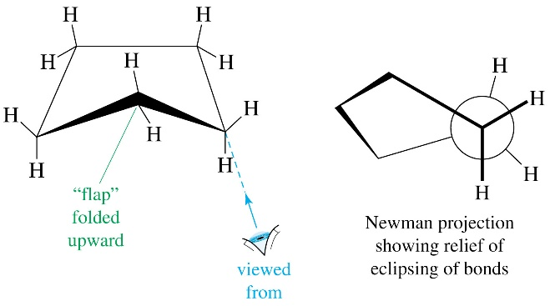
kcal mol⁻¹ (kJ mol⁻¹)
Discrepancy =
Origin of strain
60°
90°
1. Bond angle strain, especially in small rings
2. Eclipsing and gauche strain
3. Transannular strain
gauche C-C bonds

Slide 10
Cyclopropane

Slide 11
Strain Relief Through “Banana” Bonds
Weakened:
65 kcal mol⁻¹
Trimethylene diradical

Slide 12
Cyclobutane: “Puckering” Reduces Eclipsing
Cyclopentane: Envelope Conformation
Almost
staggered

Slide 13
The (Almost) Unstrained Cyclohexane:
A “Chair” Conformation
Move
up
Move
down
Newman projection along C-C bond
Chair
Staggered

Slide 14
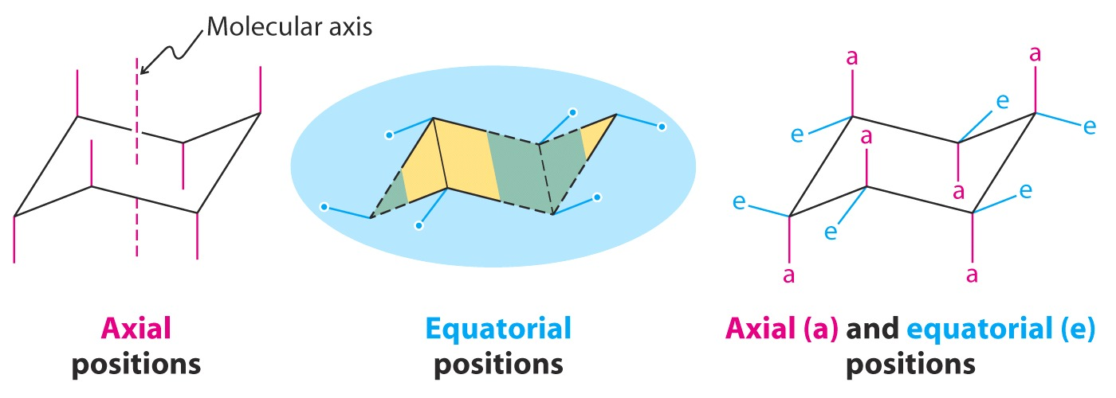
How To Draw The Chair Cyclohexane
All vertical lines
This end
“down”
This end
“up”
Equatorial bonds must be parallel to the C–C bond(s) “one over” [not the attached one(s), but the next one(s)]

Slide 15

The Cyclohexane Boat Is Strained
Move
up
Move
up
+6.9 kcal mol⁻¹
We shall see that the boat form is actually a transition state in the dynamics of cyclohexane movement.
Boat

Slide 16
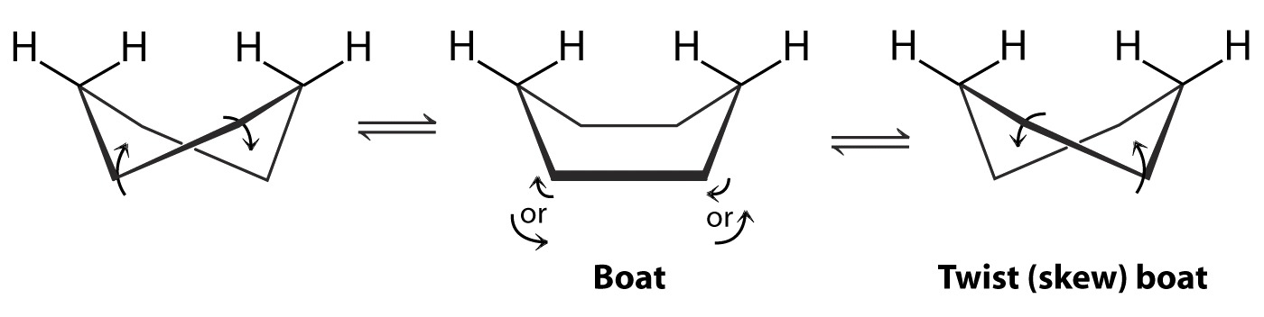
…So It Twists
More stable by 1.4 kcal mol⁻¹
More stable by 1.4 kcal mol⁻¹
But this is only part of its mobility.
The most important movement is a “flip” from one chair form to another.

Slide 17
The Cyclohexane Ring Flip
ΔG° = O
FlipAnm
Monk
Walba
Notes:
Movie9:30-Functional

Slide 18
The Chair-Chair Flip Manifold
100,000 times/sec
PEDia

Slide 19
Monosubstituted Cyclohexanes
ΔG°≠ 0
Conformational Analysis: the energetics of ax-eq substituents
Example: methylcyclohexane
H
Gauche strain
CH₃
ΔG° = +1.7
Ratio: 95:5
H
H
H
)
(
CH₃
eq
Transannular strain
ax

Slide 20
Axial-Equatorial Conformers

Slide 21
ΔG°_{eq-ax} Parallels Size
Note: These numbers do not reflect absolute size, but size with respect to transannular and gauche interactions in cyclohexane.

Slide 22
ΔG° May Be Additive
Consider the dimethylcyclohexanes:
CH₃
CH₃
CH₃
ΔG° = 0 kcal mol⁻¹
1,1-Dimethylcyclohexane
CH₃
CH₃
H₃C
ΔG° = 0 kcal mol⁻¹
CH₃
CH₃
cis-1,4-Dimethylcyclohexane
CH₃
But:
CH₃
H₃C
ΔG° = +3.4 kcal mol⁻¹ ! (I.e. 2x1.7) kcal mol⁻¹
diequatorial
diaxial
trans-1,4-Dimethylcyclohexane
CH₃

Slide 23
The Largest Group Often Wins
ax +1.7
CH₃
CH₃
eq
H₃C
H₃C
eq
H₃C
CH₃
ΔG° = 3.4-5 = -1.6 kcal mol⁻¹
CH₃
CH₃
CH₃
ax +1.7
CH₃
ax
eq -5
Large substituents, such as tert-Bu,
are said to “lock” a conformation.
Take home problem:
ΔG° = ?

Slide 24
Cis/Trans and Ax/Eq
All-cis-hexamethyl-
cyclohexane:
Alternating ax-eq
All-trans-hexamethyl-
cyclohexane:
All eq or all ax

Slide 25
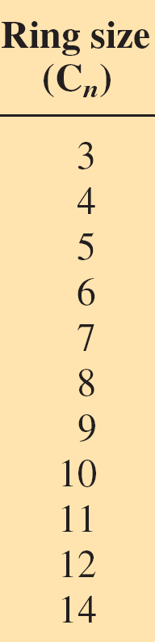
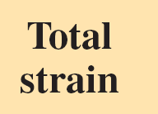
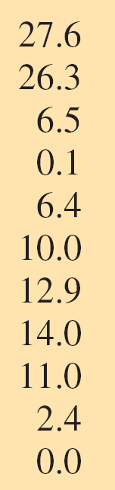
Medium Rings (8-12-Membered) Suffer Transannular Strain

Slide 26
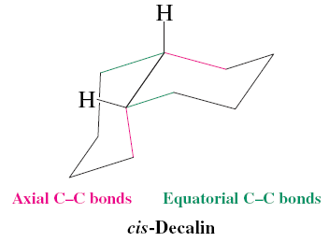
For Your Amusement: Bicyclic, Fused, Polycyclic, Polyhedral Alkanes
Bridge
Bicyclo[2.2.1]heptane (norbornane)
Locked boat
H
Fusion
H
H
trans
H
cis
Bicyclo[4.4.0]decane
(decalin), trans and cis
Home exercise: Make models and try the ring flip!

Slide 27
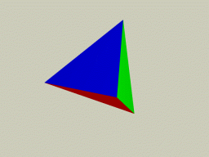

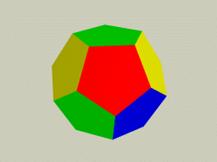
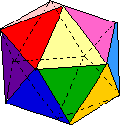
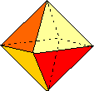
Strained Hydrocarbons: What Is The Limit?
Exotic polyhedra: The five Platonic or Cosmic solids (Plato 350 BC)
Tetrahedron
(fire)
Cube
(earth)
Dodecahedron
(“ether”)
There are two more: icosahedron (water) and octahedron (air)
Can we make the corresponding hydrocarbon frames (CH)_{n} ?
Notes:
The Platonic solids, also called the regular solids or regular polyhedra, are convex polyhedra with equivalent faces composed of congruent convex regular polygons. There are exactly five such solids (Steinhaus 1999, pp. 252-256): the cube, dodecahedron, icosahedron, octahedron, and tetrahedron, as was proved by Euclid in the last proposition of the Elements. The Platonic solids are sometimes also called "cosmic figures" (Cromwell 1997), although this term is sometimes used to refer collectively to both the Platonic solids and Kepler-Poinsot solids (Coxeter 1973).
The Platonic solids were known to the ancient Greeks, and were described by Plato in his Timaeus ca. 350 BC . In this work, Plato equated the tetrahedron with the "element" fire, the cube with earth, the icosahedron with water, the octahedron with air, and the dodecahedron with the stuff of which the constellations and heavens were made (Cromwell 1997).

Slide 28
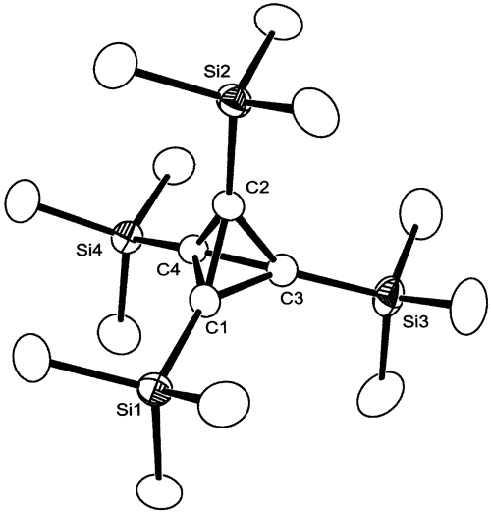
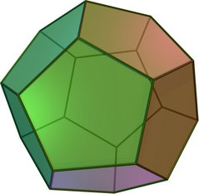
m.p. 135°C ! Strain: 130 kcal mol⁻¹
m.p. 202°C
Maier, 1978,
tetra-t-Bu-
tetrahedrane.
Substituted C₄H₄
Maier, Sekiguchi, 2002,
tetrakis(trimethylsilyl)-
tetrahedrane.
m.p. 126°C Strain: 166 kcal mol⁻¹
m.p. 430°C ! Strain: 60 kcal mol⁻¹
Eaton, 1964,
cubane, C₈H₈
Paquette, 1982, dodecahedrane, C₂₀H₂₀, 12 cyclopentane faces
Notes:
Dodecahedrane 23 steps from cyclopentadiene. 1.5mg in first synthesis. Prinzbach grams.

Slide 29
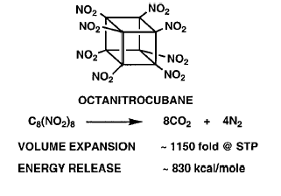
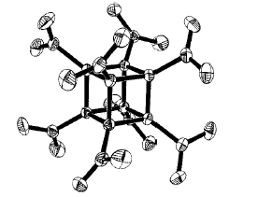
Octanitrocubane: A New Explosive And Rocket Fuel
Eaton, Adv. Mat., 2000.

