Slide 1
Chapter 3: Radical Halogenation
Notes:
The first free flight of NASA’s X-43A hypersonic research aircraft. Most supersonic aircraft produce
exhaust gases containing molecules such as nitric oxide (NO), whose radical reactions are destructive to
the Earth’s stratospheric ozone layer. In the 1970s the United States abandoned plans to build a fleet of
supersonic aircraft (SSTs, or supersonic transports) for just this reason. In contrast, the X-43A is hydrogen
fueled, posing no risk to stratospheric ozone, and may represent the first step toward the development of
environmentally acceptable high-speed flight

Slide 2
Radical Halogenation And Bond Strength
Reactions require bond breaking and bond making
Bond strengths: homolytic cleavage
A
B
∆H
A·
+
B
·
radicals
∆H = DHº = Bond dissociation energy (kcal mol⁻¹)
This process contrasts with heterolytic cleavage
+
-
A
B
A
+
B
facile
+
-
For example: H₂O + H₂O H₃O + OH
but H OH, DHº = +119

Slide 3
Bond Dissociation Energy Tables
Recall:
∆G° = ∆H° - T ∆S°
∆H° = (sum of strength of bonds broken) – (sum of strengths of bonds made)
Example: Calculate feasibility of the reaction:
CH₃–OH + H–I CH₃–I + H–OH ∆H° = ??
Notes:
First ten entries in dist.female.first --------------------------------------- name freq cum.freq rank MARY 2.629 2.629 1 PATRICIA 1.073 3.702 2 LINDA 1.035 4.736 3 BARBARA 0.980 5.716 4 ELIZABETH 0.937 6.653 5 JENNIFER 0.932 7.586 6 MARIA 0.828 8.414 7 SUSAN 0.794 9.209 8 MARGARET 0.768 9.976 9 DOROTHY 0.727 10.703 10
JAMES 3.318 3.318 1 JOHN 3.271 6.589 2 ROBERT 3.143 9.732 3 MICHAEL 2.629 12.361 4 WILLIAM 2.451 14.812 5 DAVID 2.363 17.176 6 RICHARD 1.703 18.878 7 CHARLES 1.523 20.401 8 JOSEPH 1.404 21.805 9 THOMAS 1.380 23.185 10

Slide 4
CH₃–OH + H–I CH₃–I + H–OH
93 71 -57 -119
Sum of all values: 164 – 176 = –12 kcal mol⁻¹

Slide 5
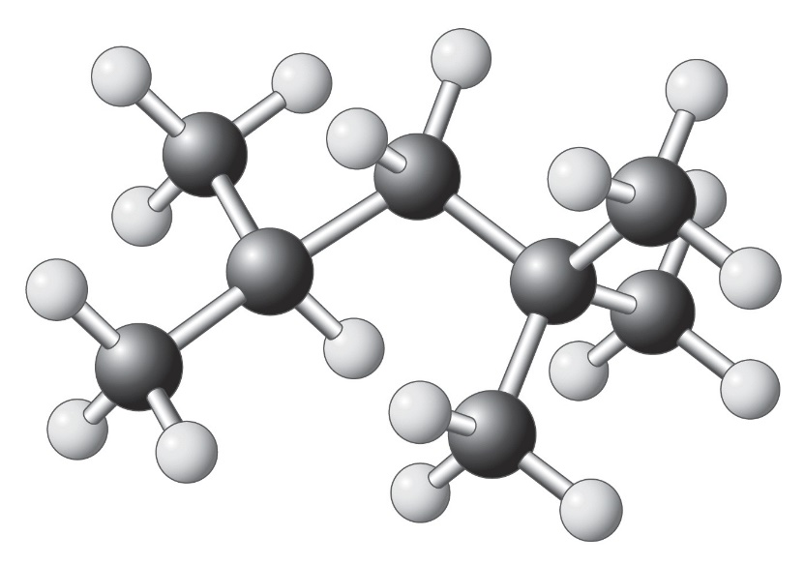
C-H Bond Strengths
To functionalize alkanes, we need to break C H
But: Are all C–H bonds the same ?
Secondary
→ No!
Primary
Tertiary
DHº s decrease along the series:
CH₄ > R_{prim}―H > R_{sec}―H > R_{tert}―H

Slide 7
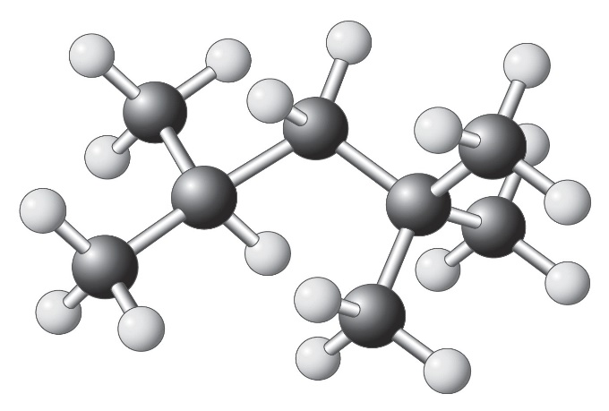
•
•
Why?
•

Slide 8
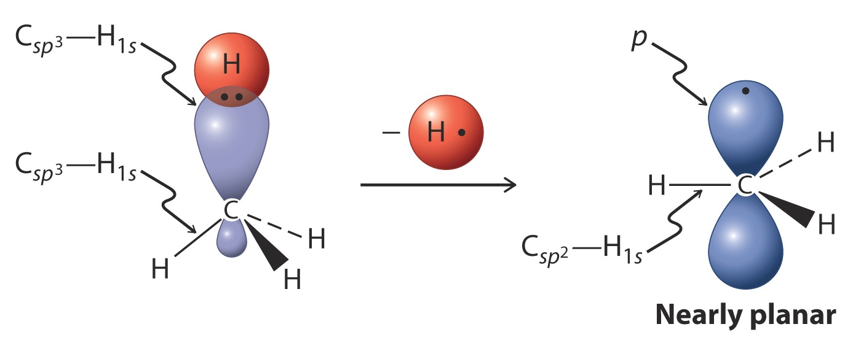
Structure Of Alkyl Radicals
R is sp²-hybridized.
Remember BH₃!
Substitution stabilizes the radical. How?

Slide 9
Hyperconjugation
p-Orbital (with single e) overlaps with bonding molecular orbital of neighboring C-H (or any other) bond.
H
Hyperconjugation
C
C
C
C

Slide 10
More Neighboring Bonds: More Hyperconjugation
Prediction: The more substituted C-H should be more reactive

Slide 11
Radical Halogenation:
Methane And Chlorine (Kcal Mol⁻¹)
hv, ∆
CCl₄
CH₃ H + Cl Cl CH₃ Cl + H Cl
105
58
-85
-103
∆Hº = -25
Exothermic, but needs heat (∆) and/or light to start.
Mechanism
hv or ∆
1. Initiation: Cl₂ 2 Cl ∆Hº = +58
“lighting the match”

Slide 12
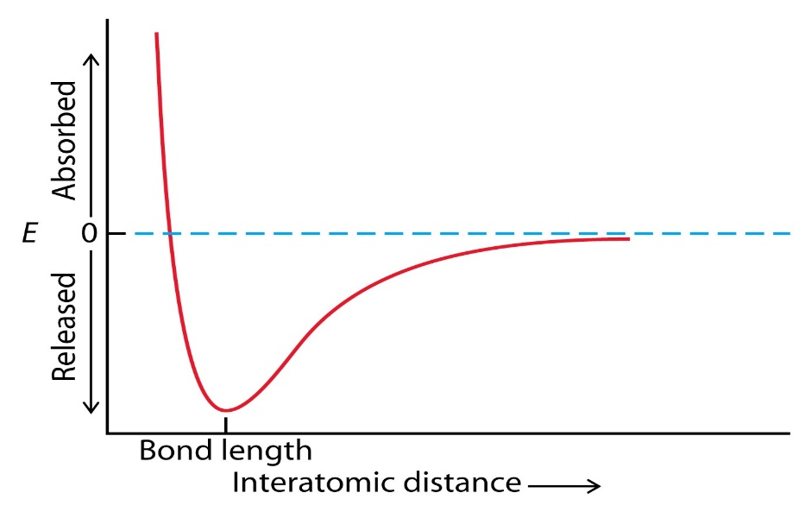
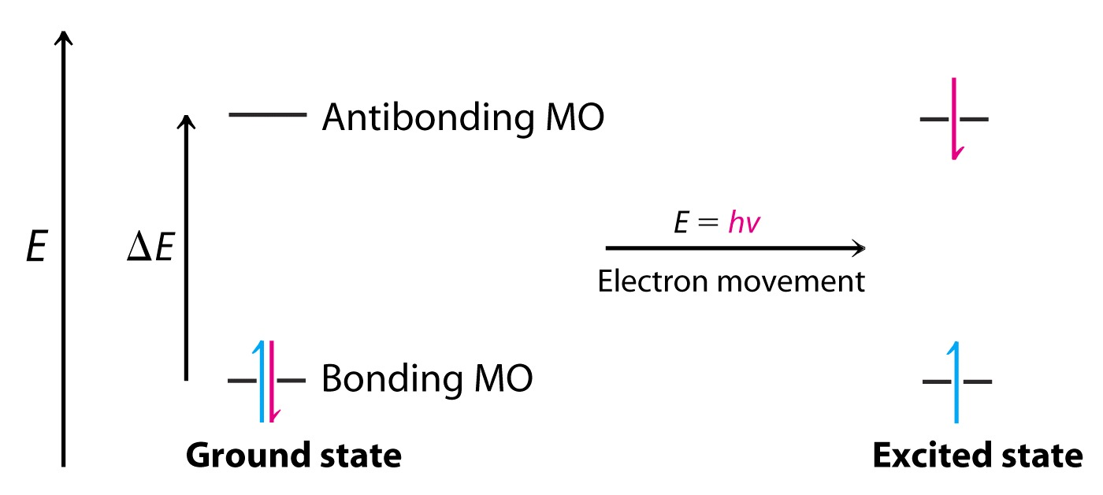
How does the Cl–Cl bond break?
Thermally: Vibrational energy gets sufficiently large to cause bond breaking.
Photochemically: Absorption of photon causes excitation of bonding electron to antibonding molecular orbital.

Slide 13
2. Propagation (“fire”): A radical chain mechanism
up!
a. CH₄ + Cl → CH₃ + HCl ∆Hº = +2
105
103
b. CH₃ + Cl₂ → CH₃Cl + Cl ∆Hº = -27
down!
58
85
[a. + b.]: CH₄ + Cl₂ → CH₃Cl + HCl ∆Hº = -25
Note: Initiation step does not enter into equation. Only a few Cl∙ needed to convert all of the starting material.
3. Termination: 2Cl → Cl₂
CH₃ + Cl → CH₃Cl
CH₃ + CH₃ → CH₃ CH₃
Kills propagation
Anim

Slide 14
Orbital Picture Of H· Abstraction
Partial radical character δ∙
Fast!
resembles
products

Slide 15
Potential energy diagram of propagation steps gives picture of the energetic “ups and downs”:
Dylan
Movie

Slide 16
Other Halogenations Of Methane
Compare important DH º values:
CH₃ X
F₂ Cl₂ Br₂ I₂ HF HCl HBr HI F Cl Br I
38 58 46 36 136 103 87 71 110 85 70 57
Initiation OK for all
Reactivity: F₂ > Cl₂ ~ Br₂ > I₂ won’t go!
explodes
good!
Cl₂ faster than Br₂
Why?

Slide 17
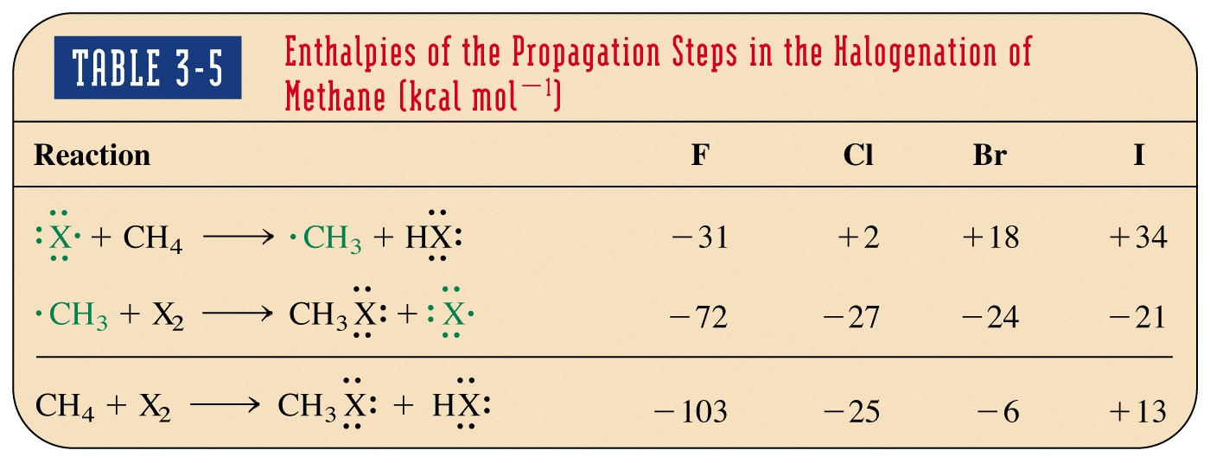
CH₃―X
F₂ Cl₂ Br₂ I₂ HF HCl HBr HI F Cl Br I
38 58 46 36 136 103 87 71 110 85 70 57
CH₃--H 105 kcal mol⁻¹
Won’t go! Endothermic
Why does reactivity (rate) follow the order F₂ > Cl₂ > Br₂?

Slide 18
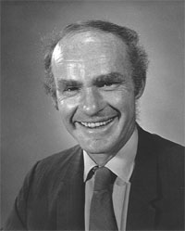
Rate determined in the first propagation step by H―X. Let’s compare the position of the transition states along reaction coordinate.
Early TS → fast , exothermic step ( F).
Late TS → slow , endothermic step ( Br, I).
Hammond Postulate
Looks like starting materials
Looks like products
George S. Hammond (1921–2005)

Slide 19
Selectivity For Different C-H Bonds
CH₃
CH₂
CH₃
CH₃
CH₃
C
CH₃
prim, sec, tert
H
Cl₂, hv
CH₃CH₂CH₃ CH₃CH₂CH₂Cl + CH₃CHCH₃
-HCl
Cl
Statistical (expected) 3 : 1
R―H (expected) Less (prim) More (sec)
Found (25 ºC) : 43 : 57
Reactivity per H: 43/6 = 7.2 57/2 = 28.5
1 : 4
Secondary C-H is more reactive than primary C-H

Slide 20
Transition states radical-like; reflect relative stabilities of radical products
Because the TSs resemble the ensuing radicals, the TS leading to the sec radical is lower in energy than that leading to the primary radical

Slide 21
What about tertiary C-H?
CH₃
CH₃
CH₃
Cl₂, hv
CH₃
C
H
ClCH₂
C
H
+
CH₃
C
Cl
-HCl
CH₃
CH₃
CH₃
Statistical (expected) 9 : 1
R―H (expected) Less (prim) More (tert)
Found (25 ºC) 64 : 36
Normalized per H: 64/9 = 7 36/1 = 36
1 : 5
Result: Relative reactivity (selectivity) in chlorinations at 25ºC: Tert : Sec : Prim = ~ 5 : 4 : 1

Slide 22
Selectivity And Other Halogens
CH₃
(CH₃)₃CH + F₂ → FCH₂CH + (CH₃)₃CF 9:1
(CH₃)₃CH + F₂ → FCH₂CH + (CH₃)₃CF 9:1
CH₃
statistical !
(CH₃)₃CH + Br₂ → (CH₃)₃CBr only !

Slide 23
Just to get a feel for the numbers……..
Selectivities vary extensively with the reagent employed, e.g., ICl, ROCl, R₂NBr, with temperature, and solvent.

