Slide 1
Organic Chemistry
Second Edition
David Klein
Chapter 12
Synthesis

Slide 2
12.1 One-Step Syntheses
When building a home, you must have the right tools, but you also need to know HOW to use the tools
When building a molecule (designing a synthesis), a lot of tools are available. Where are they?
To optimize your synthesis, you must understand HOW the tools work
What tools (reagents and conditions) are needed for the synthesis below?

Slide 3
12.1 One-Step Syntheses
You may be able to solve one-step syntheses by matching the reaction pattern with an example in the text book
To add Br-Br across a C=C double bond, an alkene is generally treated with Br₂ / CCl₄ in the dark
How do you solve such syntheses without the textbook and without having to memorize each set of reagents?
Learning to use any tool requires PRACTICE
Its also helpful to know mechanisms. WHY?

Slide 4
12.1 One-Step Syntheses
Solving one-step syntheses
Analyze the structures of the reactant and product
Asses HOW the functional groups have changed
Use the reactions and mechanisms you have learned to determine appropriate reagents and conditions
Check your answer by working out the mechanism
Solve the synthesis
Practice with conceptual checkpoints
12.1 and 12.2

Slide 5
12.2 Functional Group Transformations
Let’s review some synthetic tools we have learned so far
In chapter 9, we learned how to shift the position of a halide
The regiochemical considerations in this process are vital to making the correct product – see next slide

Slide 6
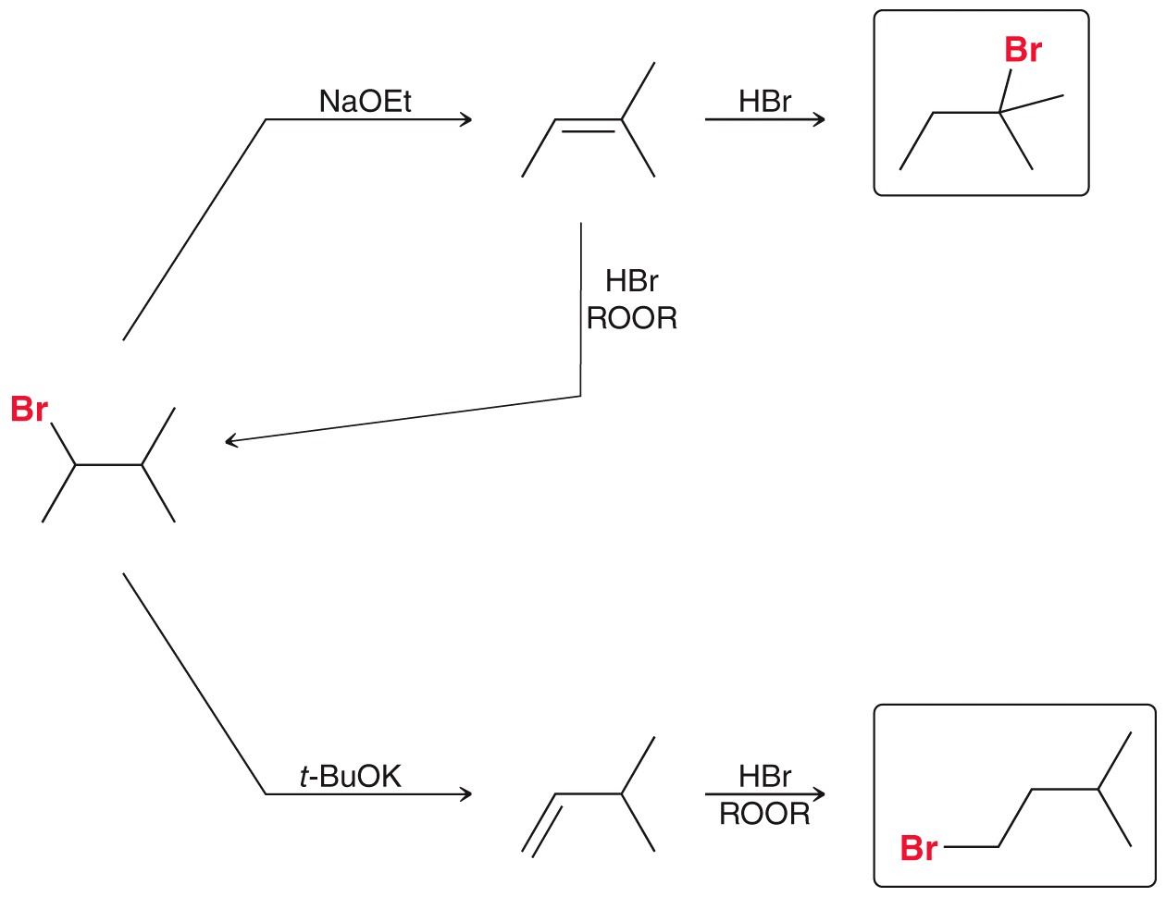
12.2 Functional Group Transformations
Explain the regiochemistry for each reaction

Slide 7
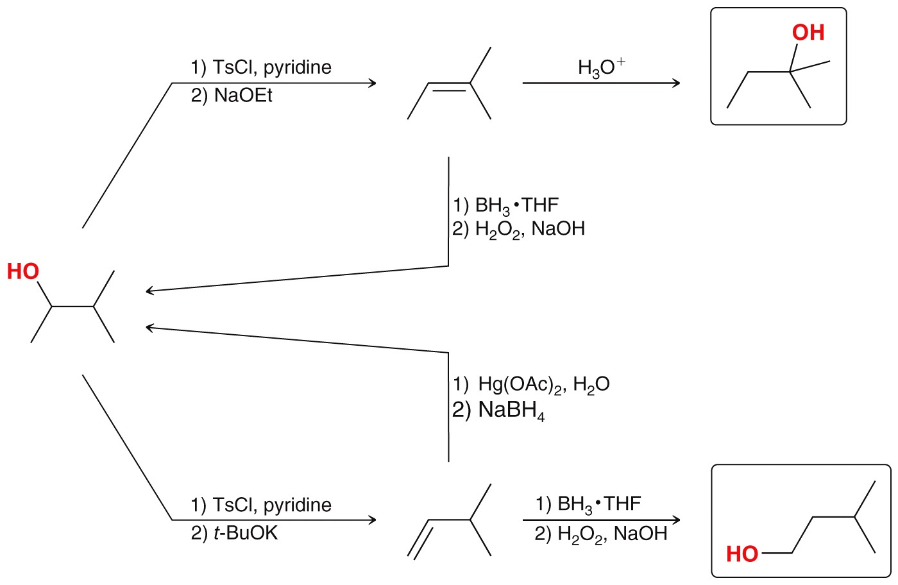
12.2 Functional Group Transformations
The techniques are slightly modified for an -OH group
Explain the regiochemistry for each reaction

Slide 8
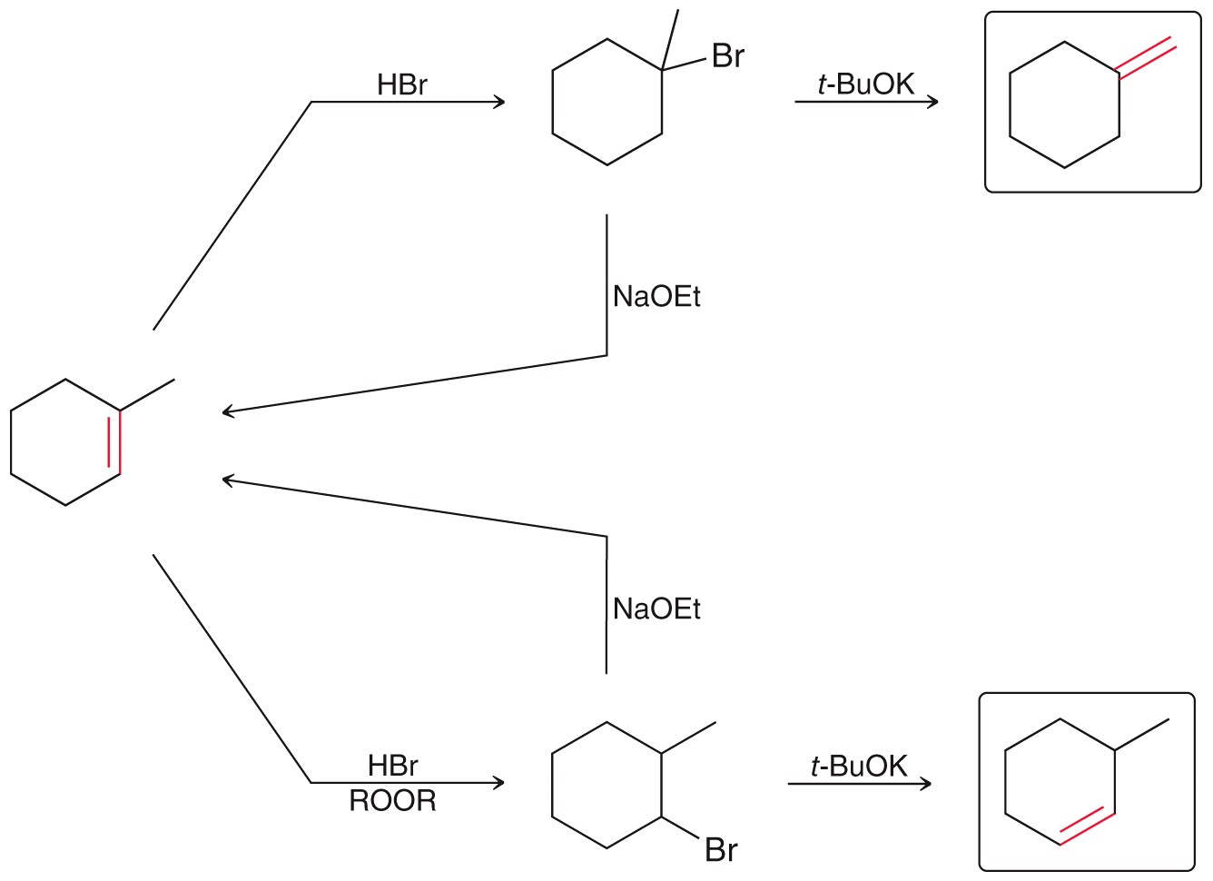
12.2 Functional Group Transformations
In chapter 9, we learned how to shift the position of a C=C double bond
Explain the regiochemistry for each reaction

Slide 9
12.2 Functional Group Transformations
In chapter 11, we learned how to introduce a halide
With the introduction of a halide and its subsequent elimination, we can control the degree of saturation

Slide 10
12.2 Functional Group Transformations
Practice with SkillBuilder 12.1
Give necessary reagents for the function group transformation below. Multiple steps are necessary

Slide 11
12.3 Carbon Skeleton Transformations
There are many important molecules that have complex carbon skeletons
The ability to design syntheses that produce a desired carbon skeleton is highly prized
Some reactions will increase the number of carbons in the molecule
Some reactions will decrease the number of carbons in the molecule

Slide 12
12.3 Carbon Skeleton Transformations
So far, we have learned only one transformation that increases the number of carbons in a molecule

Slide 13
12.3 Carbon Skeleton Transformations
We have also learned a way to decrease the number of carbons in a molecule
In the future, we will discuss many more reactions that alter the carbon skeleton
Practice with SkillBuilder 12.2

Slide 14
12.3 Carbon Skeleton Transformations
Give necessary reagents for the transformation below. Multiple steps are necessary

Slide 15
12.4 Approach for Complex Syntheses
Some syntheses require a change in both the carbon skeleton and in the functional groups
Solving such syntheses
Analyze the structures of the reactant and product
Asses HOW the carbon skeleton has changed
Asses HOW the functional groups have changed
Review the proposed steps to make sure that the regioselectivity and stereoselectivity in each step lead to the desired product
Practice with SkillBuilder 12.3

Slide 16
12.4 Approach for Complex Syntheses
For the synthesis below
Analyze the structures of the reactant and product
Asses HOW the carbon skeleton has changed
Asses HOW the functional groups have changed
Review the proposed steps to make sure that the regioselectivity and stereoselectivity in each step lead to the desired product

Slide 17
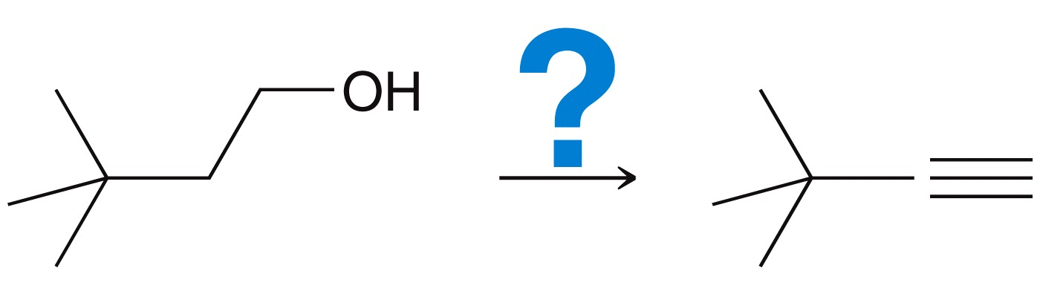
12.5 Retrosynthetic Analysis
For more challenging, complex multi-step syntheses, it is often helpful to work backwards (retro) in our analysis, although the same basic analysis is performed
Perform a retrosynthetic analysis for the reaction below
Analyze the structure of the reactant and product. What functional groups are we dealing with?

Slide 18
12.5 Retrosynthetic Analysis
Perform a retrosynthetic analysis for the reaction below
Asses HOW the carbon skeleton has changed. In this specific case, the carbon skeleton is not changing

Slide 19
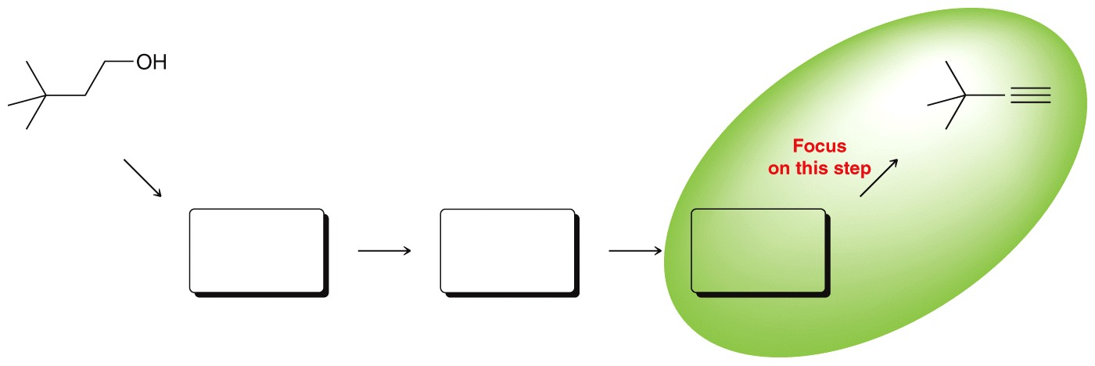
12.5 Retrosynthetic Analysis
Perform a retrosynthetic analysis for the reaction below
Work backwards: focus on the last step in the synthesis
Asses HOW the functional groups have changed. We want to make an alkyne, so what reactions do we know that can be used to make an alkyne? – see next slide

Slide 20
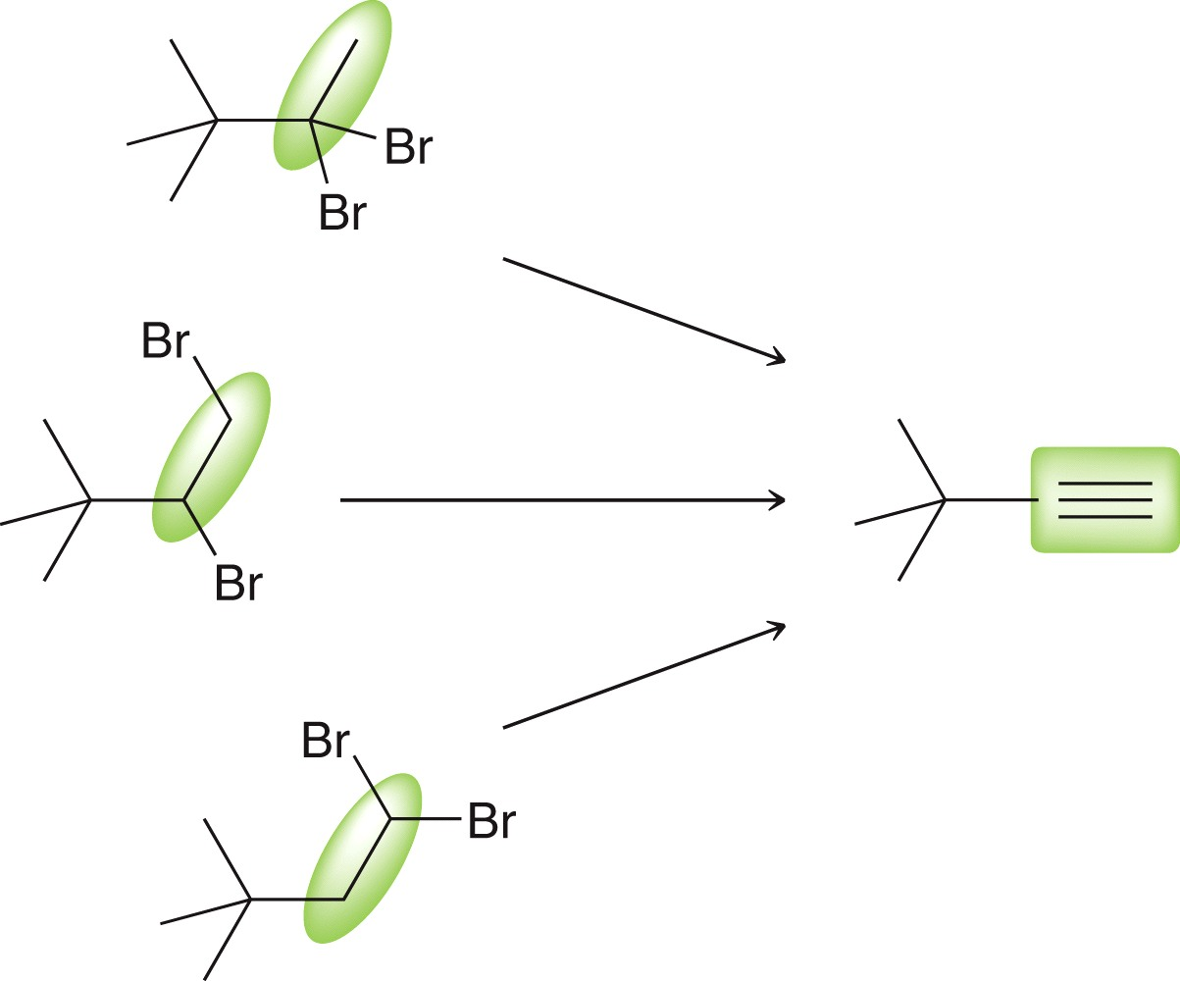
12.5 Retrosynthetic Analysis
We only learned one method to synthesize an alkyne
Review the regioselectivity and stereoselectivity in each step

Slide 21
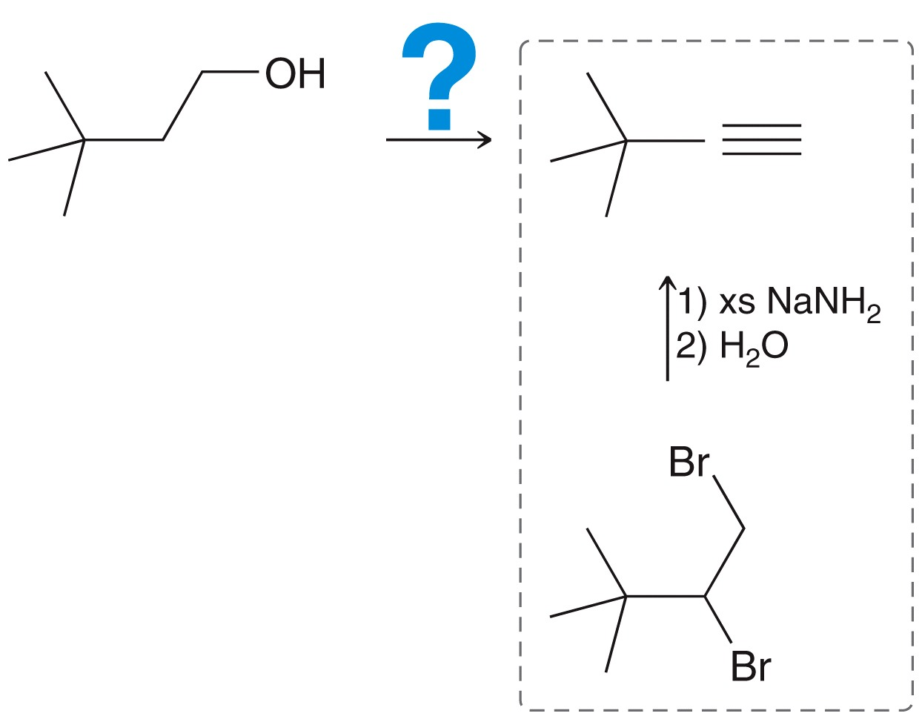
12.5 Retrosynthetic Analysis
The last step in the synthesis must involve a geminal dihalide
WHY not a vicinal dihalide? How would a vicinal dihalide be made?

Slide 22
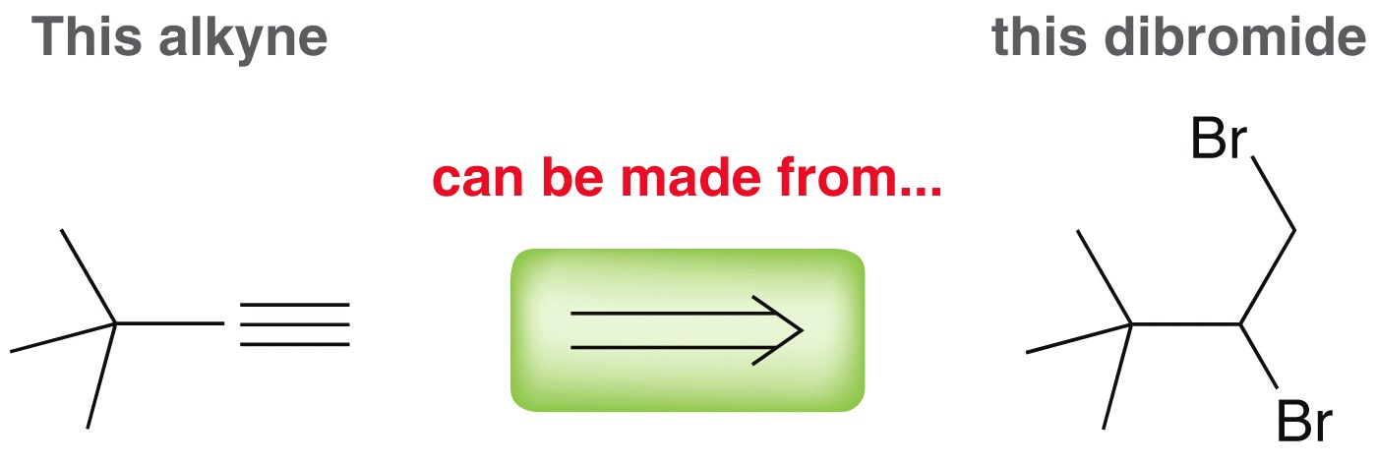
12.5 Retrosynthetic Analysis
A retrosynthetic arrow is used by chemists to show the sequence of reactions in the reverse direction
Now, let’s continue the analysis by working another step backwards

Slide 23
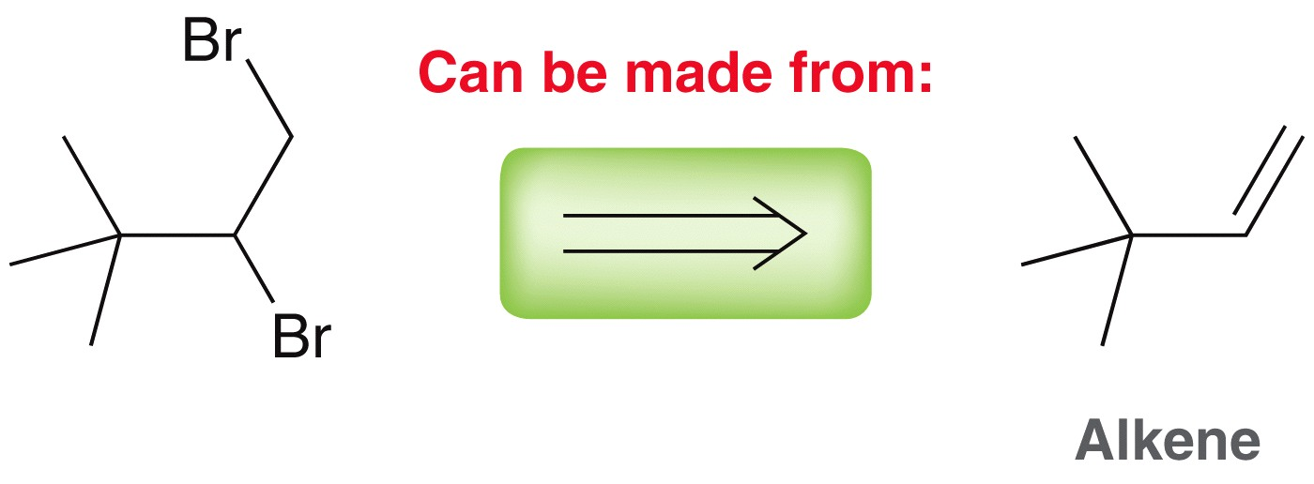
12.5 Retrosynthetic Analysis
Analyze the structure of the reactant and product. Do we know of a method to synthesize a geminal dihalide?
Yes, we can use an addition reaction
What reagents do we need?

Slide 24
12.5 Retrosynthetic Analysis
In the full retrosynthetic analysis, so far we have the last two steps worked out

Slide 25
12.5 Retrosynthetic Analysis
Recall that we used this method previously for converting alkenes to alkynes

Slide 26
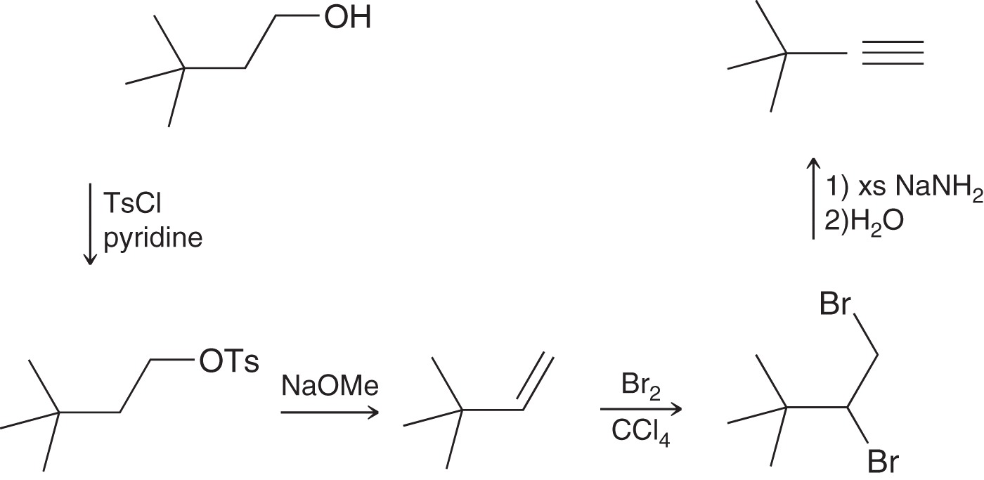
12.5 Retrosynthetic Analysis
One step remains in the analysis, so we can work in the forward direction
Why is the Ts group necessary?

Slide 27
12.5 Retrosynthetic Analysis
Review the proposed steps to make sure that the regioselectivity and stereoselectivity in each step lead to the desired product
Practice with SkillBuilder 12.4

Slide 28
12.5 Retrosynthetic Analysis
Perform a retrosynthetic analysis for the conversion below

Slide 29
12.6 Practical Tips
To build a molecule, you must be able to choose the right tools for the job
It will be helpful if you create a list of tools and categorize them into two sets of reactions
Reactions that alter the carbon skeleton – see section 12.3
Reactions that alter the functional groups – see section 12.2
As we learn more reactions, expand your list

Slide 30
12.6 Create Your Own Problems
A great way to practice syntheses is to design your own problems
Start with a relatively simple reactant compound
Choose a set of reagents to change the compound’s carbon skeleton or functional groups, and predict the structure of the product
Repeat step 2 a few more times
Take out all of the intermediates and reagents so you don’t give the answer away
Swap problems with a classmate to practice more

Slide 31
12.6 Create Your Own Problems
This process will help you to think about syntheses in new ways
Let’s work through an example
Start with a relatively simple reactant compound. Let’s start with acetylene
Choose a set of reagents to change the compound’s carbon skeleton or functional groups, and predict the structure of the product

Slide 32
12.6 Create Your Own Problems
Repeat step 2 a few more times
Take out all of the intermediates and reagents so you don’t give the answer away
Swap problems with a classmate

Slide 33
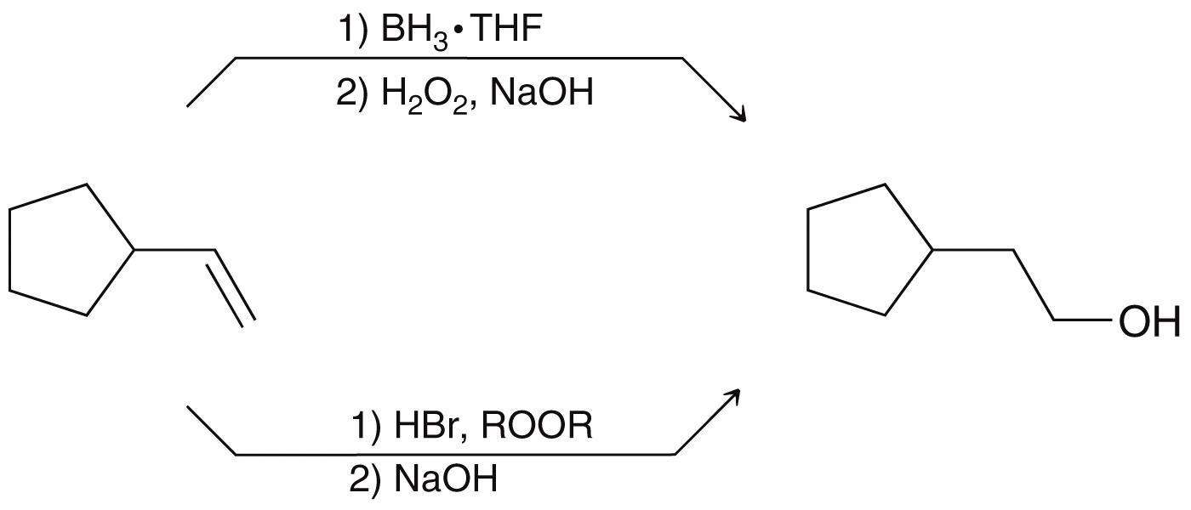
12.6 Create Your Own Problems
There will often be more than one way to solve a synthesis problem
In general, a chemist’s goal is to find the most facile synthesis generally having the fewest steps

Slide 34
Additional Practice Problems
Give necessary reagents for the transformation below.

Slide 35
Additional Practice Problems
Give necessary reagents for the transformation below.

Slide 36
Additional Practice Problems
Give necessary reagents for the transformation below.

