Slide 1
Chapter 2 Atoms, Molecules, and Ions
Jim Geiger
Cem 151

Slide 2
Atomic Theory of Matter
The theory of atoms:
Original to the Greeks
Leuccipus, Democritus and Lucretius
(Aristotle thought they were nuts)
He believed that one could divide up a piece of matter an infinite number of times, that is, one never came up with a piece of matter that could not be further divided. He suggested that everything in the world was made up of some combination of four elements: earth, fire, water, and air. The elements were acted upon by the two forces of gravity and levity. Gravity was the tendency for earth and water to sink, and levity the tendency for air and fire to rise.
John Dalton (1805-1808)
Revived the idea and made it science by measuring the atomic weights of 21 elements.
That’s the key thing because then you can see how elements combine.
Notes:
Figure 2.1 John Dalton (1766-1844)

Slide 3
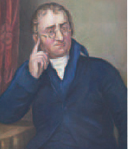
Dalton’s Postulates
Each element is composed of extremely small particles called atoms.
Tiny balls make up the world

Slide 4
Dalton’s Postulates
All atoms of a given element are identical to one another in mass and other properties, but the atoms of one element are different from the atoms of all other elements.
O
N

Slide 5
Dalton’s Postulates
Atoms of an element are not changed into atoms of a different element by chemical reactions; atoms are neither created nor destroyed in chemical reactions. (As far as Dalton knew, they couldn’t be changed at all).
O
N
O
N
Red O’s stay Os and aqua N’s stay N’s.

Slide 6
Dalton’s Postulates
Compounds are formed when atoms of more than one element combine; a given compound always has the same relative number and kind of atoms.
H
N
NH₃
ammonia
Chemistry happens when the balls rearrange

Slide 7
Law of Constant Composition Joseph Proust (1754–1826)
Also known as the law of definite proportions.
The elemental composition of a pure substance never varies.
The relative amounts of each element in a compound doesn’t vary.
H
N
NH₃
ammonia
ammonia always has 3 H and 1 N.

Slide 8
Law of Conservation of Mass
The total mass of substances present at the end of a chemical process is the same as the mass of substances present before the process took place.
3H₂ + N₂ 2NH₃
ammonia
The atoms on the left all appear on the right

Slide 9
The Electron
Streams of negatively charged particles were found to emanate from cathode tubes.
J. J. Thompson (1897).
Maybe atoms weren’t completely indivisible after all.
Notes:
Figure 2.4

Slide 10
The Electron
Thompson measured the charge/mass ratio of the electron to be 1.76 × 10⁸ coulombs/g.
How? by manipulating the magnetic and electric fields and observing the change in the beam position on a fluorescent screen.
Notes:
Figure 2.4

Slide 11
Millikan Oil Drop Experiment
measured charge of electron Univ. Chicago (1909).
How?
Vary the electric field (E) until the drops stop.
Vary the charge (q) on the drop with more X-rays. Get a multiple of 1.6x10⁻¹⁹ Coulombs. The charge of 1 electron.
Eq = mg
You set E, measure mass of drop (m) & know g. Find q.
Major result: q couldn’t be any number. It was a multiple of 1.6x10⁻¹⁹ Coulombs
Notes:
Figure 2.5

Slide 12
Radioactivity:
The spontaneous emission of radiation by an atom.
First observed by Henri Becquerel.
(1903 Nobel Prize with Pierre and Marie Curie)
Also studied by Marie and Pierre Curie.
“rays” not particles
particles of some sort.
Stuff comes out of atoms, “subatomic particles”

Slide 13
Radioactivity
Three types of radiation were discovered by Ernest Rutherford: (memorize the 3 types of particle)
α particles, attracted to negative electrode, so they have a positive charge, much more mass than negative stuff (turn out to be He nuclei)
β particles, attracted to positive electrode, so
they have a negative charge, 1000s of times less massive (turn out to be electrons coming from nucleus).
γ rays, no charge, no mass, like light.
Notes:
Figure 2.8

Slide 14
The Atom, circa 1900:
“Plum pudding” model, put forward by Thompson.
Positive sphere of matter with negative electrons imbedded in it.
most of the volume = positive stuff because most of the mass is positive
Expectation: density more or less uniform throughout.
Notes:
Figure 2.9

Slide 15
Discovery of the Nucleus The Gold Foil Experiment
Rutherford and Marsden shot α particles at a thin sheet of gold foil and observed the pattern of scatter of the particles.
Notes:
Figure 2.10

Slide 16
The Nuclear Atom
Virtually all the particles went straight through
Most of the atom essentially empty
A few particles deflected,some straight back.
A very small part of the atom is very dense, impenetrable.
The mass must be concentrated.
The size of nucleus will be proportional to the # of highly scattered particles.
Notes:
Figure 2.11

Slide 17
The Nuclear Atom
Rutherford and Marsden postulated a very small, dense nucleus with the negative electrons around the outside of the atom.
Most of the volume of the atom is empty space.
Notes:
Figure 2.12

Slide 18
Other Subatomic Particles
Protons were discovered by Rutherford in 1919.
Have the positive charge in the atom.
Neutrons were discovered by James Chadwick in 1932.
Have mass like proton, but no charge. Why was it harder to discover them?

Slide 19
Subatomic Particles
Protons and electrons are the only particles that have a charge.
Protons and neutrons have similar mass.
The mass of an electron is so small we will often ignore it.
Notes:
Table 2.1

Slide 20
Symbols of Elements: depicting the subatomic particles
Elements are symbolized by one or two letters.

Slide 21
Atomic Number
All atoms of the same element have the same number of protons:
The atomic number (Z)

Slide 22
Atomic Mass
The mass of an atom in atomic mass units (amu) is approximately the total number of protons and neutrons in the atom.

Slide 23
Isotopes:
Elements are defined by the number of protons.
Isotopes are atoms of the same element with different masses.
Isotopes have different numbers of neutrons.
11
6
12
6
13
6
14
6
C
C
C
C
#
Neutrons 5 6 7 8

Slide 24
Atomic Mass
Atomic and molecular masses can be measured with great accuracy with a mass spectrometer. Heavier ion turns less in the magnetic field (more momentum, because of higher mass (mv)) (magnetic moments of ions similar). Aston, 1919.
Notes:
Figure 2.13

Slide 25
Average Mass
Because in the real world all the elements exist as mixtures of isotopes.
And we measure many many atoms at a time
“Natural abundance”
Average mass is calculated from the isotopes of an element weighted by their relative abundances.

Slide 26
Average mass, example
Isotope | abundance | Atomic mass
²⁴Mg | 78.99% | 23.98504 amu
²⁵Mg | 10.00% | 24.98584 amu
²⁶Mg | 11.01% | 25.98259 amu
Given the above data, what is the average molecular mass of magnesium (Mg)?
.7899(23.98504)+0.1000(24.98584)+0.1101(25.98259)=
18.95 + 2.499 + 2.861 = 24.31

Slide 27
Periodic Table:
A systematic catalog of elements.
Elements are arranged in order of atomic number.
But why like this?

Slide 28
Periodicity
When one looks at the chemical properties of elements, one notices a repeating pattern of reactivities.

Slide 29
Periodic Table
The rows on the periodic chart are periods.
Columns are groups.
Elements in the same group have similar chemical properties.
Derived empirically, no theory to explain it.

Slide 30
Groups
These five groups are known by their names.
You gotta know these very well.

Slide 31
Periodic Table
Nonmetals are on the upper right-hand corner of the periodic table (with the exception of H).

Slide 32
Periodic Table
Metalloids border the stair-step line (with the exception of Al and Po, which are both metals).

Slide 33
Periodic Table
Metals are on the left side of the chart.

Slide 34
Elements of life
Elements required for living organisms.
Red, most abundant
blue, next most abundant
Green, trace amounts.

Slide 35
Chemical Formulas
The subscript to the right of the element
tells the number of atoms of that element in the compound.

Slide 36
Molecular Compounds
Molecular compounds are composed of molecules and almost always contain only nonmetals.

Slide 37
Diatomic Molecules
These seven elements occur naturally as molecules containing two atoms.
You should know these guys.

Slide 38
Types of Formulas
Empirical formulas give the lowest whole-number ratio of atoms of each element in a compound.
Molecular formulas give the exact number of atoms of each element in a compound.
Example: ethane:
Empirical formula: CH₃
Molecular formula: C₂H₆

Slide 39
Types of Formulas
Structural formulas show the order in which atoms are bonded.
Perspective drawings also show the three-dimensional array of atoms in a compound.

Slide 40
Ions
When atoms lose or gain electrons, they become ions. Often they lose or gain electrons to have the same number of electrons as the nearest noble gas.
Cations are positive and are formed by elements on the left side of the periodic chart (metals).
Anions are negative and are formed by elements on the right side of the periodic chart (nonmetals).

Slide 41
Mono-atomic ions
metals
nonmetals
Metals usually become cations (+)
Nonmetals usually become anions (-)

Slide 42
Ionic compounds
A metal will give up electrons to a nonmetal forming a cation (+) (the metal), and an anion (-) (the nonmetal).
Na + Cl
Na⁺ + Cl⁻
NaCl
Mg + 2Cl Mg²⁺+2Cl⁻ MgCl₂
Note, everybody gains or loses electrons to be like the nearest noble gas.
Compounds are always electrically neutral!!

Slide 43
Writing Formulas
Because compounds are electrically neutral, one can determine the formula of a compound this way:
The charge on the cation becomes the subscript on the anion.
The charge on the anion becomes the subscript on the cation.
If these subscripts are not in the lowest whole-number ratio, divide them by the greatest common factor.
Mg²⁺ O²⁻ MgO Not Mg₂O₂

Slide 44
Common Cations
*
*
*
*
*
*
*
*
*
*
*
*
*
*
*
*
*
*
*
*
*
*You should know these.

Slide 45
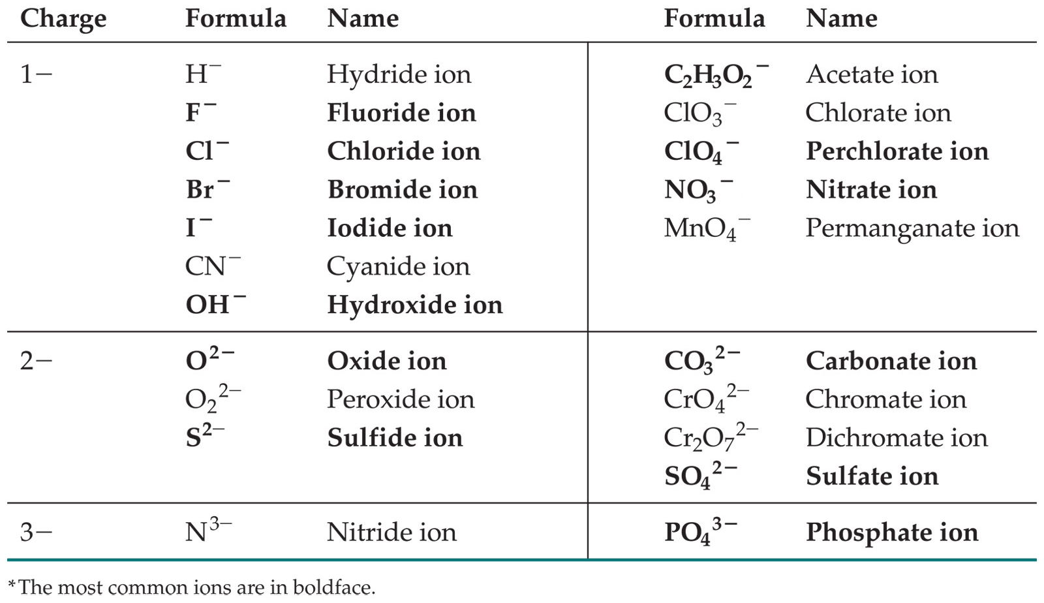
Common Anions

Slide 46
Polyatomic anions
I₃⁻ triiodide
O₂⁻ Superoxide
OH⁻ hydroxide
CN⁻ cyanide
SCN⁻ thiocyanate
NO₃⁻ nitrate
NO₂⁻ nitrite
SO₃⁻² sulfite
HSO₃⁻ bisulfite
SO₄⁻² sulfate
HSO₄⁻ bisulfate
HCO₃⁻ bicarbonate
CO₃⁻² carbonate
CH₃CO₂⁻ Acetate
HPO₄²⁻ hydrogen phosphate
H₂PO₄⁻ dihydrogen phosphate
PO₄⁻³ Phosphate
ClO⁻ hypochlorite
ClO₂⁻ chlorite
ClO₃⁻ chlorate
ClO₄⁻ perchlorate
MnO₄⁻ Permanganate
CrO₄⁻² Chromate
Cr₂O₇⁻² Dichromate
You must memorize ALL of these!

Slide 47
Patterns in Oxyanion Nomenclature
When there are only two oxyanions involving the same element:
The one with fewer oxygens ends in -ite
NO₂⁻ : nitrite; SO₃²⁻ : sulfite
The one with more oxygens ends in -ate
NO₃⁻ : nitrate; SO₄²⁻ : sulfate

Slide 48
Patterns in Oxyanion Nomenclature
When there are more than two:
The one with the fewest oxygens has the prefix hypo- and ends in -ite
ClO⁻ : hypochlorite
The one with the second fewest oxygens ends in -ite
ClO₂⁻ : chlorite
The one with the second most oxygens ends in -ate
ClO₃⁻ : chlorate
The one with the most oxygens has the prefix per- and ends in -ate
ClO₄⁻ : perchlorate

Slide 49
Inorganic Nomenclature
name of cation goes first.
If anion is element, change ending to -ide;
If anion is polyatomic ion, simply write the name of the polyatomic ion.
If the cation can have more than one possible charge, write the charge as a Roman numeral in parentheses. (Fe(II), Fe(III))

Slide 50
Examples naming inorganic compounds
Write the name of the cation.
If the anion is an element, change its ending to -ide; if the anion is a polyatomic ion, simply write the name of the polyatomic ion.
If the cation can have more than one possible charge, write the charge as a Roman numeral in parentheses.
NaCl sodium chloride
NH₄NO₃ ammonium nitrate
Fe(SO₄) Iron(II) sulfate
KCN potassium cyanide
RbOH Rubidium hydroxide
LiC₂H₃O₂ lithium acetate
NaClO₃ sodium chlorate
NaClO₄ sodium perchlorate
K₂CrO₄ potassium chromate
NaH Sodium hydride

Slide 51
Examples naming inorganic compounds
Write the name of the cation.
If the anion is an element, change its ending to -ide; if the anion is a polyatomic ion, simply write the name of the polyatomic ion.
If the cation can have more than one possible charge, write the charge as a Roman numeral in parentheses.
potasium permanganate KMnO₄
Calcium carbonate CaCO₃
Calcium bicarbonate Ca(HCO₃)₂
ammonium dichromate NH₄(Cr₂O₇)
potassium phosphate K₃PO₄
Lithium oxide Li₂O (O²⁻ is the anion)
sodium peroxide Na₂O₂ (O₂²⁻ is the anion)
Calcium sulfide CaS

Slide 52
Hydrogen
H can be cation or anion
H⁻ hydride
H⁺ (the cation of an inorganic compound) makes an acid, naming different.

Slide 53
Acid Nomenclature
If the anion in the acid ends in -ide, change the ending to -ic acid and add the prefix hydro- :
HCl: hydrochloric acid
HBr: hydrobromic acid
HI: hydroiodic acid

Slide 54
Acid Nomenclature
If the anion in the acid ends in -ate, change the ending to -ic acid:
HClO₃: chloric acid
HClO₄: perchloric acid

Slide 55
Acid Nomenclature
If the anion in the acid ends in -ite, change the ending to -ous acid:
HClO: hypochlorous acid
HClO₂: chlorous acid

Slide 56
Naming Binary Compounds (2 nonmetals)
less electronegative atom (element closest to the lower lefthand corner of periodic table).
A prefix is used to denote the number of atoms of each element in the compound (mono- is not used on the first element listed, however.)

Slide 57
Nomenclature of Binary Compounds (two nonmetals)
The ending on the more electronegative element is changed to -ide.
CO₂: carbon dioxide
CCl₄: carbon tetrachloride

Slide 58
Nomenclature of Binary Compounds
If the prefix ends with a or o and the name of the element begins with a vowel, the two successive vowels are often merged into one:
N₂O₅: dinitrogen pentoxide
not: dinitrogen pentaoxide

Slide 59
Nomenclature of binary compounds
carbon dioxide
carbon tetrafluoride
nitrogen triiodide
oxygen difluoride
phosphorous pentachloride
hydrogen sulfide
tetraphosphorous decoxide
CO₂
CF₄
NI₃
OF₂
PCl₅
H₂S
P₄O₁₀

Slide 60
Ionic Bonds
Ionic compounds (such as NaCl) are generally formed between metals and nonmetals.

Slide 61
Barking Dog
2HNO₃ + 2Cu ------> NO + NO₂ + 2Cu²⁺ + 2H⁺
3 NO + CS₂ -> 3/2 N₂ + CO + SO₂ + 1/8 S₈
4 NO + CS₂ -> 2 N₂ + CO₂ + SO₂ + 1/8 S₈
Notes:
When the nitrogen monoxide or nitrous oxide is mixed with carbon disulfide and ignited, a combustion wave travels down the tube. If the tube is long enough you can follow the progression of the wave. The gas ahead of the wavefront is compressed and explodes at a distance determined by the length of the tube (which is why when you re-ignite the mixture, the 'barking' sounds in harmonics). The bright blue light that accompanies the reaction is one of the few examples of a chemiluminescent reaction that occurs in the gas phase. The exothermic decomposition reaction between nitrogen monoxide (oxidizer) and carbon disulfide (fuel) forms nitrogen, carbon monoxide, carbon dioxide, sulfur dioxide and elemental sulfur.
Notes about the Barking Dog Reaction
This reaction was performed by Justus von Liebig in 1853 using nitrogen monoxide and carbon disulfide. The demonstration was so well-received that Liebig performed it a second time, although this time there was an explosion (Queen Therese of Bavaria received a minor wound on the cheek). It's possible the nitrogen monoxide in the second demonstration was contaminated with oxygen, to form nitrogen dioxide.

